Slide 1
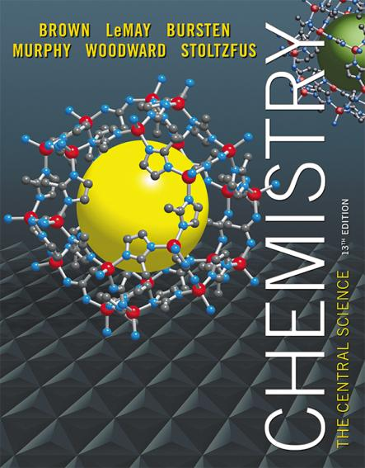
Chapter 13 Properties of Solutions
Lecture Presentation
James F. Kirby
Quinnipiac University
Hamden, CT
.

Slide 2
Solutions
Solutions are homogeneous mixtures of two or more pure substances.
In a solution, the solute is dispersed uniformly throughout the solvent.
The ability of substances to form solutions depends on
natural tendency toward mixing.
intermolecular forces.

Slide 3
Natural Tendency toward Mixing
Mixing of gases is a spontaneous process.
Each gas acts as if it is alone to fill the container.
Mixing causes more randomness in the position of the molecules, increasing a thermodynamic quantity called entropy.
The formation of solutions is favored by the increase in entropy that accompanies mixing.

Slide 4
Intermolecular Forces of Attraction
Any intermolecular force of attraction (Chapter 11) can be the attraction between solute and solvent molecules.

Slide 5
Attractions Involved When Forming a Solution
Solute–solute interactions must be overcome to disperse these particles when making a solution.
Solvent–solvent interactions must be overcome to make room for the solute.
Solvent–solute interactions occur as the particles mix.

Slide 6
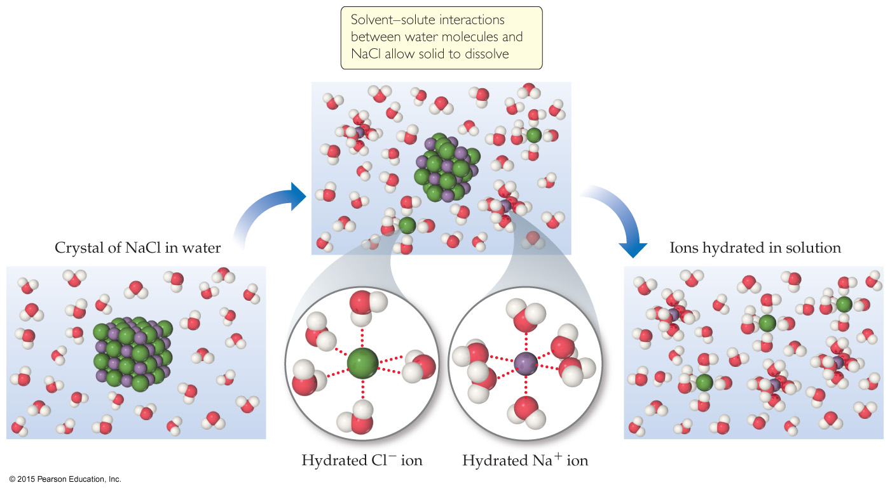
Energetics of Solution Formation

Slide 7
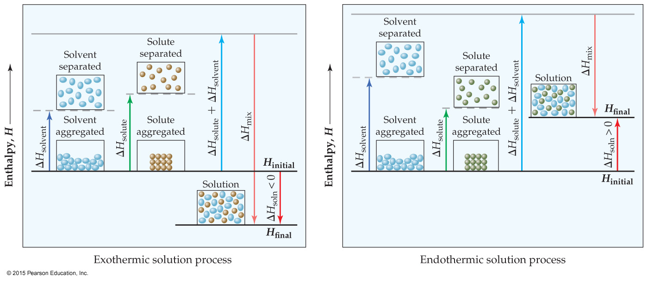
Exothermic or Endothermic
For a reaction to occur, ΔH_{mix} must be close to the sum of ΔH_{solute} and ΔH_{solvent}.
Remember that the randomness from entropy will affect the process, too.

Slide 8
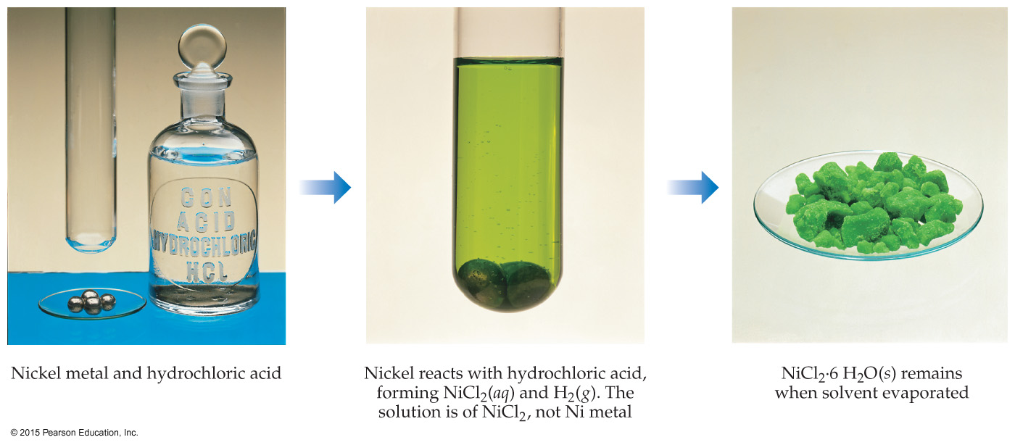
Aqueous Solution vs. Chemical Reaction
Just because a substance disappears when it comes in contact with a solvent, it does not mean the substance dissolved. It may have reacted, like nickel with hydrochloric acid.

Slide 9
Opposing Processes
The solution-making process and crystallization are opposing processes.
When the rate of the opposing processes is equal, additional solute will not dissolve unless some crystallizes from solution. This is a saturated solution.
If we have not yet reached the amount that will result in crystallization, we have an unsaturated solution.

Slide 10
Solubility
Solubility is the maximum amount of solute that can dissolve in a given amount of solvent at a given temperature.
Saturated solutions have that amount of solute dissolved.
Unsaturated solutions have any amount of solute less than the maximum amount dissolved in solution.
Surprisingly, there is one more type of solution.

Slide 11
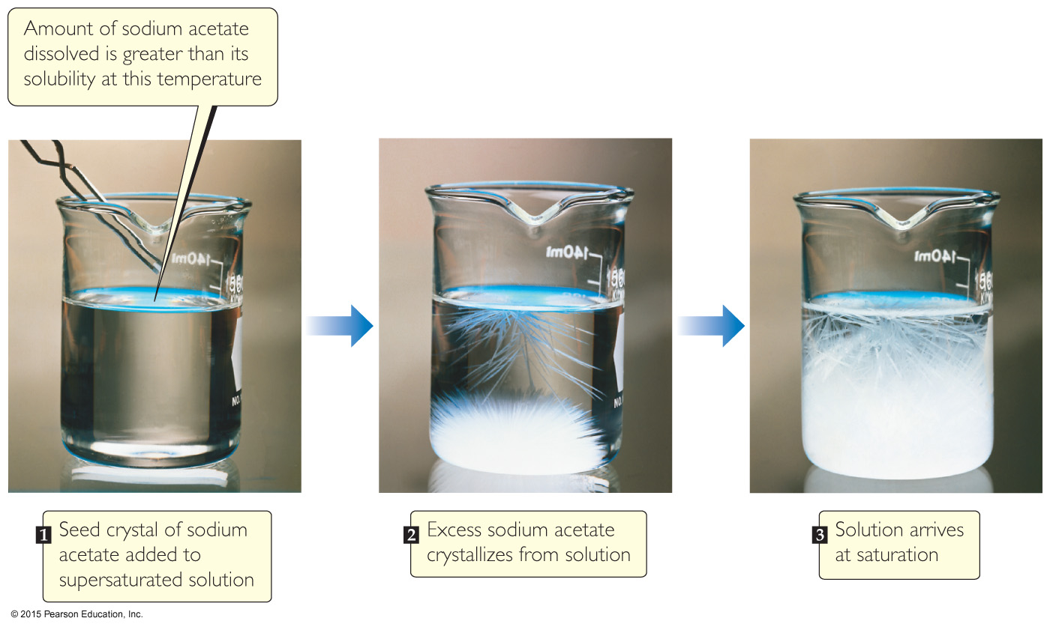
Supersaturated Solutions
In supersaturated solutions, the solvent holds more solute than is normally possible at that temperature.
These solutions are unstable; crystallization can usually be stimulated by adding a “seed crystal” or scratching the side of the flask.
These are uncommon solutions.

Slide 12
Factors That Affect Solubility
Solute–solvent Interactions
Pressure (for gaseous solutes)
Temperature

Slide 13
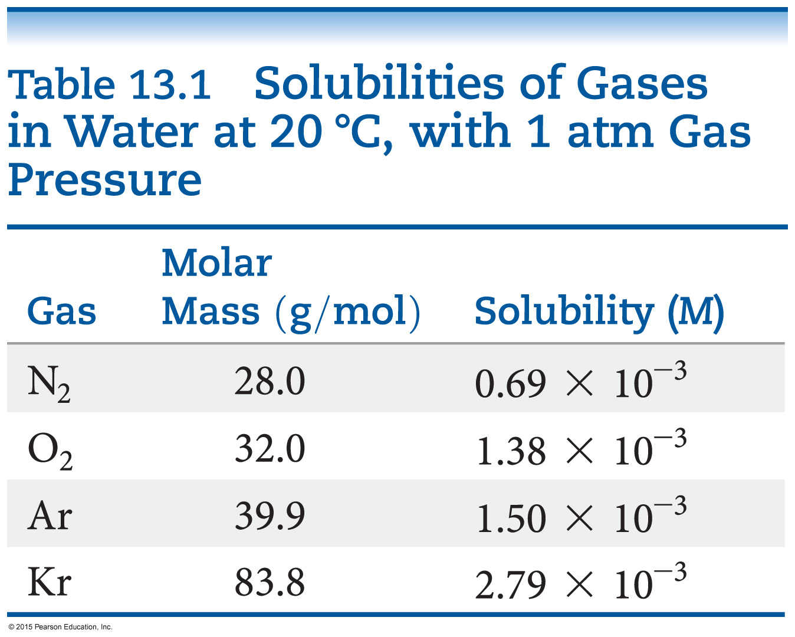
Solute–Solvent Interactions
Simply put: “Like dissolves like.”
That does not explain everything!
The stronger the solute–solvent interaction, the greater the solubility of a solute in that solvent.
The gases in the table only exhibit dispersion force. The larger the gas, the more soluble it will be in water.

Slide 14
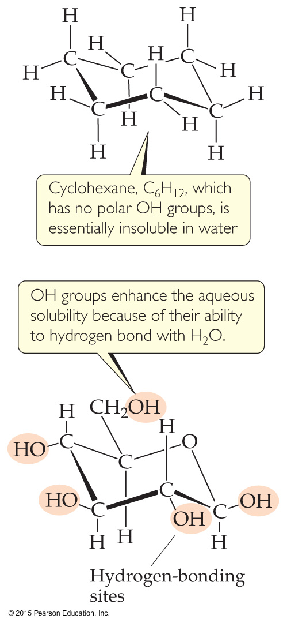
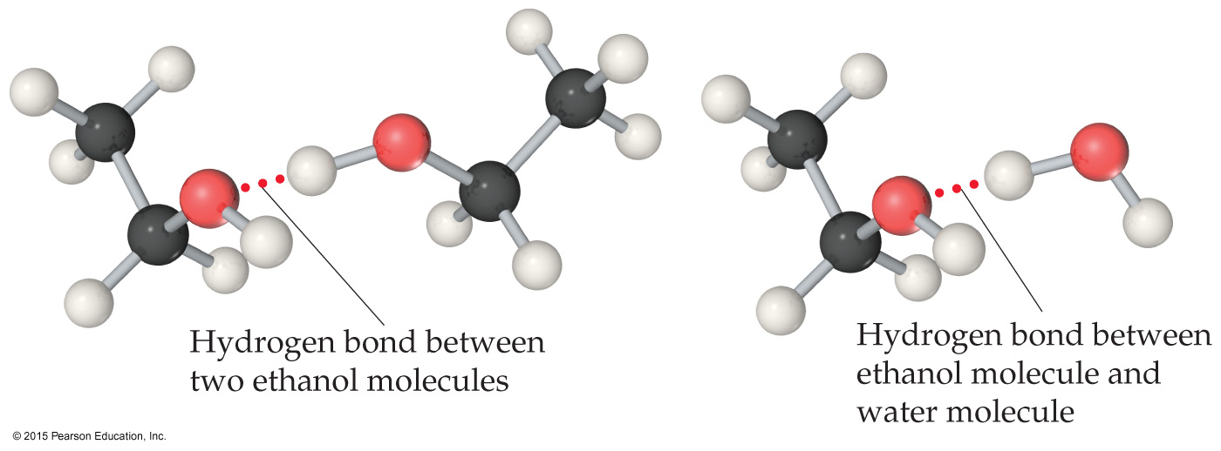
Organic Molecules in Water
Polar organic molecules dissolve in water better than nonpolar organic molecules.
Hydrogen bonding increases solubility, since C–C and C–H bonds are not very polar.

Slide 15
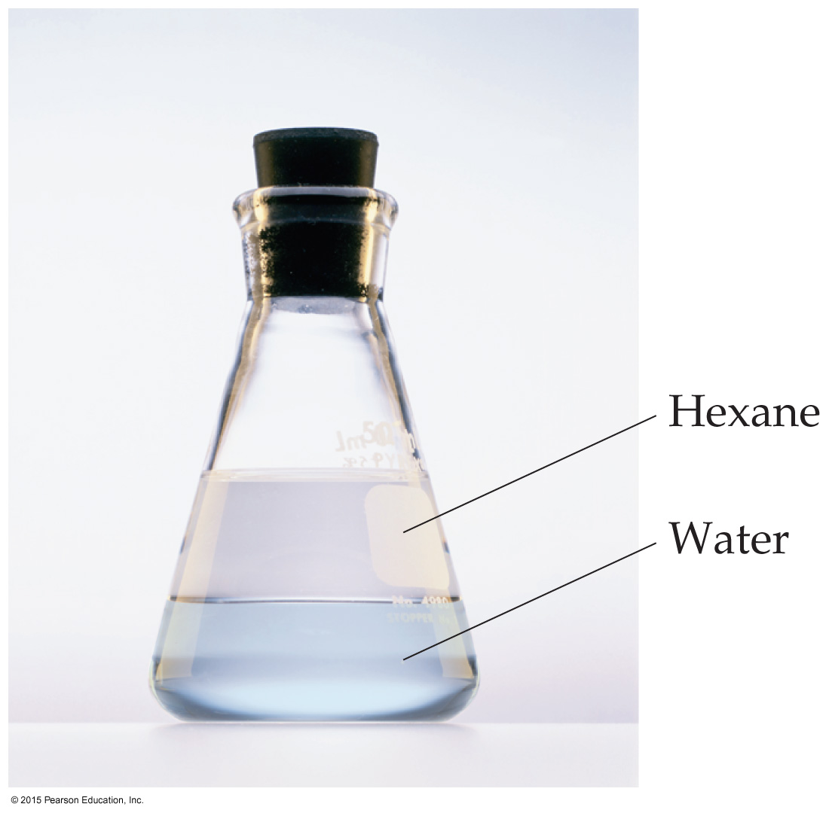
Liquid/Liquid Solubility
Liquids that mix in all proportions are miscible.
Liquids that do not mix in one another are immiscible.
Because hexane is nonpolar and water is polar, they are immiscible.

Slide 16
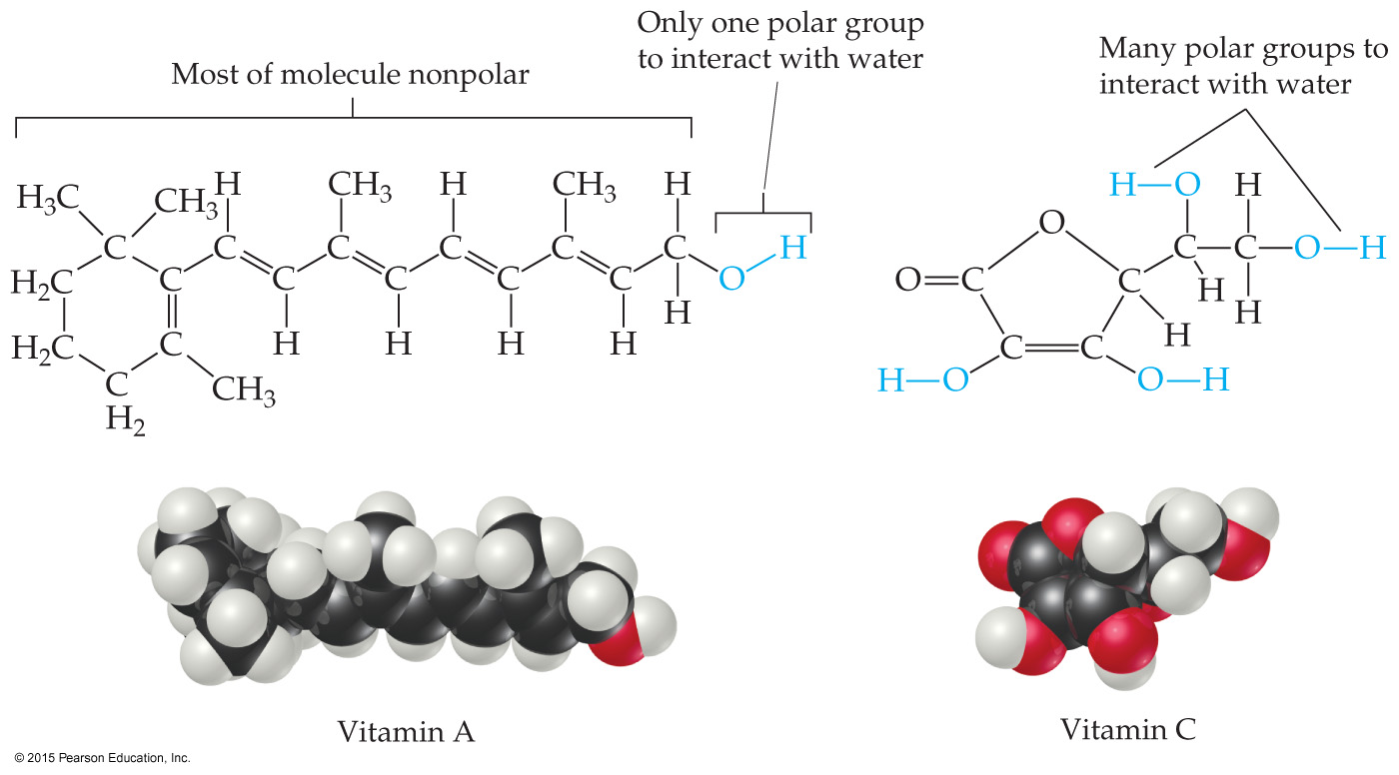
Solubility and Biological Importance
Fat-soluble vitamins (like vitamin A) are nonpolar; they are readily stored in fatty tissue in the body.
Water-soluble vitamins (like vitamin C) need to be included in the daily diet.

Slide 17
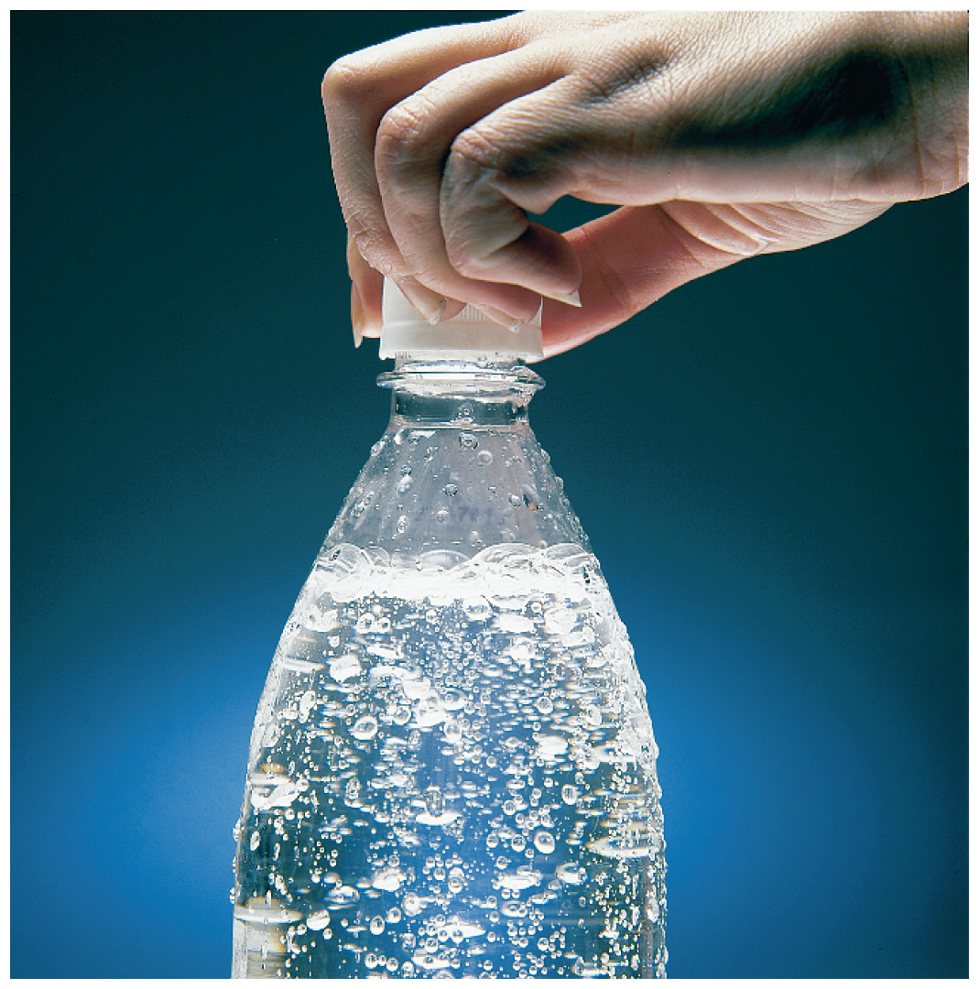
Pressure Effects
The solubility of solids and liquids are not appreciably affected by pressure.
Gas solubility is affected by pressure.

Slide 18
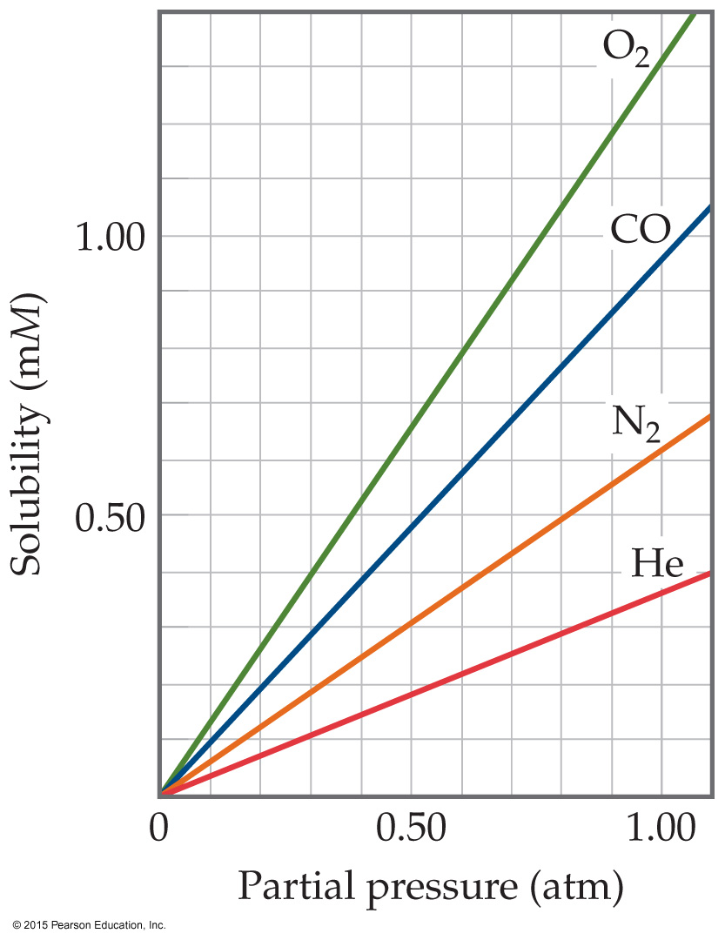
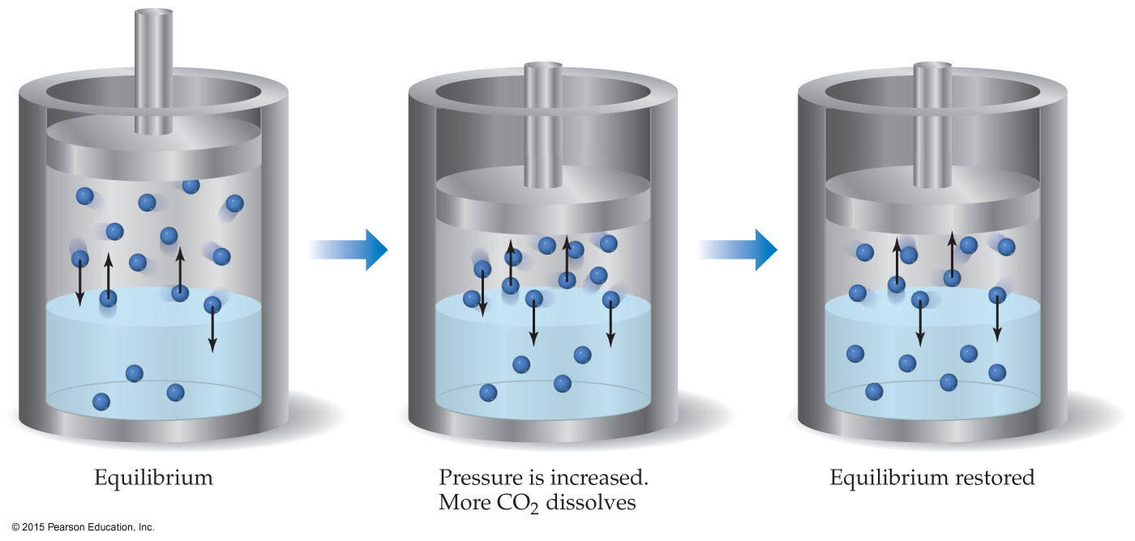
Henry’s Law
The solubility of a gas is proportional to the partial pressure of the gas above the solution.

Slide 19
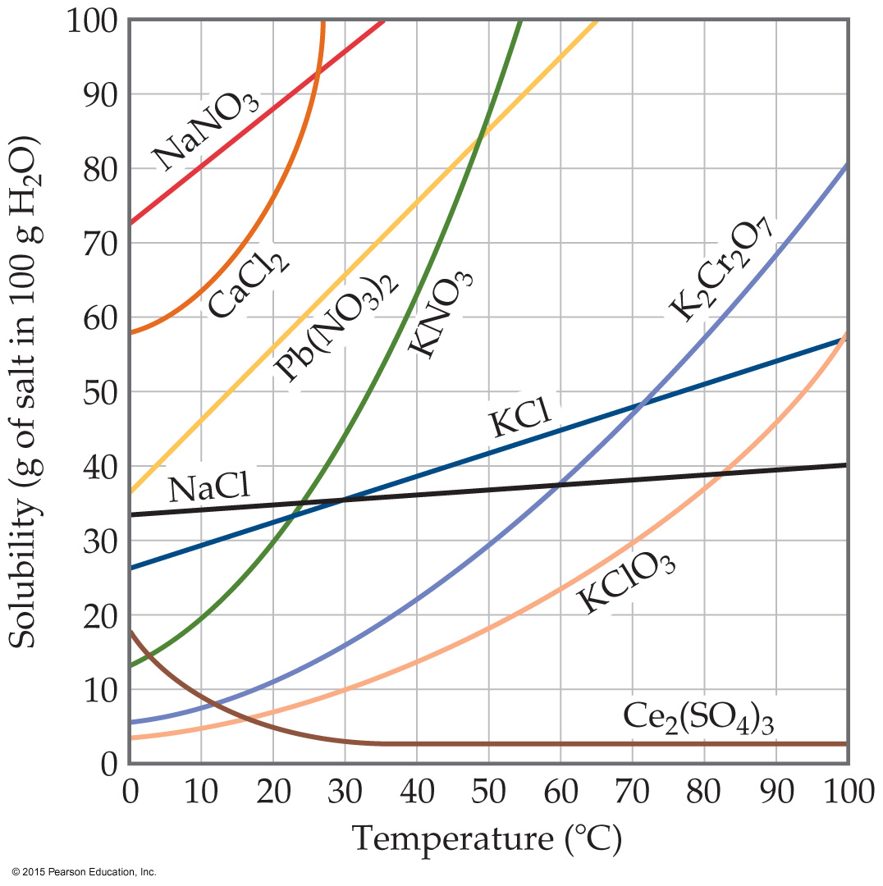
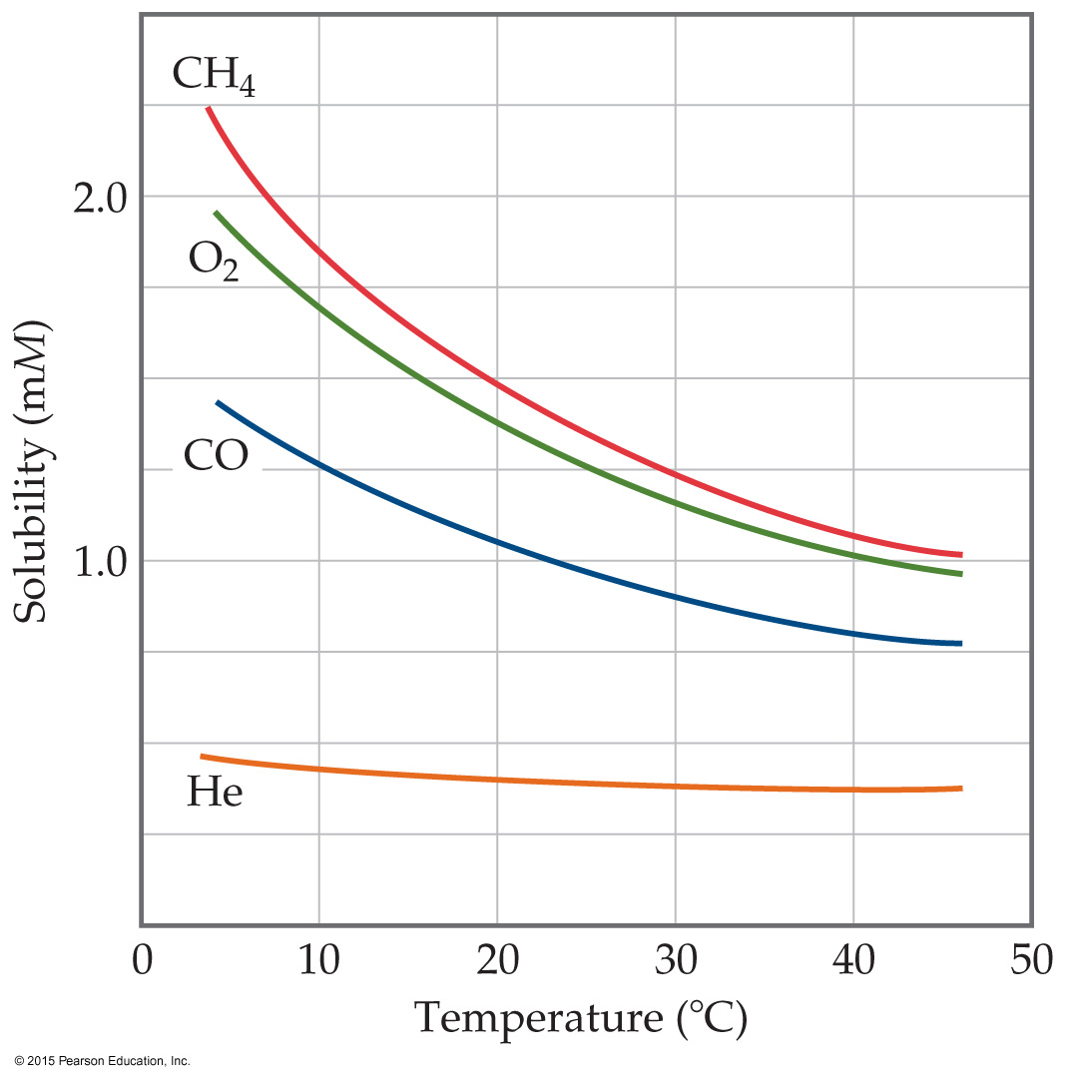
Temperature Effects
For most solids, as temperature increases, solubility increases. However, clearly this is not always true—some increase greatly, some remain relatively constant, and others decrease.
For all gases, as temperature increases, solubility decreases. Cold rivers have higher oxygen content than warm rivers.

Slide 20
Solution Concentration
We have discussed solubility and solutions qualitatively: saturated (which is quantitative), unsaturated, and supersaturated.
Now we will give specific amounts to solutions.

Slide 21
Units of Concentration
Mass percentage
Parts per million (ppm)
Parts per billion (ppb)
Mole fraction
Molarity
Molality

Slide 22
1) Mass Percentage
Percent means “out of 100.”
Take the ratio of the mass of the solute to the total solution mass.
Multiply by 100 to make it a percent.

Slide 23
2) Parts per Million (ppm) 3) Parts per Billion (ppb)
still relating mass of a solute to the total mass of the solution
Since percent is out of 100, we multiplied by 100.
ppm is per million, so we multiply by 10⁶.
ppb is per billion, so we multiply by 10⁹.

Slide 24
(4) Mole Fraction (χ)
Mole fraction is the ratio of moles of a substance to the total number of moles in a solution.
It does not matter if it is for a solute or for a solvent.

Slide 25
(5) Molarity (M) (6) Molality (m)
Be careful of your penmanship!
Molarity was discussed in Chapter 4 as moles of solute per liter of solution.
Molality is moles of solute per kilogram of solvent.

Slide 26
Molarity vs. Molality
When water is the solvent, dilute solutions have similar molarity and molality.
Molality does not vary with temperature (mass does not change).
Molarity varies with temperature (volume changes).

Slide 27
Converting Units
Follow dimensional analysis techniques from Chapter 1.
To convert between molality and molarity, the density of the solution must be used.

Slide 28
Colligative Properties
Colligative properties depend only on the quantity, not on the identity of the solute particles.
Among colligative properties are:
Vapor-pressure lowering
Boiling-point elevation
Freezing-point depression
Osmotic pressure

Slide 29
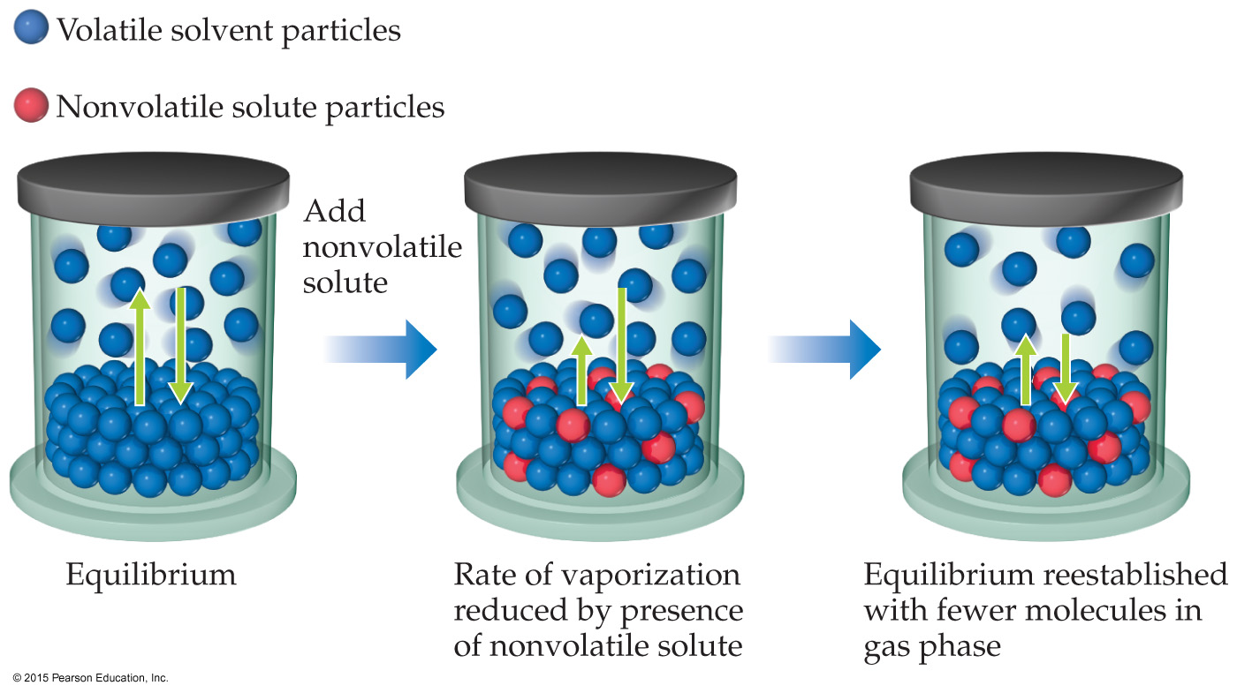
Vapor Pressure
Because of solute–solvent intermolecular attraction, higher concentrations of nonvolatile solutes make it harder for solvent to escape to the vapor phase. Therefore, the vapor pressure of a solution is lower than that of the pure solvent.

Slide 30
Raoult’s Law
The vapor pressure of a volatile solvent over the solution is the product of the mole fraction of the solvent times the vapor pressure of the pure solvent.
In ideal solutions, it is assumed that each substance will follow Raoult’s Law.

Slide 31
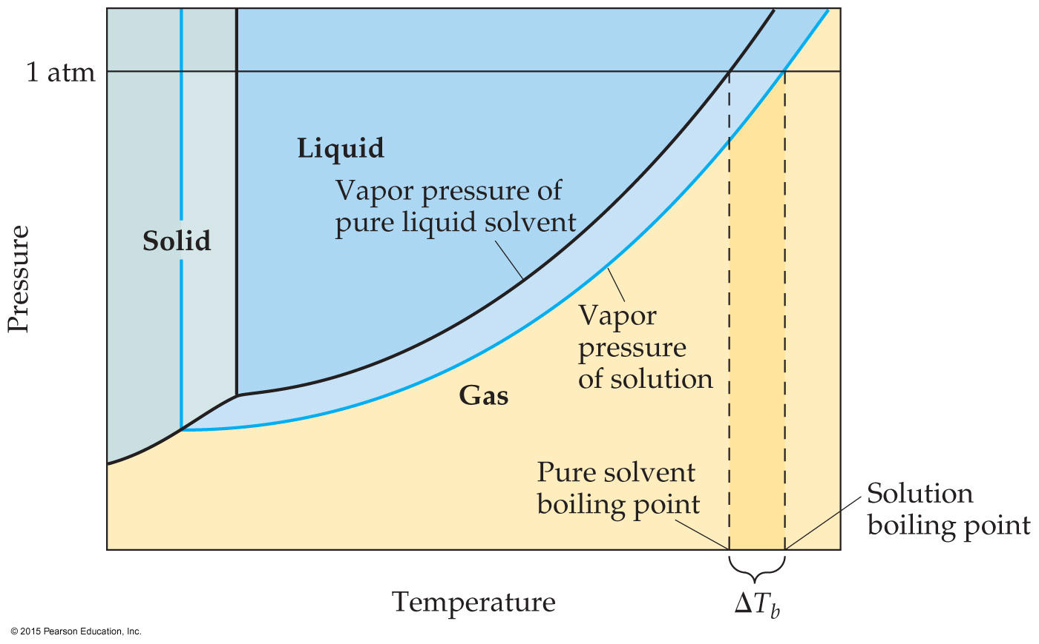
Boiling-Point Elevation
Since vapor pressures are lowered for solutions, it requires a higher temperature to reach atmospheric pressure. Hence, boiling point is raised.

Slide 32
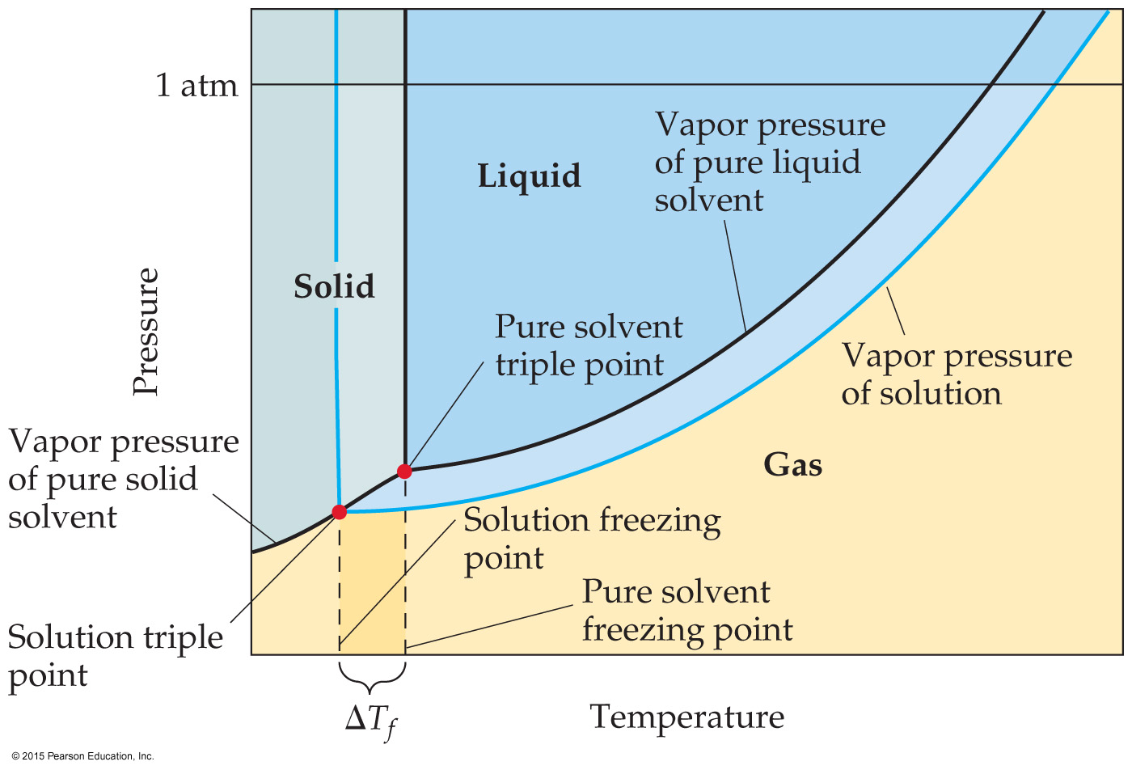
Freezing-Point Depression
The construction of the phase diagram for a solution demonstrates that the freezing point is lowered while the boiling point is raised.

Slide 33
Boiling-Point Elevation and Freezing-Point Depression
The change in temperature is directly proportional to molality (using the van’t Hoff factor).

Slide 34
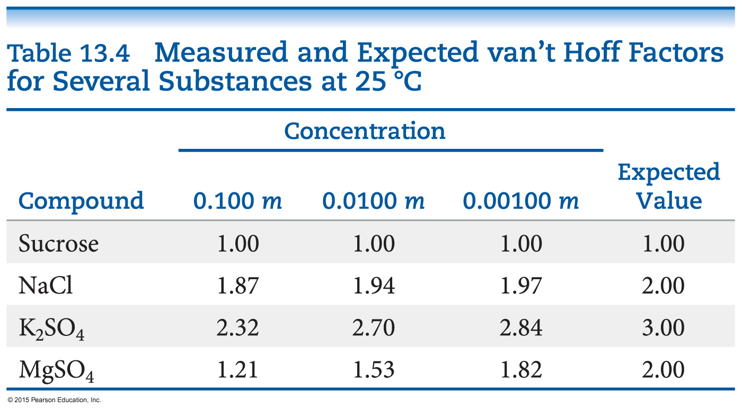
The van’t Hoff Factor (i)
What is the van’t Hoff factor?
It takes into account dissociation in solution!
Theoretically, we get 2 particles when NaCl dissociates. So, i = 2.
In fact, the amount that particles remain together is dependent on the concentration of the solution.

Slide 35
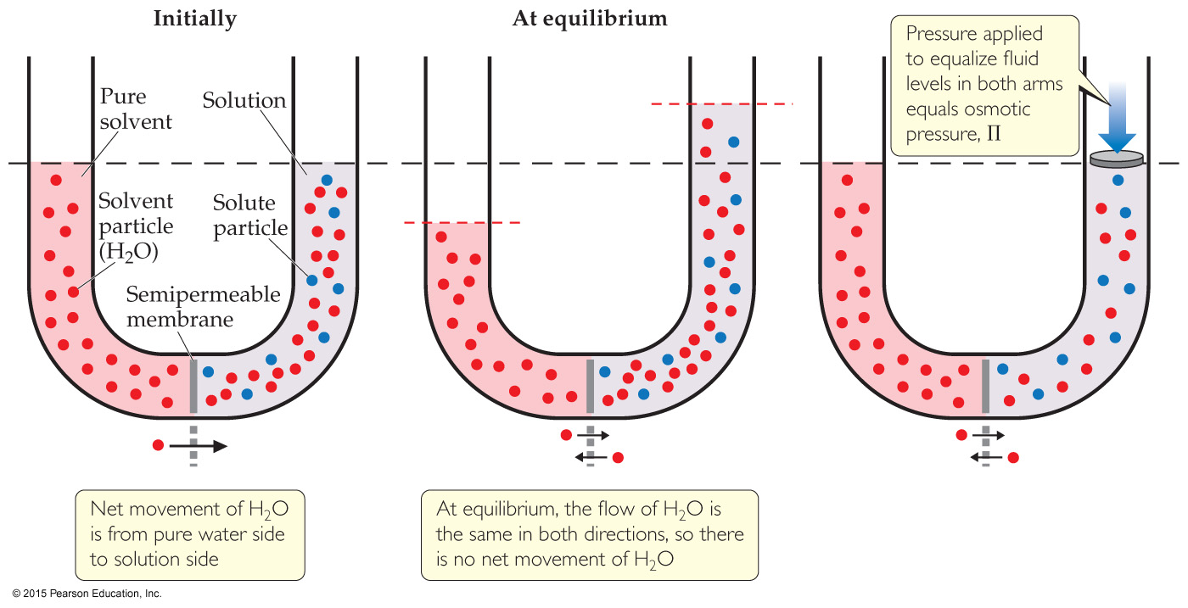
Osmosis
Some substances form semipermeable membranes, allowing some smaller particles to pass through, but blocking larger particles.
The net movement of solvent molecules from solution of low to high concentration across a semipermeable membrane is osmosis. The applied pressure to stop it is osmotic pressure.

Slide 36
Osmotic Pressure
Osmotic pressure is a colligative property.
If two solutions separated by a semipermeable membrane have the same osmotic pressure, no osmosis will occur.

Slide 37
Types of Solutions & Osmosis
Isotonic solutions: Same osmotic pressure; solvent passes the membrane at the same rate both ways.
Hypotonic solution: Lower osmotic pressure; solvent will leave this solution at a higher rate than it enters with.
Hypertonic solution: Higher osmotic pressure; solvent will enter this solution at a higher rate than it leaves with.

Slide 38
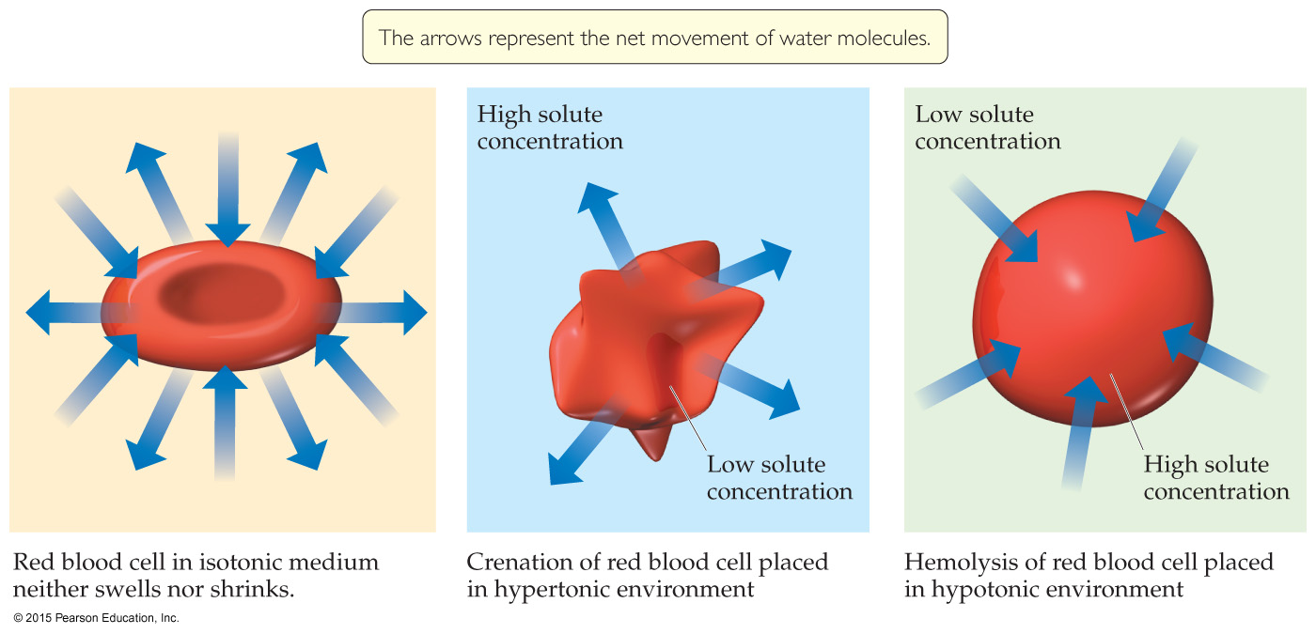
Osmosis and Blood Cells
Red blood cells have semipermeable membranes.
If stored in a hypertonic solution, they will shrivel as water leaves the cell; this is called crenation.
If stored in a hypertonic solution, they will grow until they burst; this is called hemolysis.

Slide 39
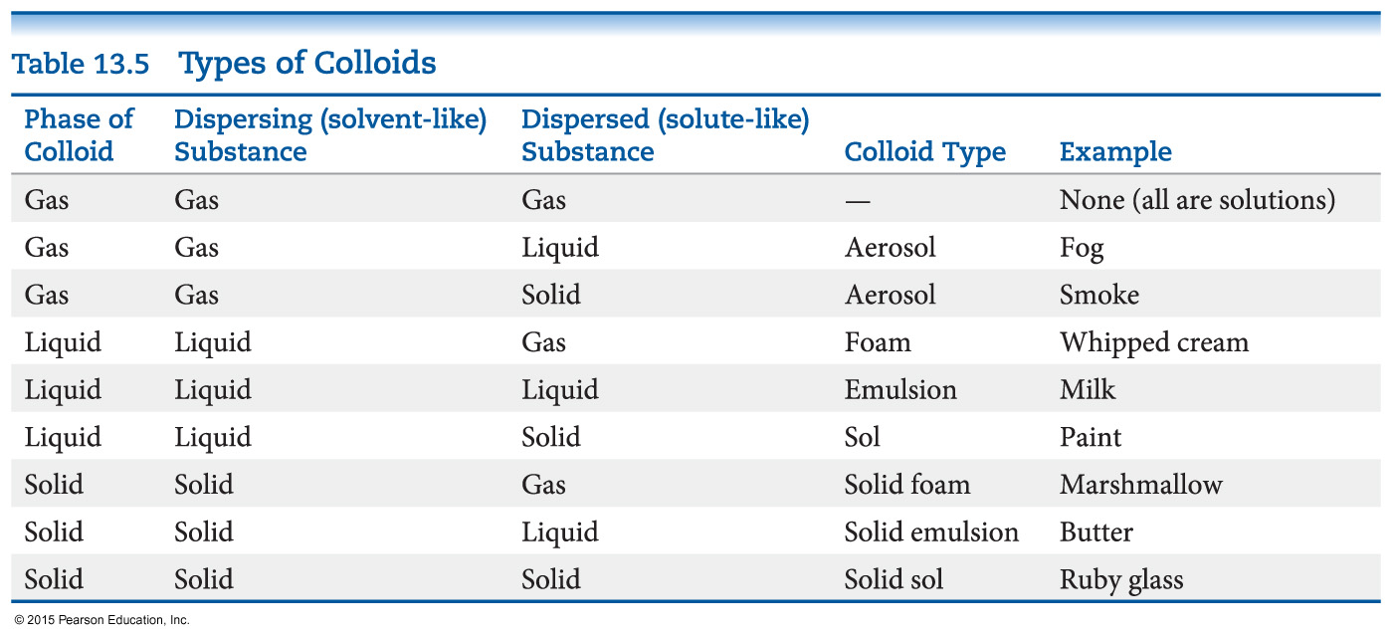
Colloids
Suspensions of particles larger than individual ions or molecules, but too small to be settled out by gravity, are called colloids.

Slide 40
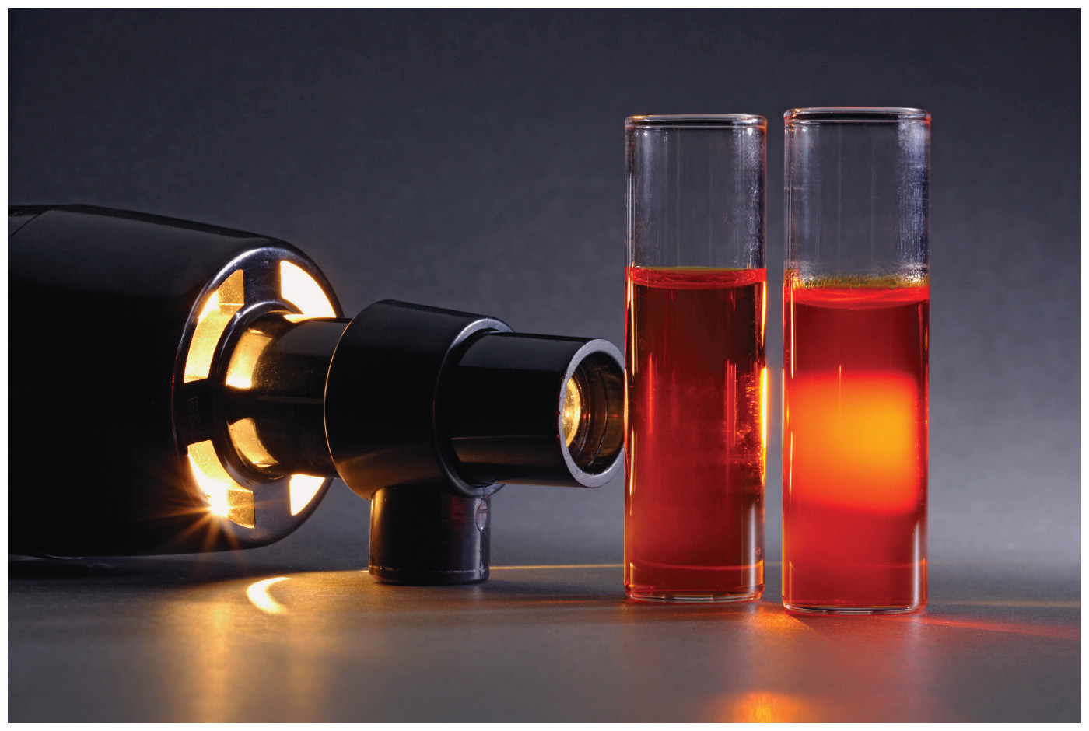
Tyndall Effect
Colloidal suspensions can scatter rays of light. (Solutions do not.)
This phenomenon is known as the Tyndall effect.

Slide 41
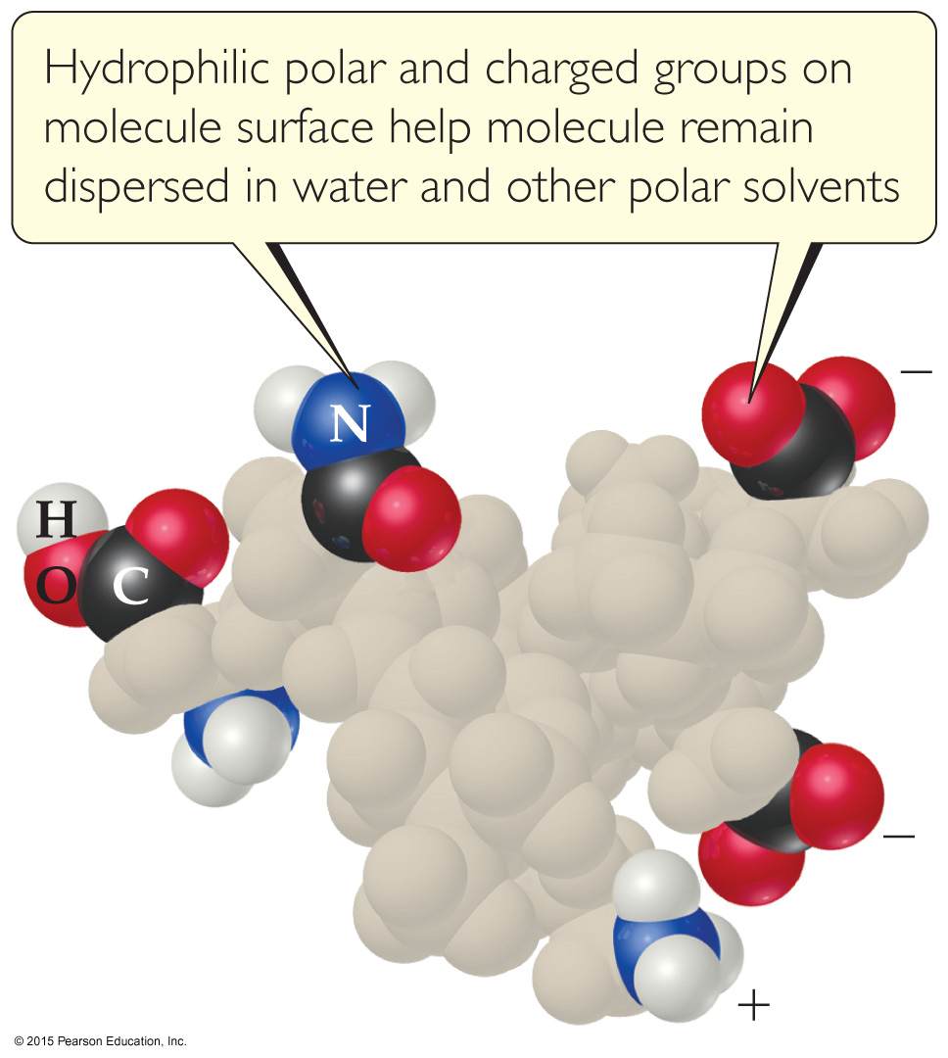
Colloids and Biomolecules
Some molecules have a polar, hydrophilic (water-loving) end and a nonpolar, hydrophobic (water-fearing) end.

Slide 42
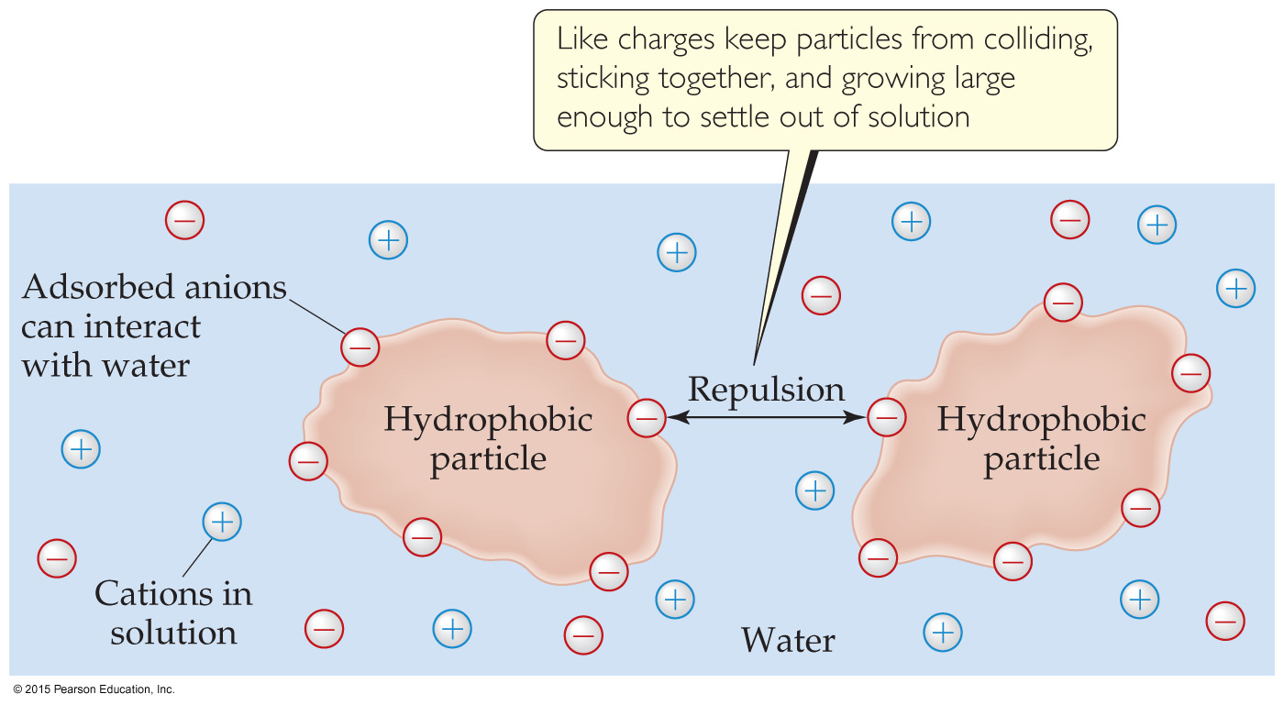
Stabilizing Colloids by Adsorption
Ions can adhere to the surface of an otherwise hydrophobic colloid.
This allows it to interact with aqueous solution.

Slide 43
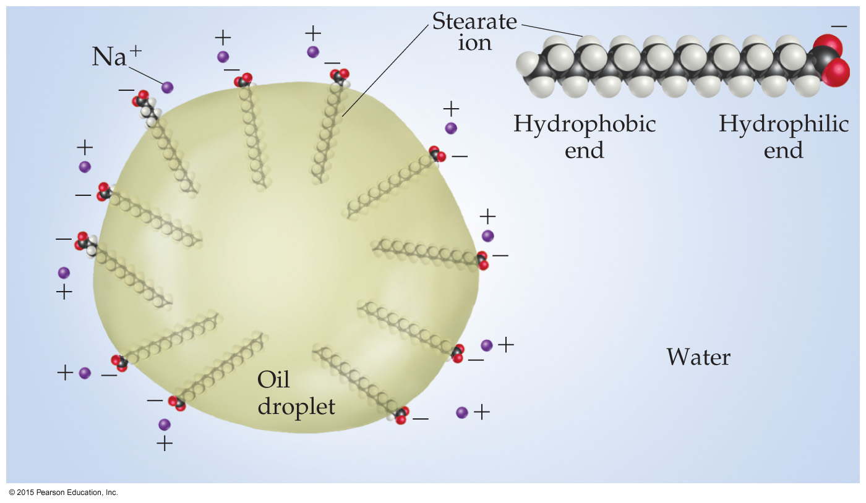
Colloids in Biological Systems
Colloids can aid in the emulsification of fats and oils in aqueous solutions.
An emulsifier causes something that normally does not dissolve in a solvent to do so.

Slide 44
Brownian Motion
Motion of colloids due to numerous collisions with the much smaller solvent.

