Slide 1
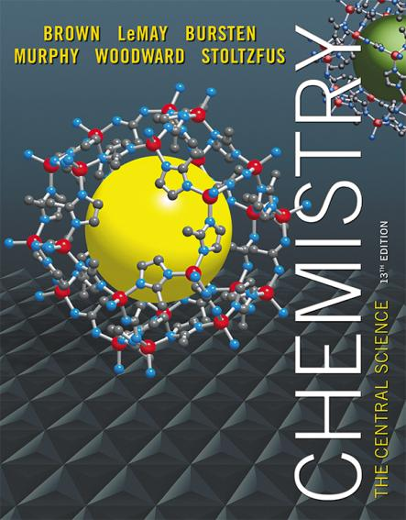
Lecture Presentation
Chapter 11 Liquids and Intermolecular Forces
James F. Kirby
Quinnipiac University
Hamden, CT

Slide 2
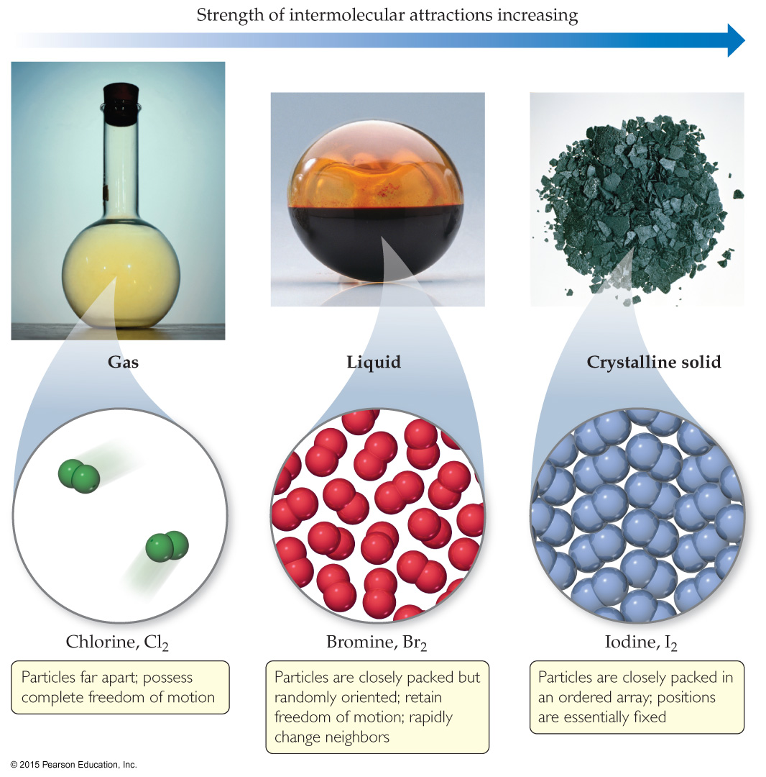
States of Matter
The fundamental difference between states of matter is the strength of the intermolecular forces of attraction.
Stronger forces bring molecules closer together.
Solids and liquids are referred to as the condensed phases.

Slide 3
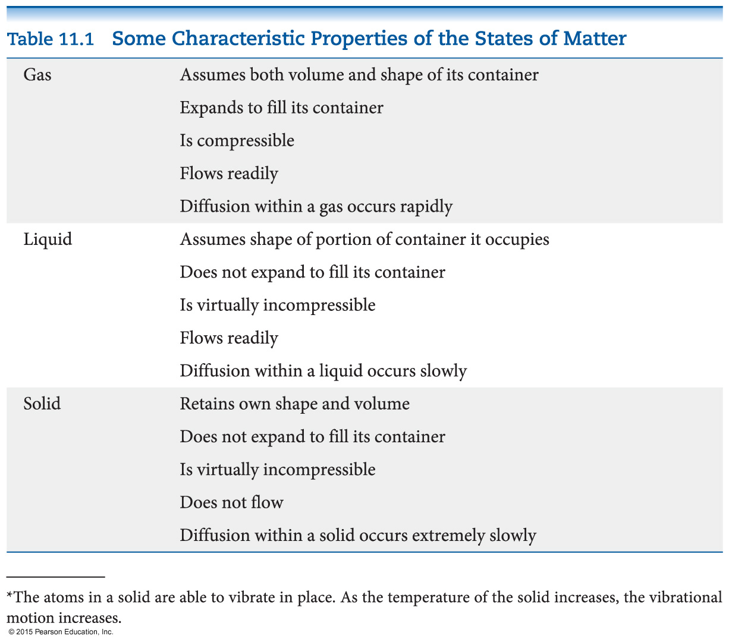
Differences in the States of Matter

Slide 4
Which State of Matter?
The answer to this question largely relies on the
balance between the kinetic energies of the particles.
interparticle energies of attraction.

Slide 5
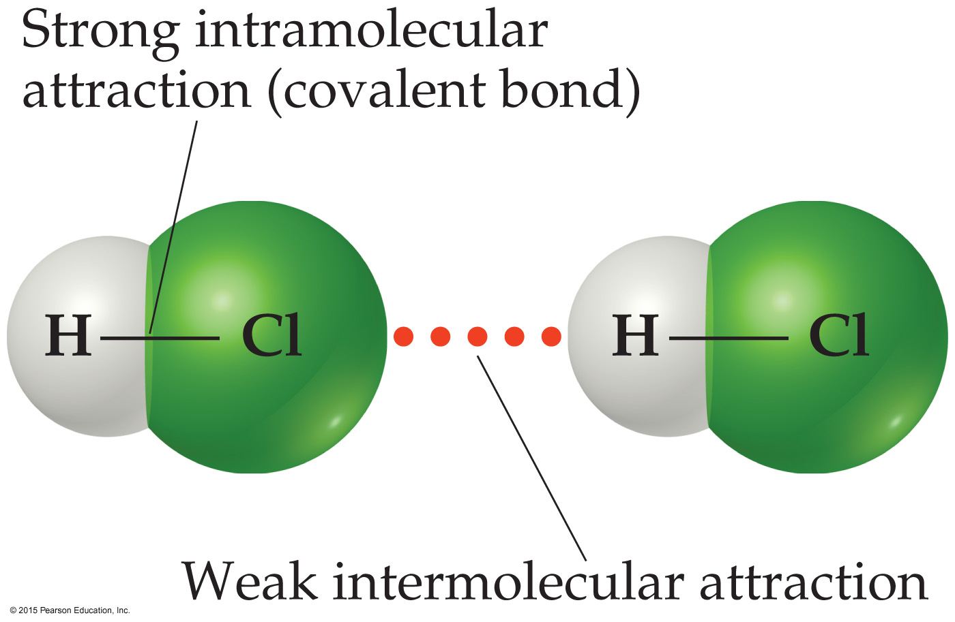
Intermolecular Forces
The attractions between molecules are not nearly as strong as the intramolecular attractions (bonds) that hold compounds together.
Many physical properties reflect intermolecular forces, like boiling points, melting points, viscosity, surface tension, and capillary action.

Slide 6
Types of Intermolecular Force
Weakest to strongest forces:
dispersion forces (or London dispersion forces)
dipole–dipole forces
hydrogen bonding (a special dipole–dipole force)
ion–dipole forces
Note: The first two types are also referred to collectively as van der Waals forces.

Slide 7
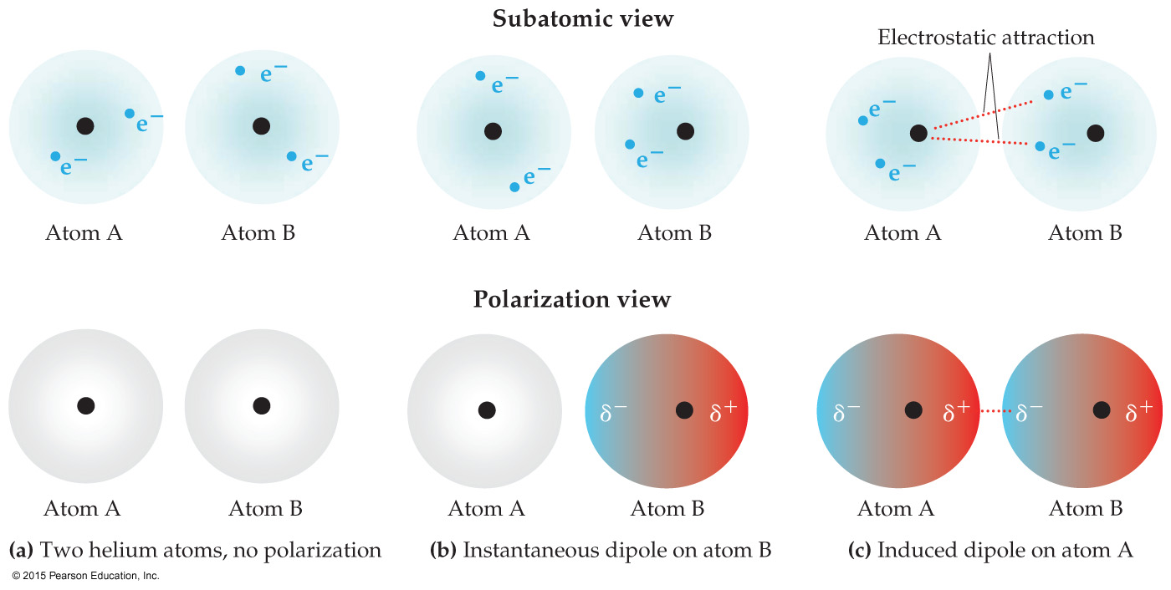
Dispersion Forces
The figure below shows how a nonpolar particle (in this case a helium atom) can be temporarily polarized to allow dispersion force to form.
The tendency of an electron cloud to distort is called its polarizability.

Slide 8
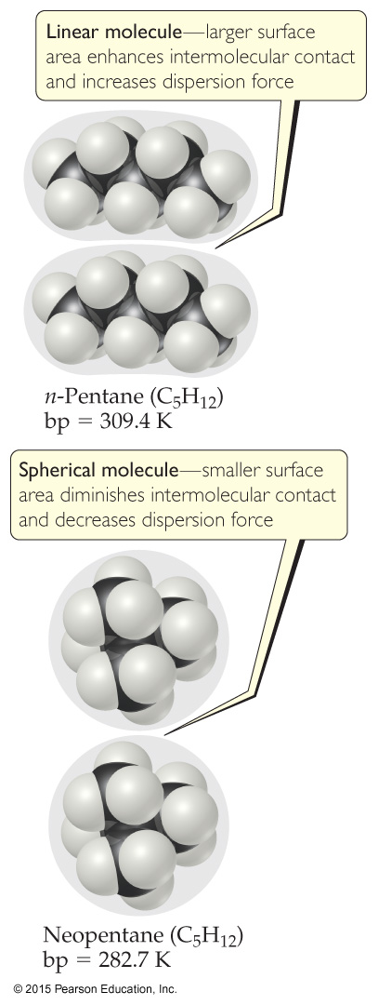
Factors Which Affect Amount of Dispersion Force in a Molecule
number of electrons in an atom (more electrons, more dispersion force)
size of atom or molecule/molecular weight
shape of molecules with similar masses (more compact, less dispersion force)

Slide 9
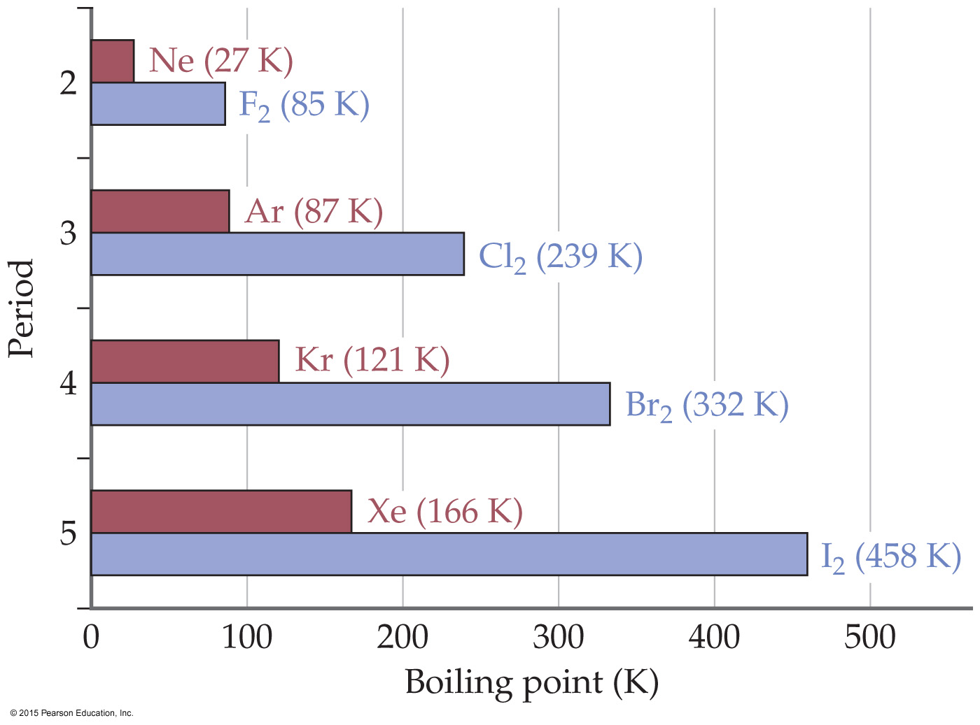
Polarizability & Boiling Point
If something is easier to polarize, it has a lower boiling point.
Remember: This means less intermolecular force (smaller molecule: lower molecular weight, fewer electrons).

Slide 10
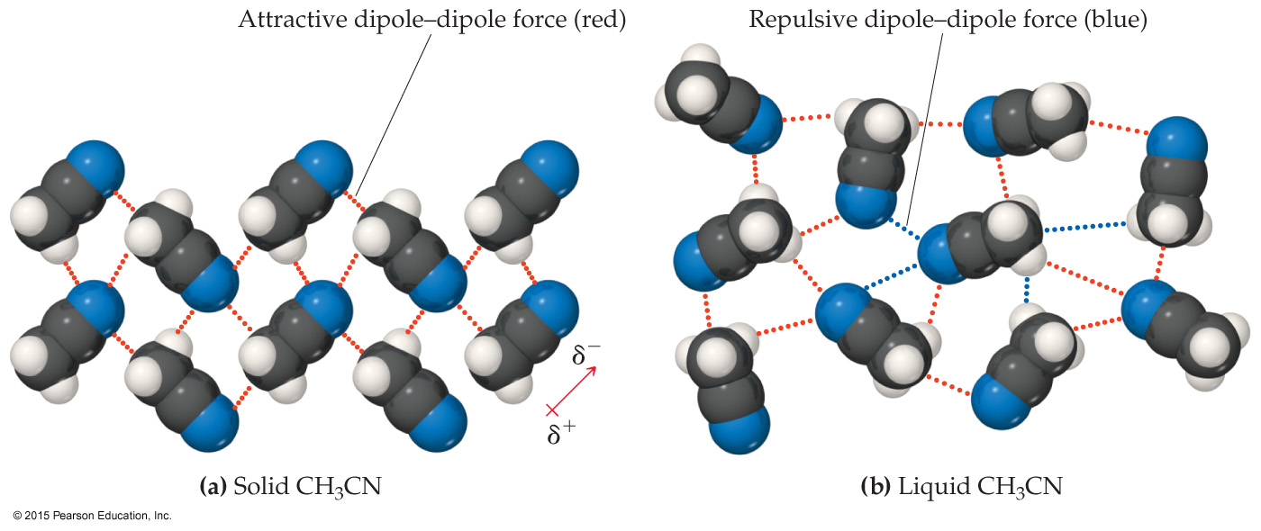
Dipole–Dipole Interactions
Polar molecules have a more positive and a more negative end–a dipole (two poles, δ⁺ and δ⁻).
The oppositely charged ends attract each other.

Slide 11
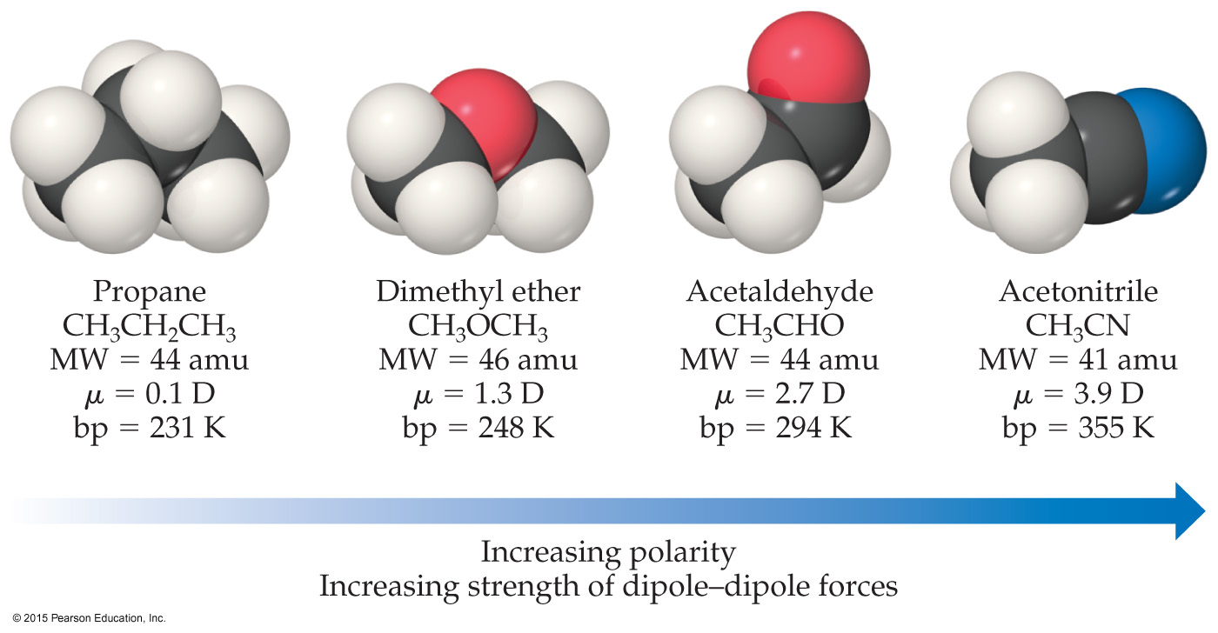
Dipole–Dipole Interactions
For molecules of approximately equal mass and size, the more polar the molecule, the higher its boiling point.

Slide 12
Which Have a Greater Effect: Dipole–Dipole Interactions or Dispersion Forces?
If two molecules are of comparable size and shape, dipole–dipole interactions will likely be the dominating force.
If one molecule is much larger than another, dispersion forces will likely determine its physical properties.

Slide 13
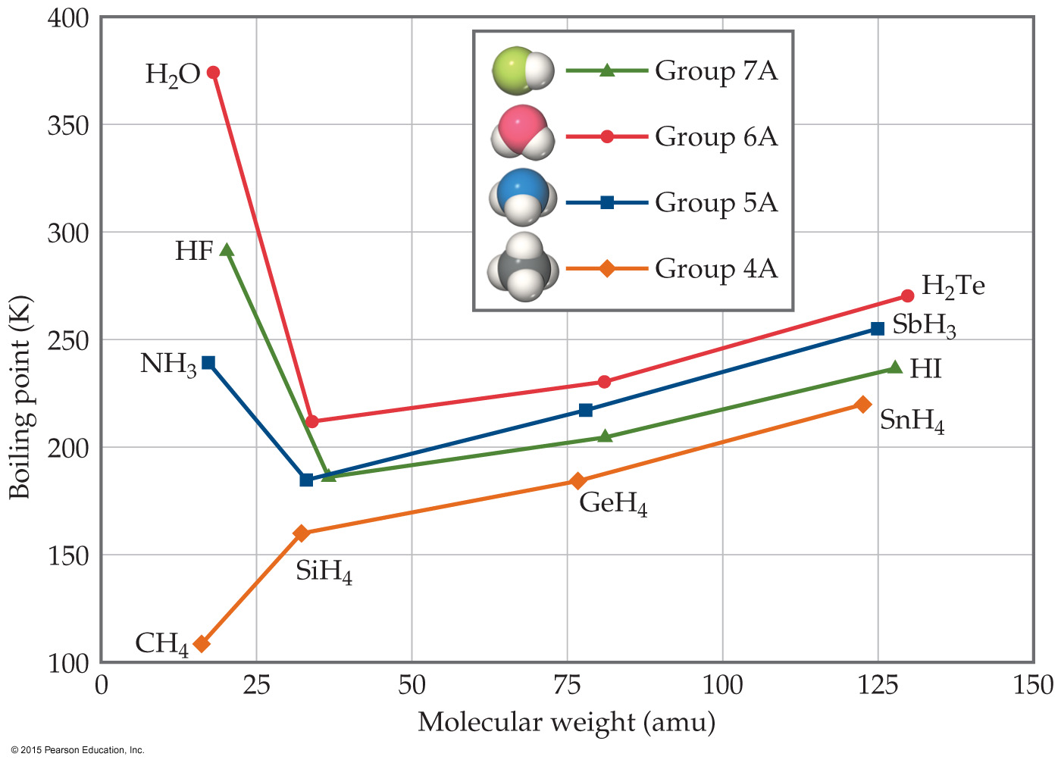
What Does This Graph Show Us?
In a group, the period 3/4/5 elements have higher boiling points as the group member gets larger.
What happens with the period 2 elements? For group 4A, the trend is continued. What about for the other groups?

Slide 14
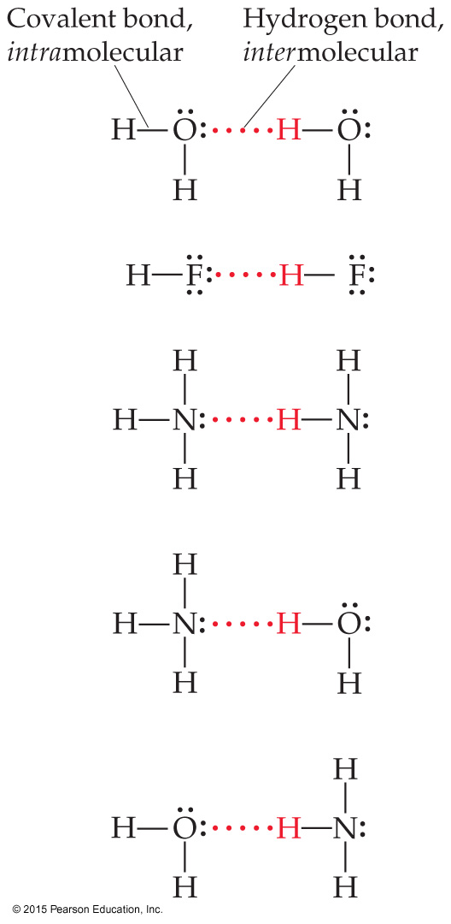
Hydrogen Bonding
The dipole–dipole interactions experienced when H is bonded to N, O, or F are unusually strong.
We call these interactions hydrogen bonds.
A hydrogen bond is an attraction between a hydrogen atom attached to a highly electronegative atom and a nearby small electronegative atom in another molecule or chemical group.

Slide 15
What Forms Hydrogen Bonds?
Hydrogen bonding arises in part from the high electronegativity of nitrogen, oxygen, and fluorine.
These atoms interact with a nearly bare nucleus (which contains one proton).

Slide 16
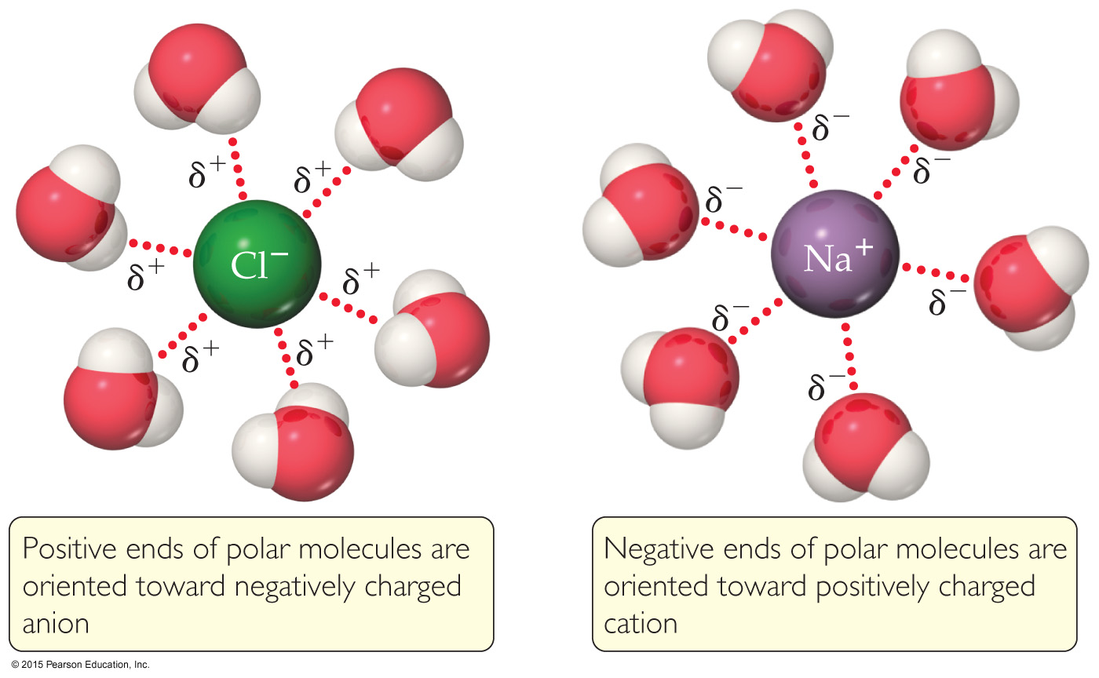
Ion–Dipole Interactions
Ion–dipole interactions are found in solutions of ions.
The strength of these forces is what makes it possible for ionic substances to dissolve in polar solvents.

Slide 17
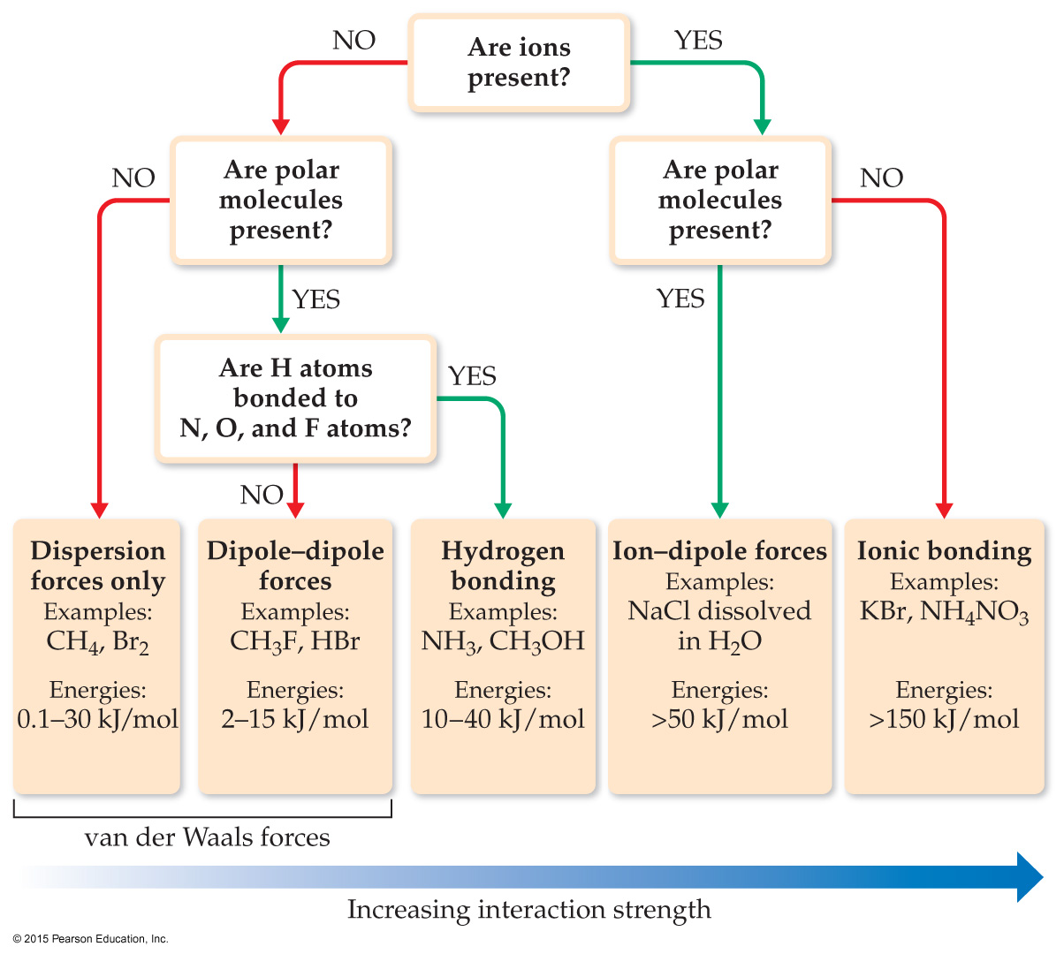
Summarizing Intermolecular Forces

Slide 18
Liquid Properties Affected by Intermolecular Forces
boiling point (previously discussed) and melting point
viscosity
surface tension
capillary action

Slide 19
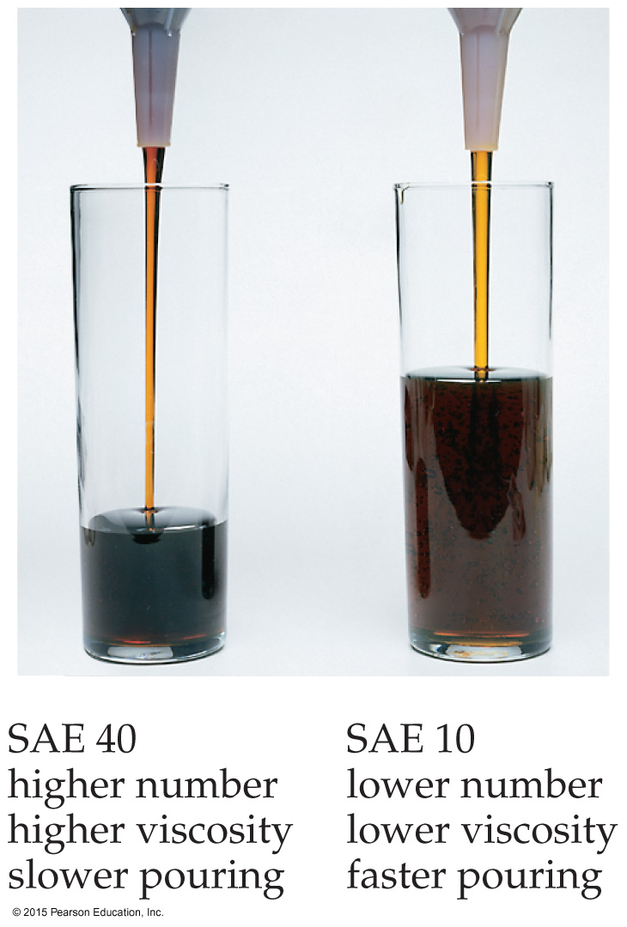
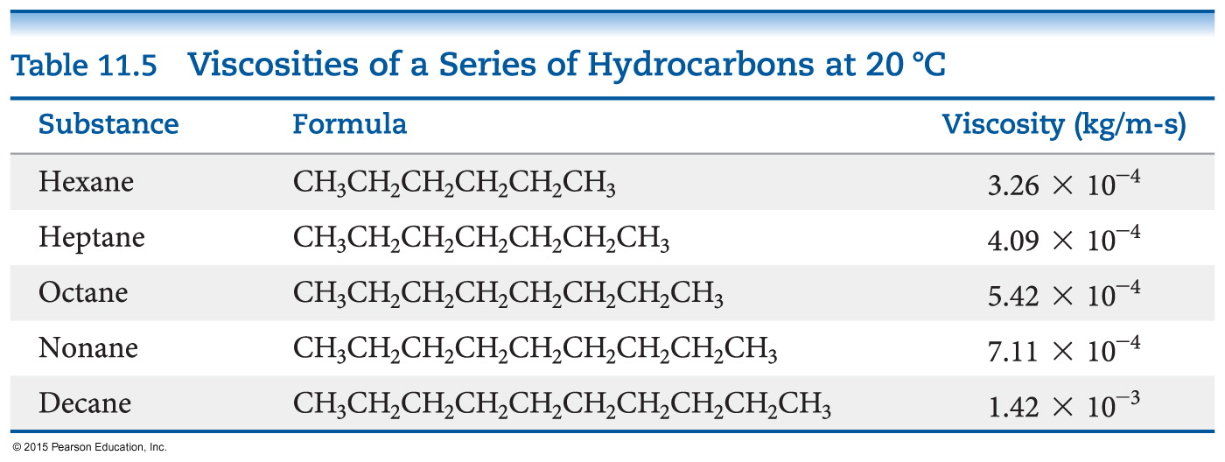
Viscosity
Resistance of a liquid to flow is called viscosity.
It is related to the ease with which molecules can move past each other.
Viscosity increases with stronger intermolecular forces and decreases with higher temperature.

Slide 20
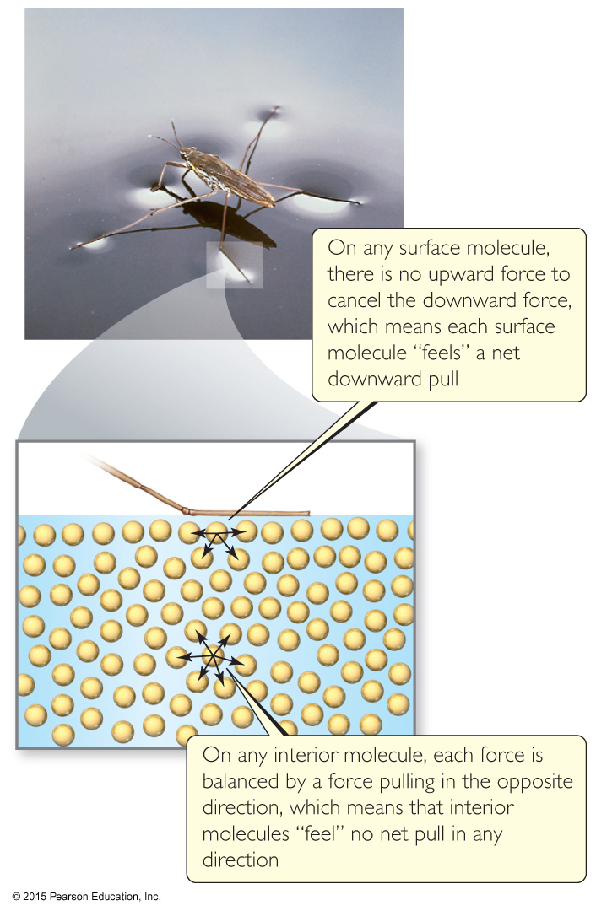
Surface Tension
Water acts as if it has a “skin” on it due to extra inward forces on its surface. Those forces are called the surface tension.

Slide 21
Cohesion and Adhesion
Intermolecular forces that bind similar molecules to one another are called cohesive forces.
Intermolecular forces that bind a substance to a surface are called adhesive forces.
These forces are important in capillary action.

Slide 22
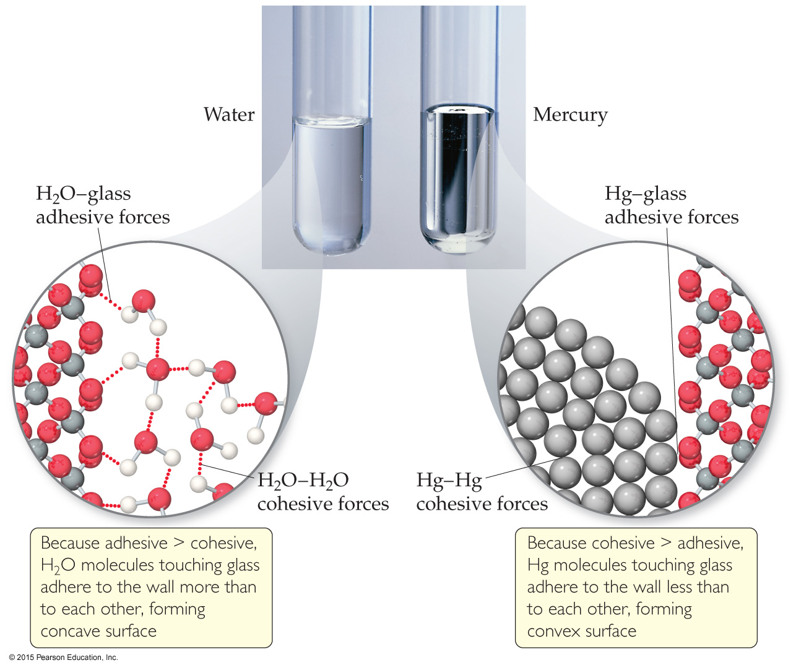
Capillary Action
The rise of liquids up narrow tubes is called capillary action.
Adhesive forces attract the liquid to the wall of the tube.
Cohesive forces attract the liquid to itself.
Water has stronger adhesive forces with glass; mercury has stronger cohesive forces with itself.

Slide 23
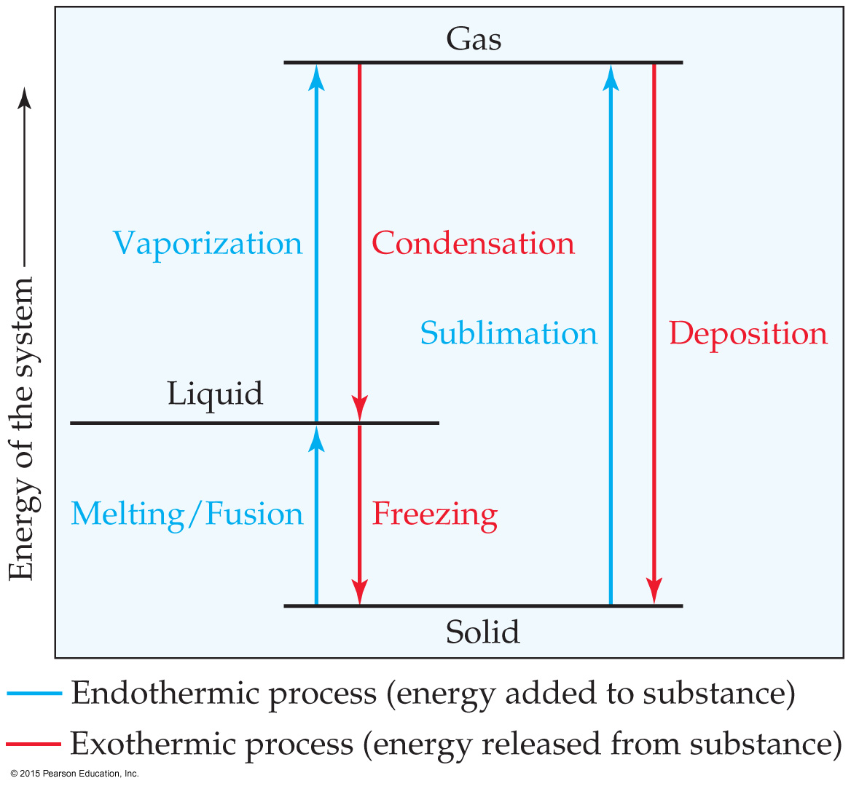
Phase Changes
Conversion from one state of matter to another is called a phase change.
Energy is either added or released in a phase change.
Phase changes: melting/freezing, vaporizing/condensing, subliming/depositing.
Notes:
Start here 6/21/10

Slide 24
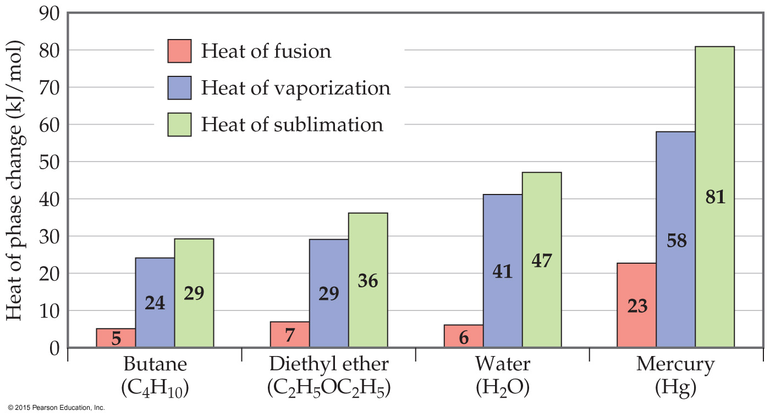
Energy Change & Change of State
The heat of fusion is the energy required to change a solid at its melting point to a liquid.
The heat of vaporization is the energy required to change a liquid at its boiling point to a gas.
The heat of sublimation is the energy required to change a solid directly to a gas.

Slide 25
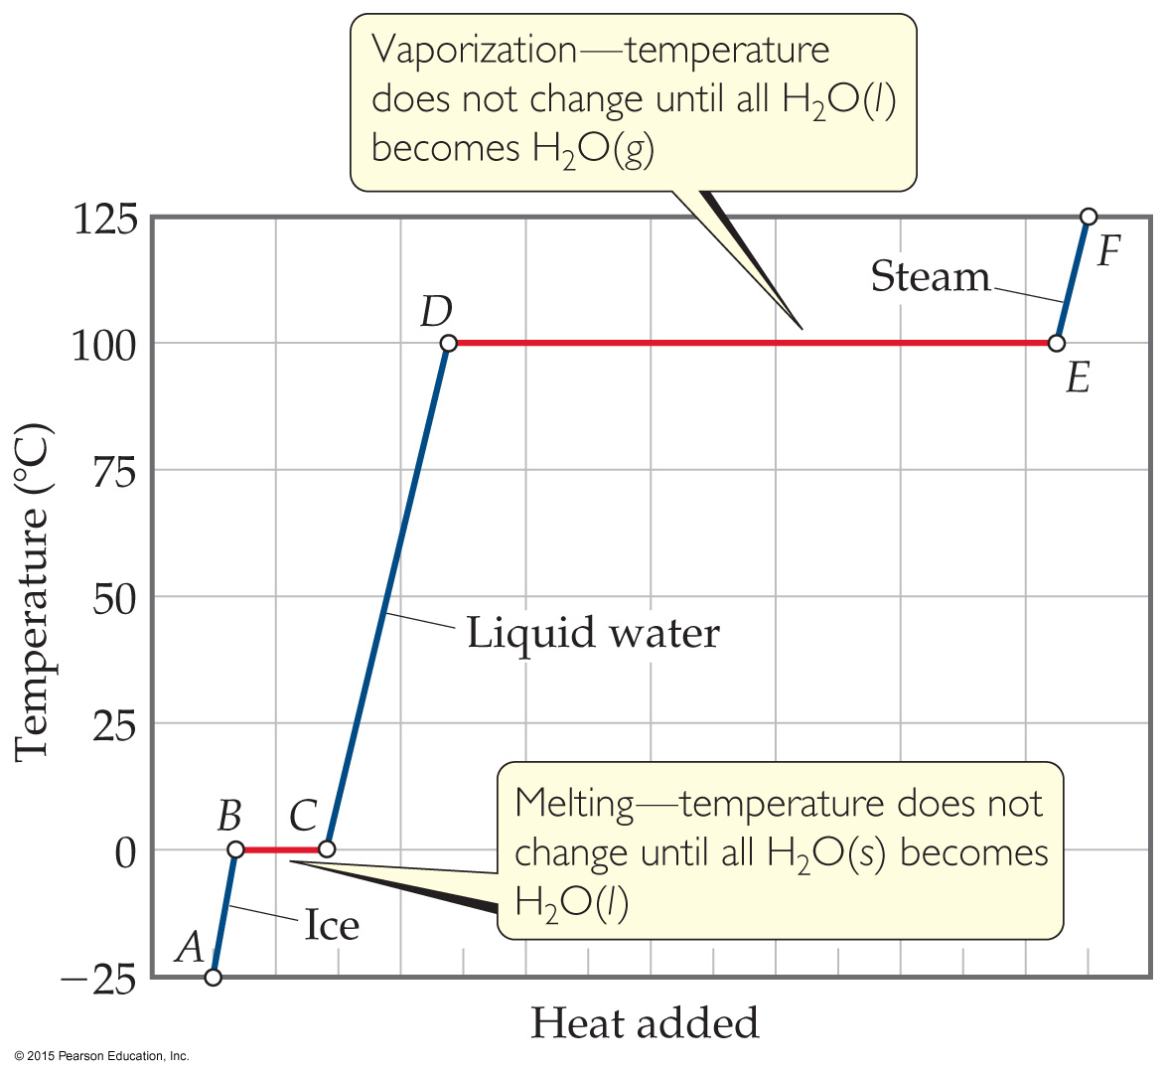
Heating Curves
A plot of temperature vs. heat added is called a heating curve.
Within a phase, heat is the product of specific heat, sample mass, and temperature change.
The temperature of the substance does not rise during a phase change.
For the phase changes, the product of mass and the heat of fusion of vaporization is heat.

Slide 26
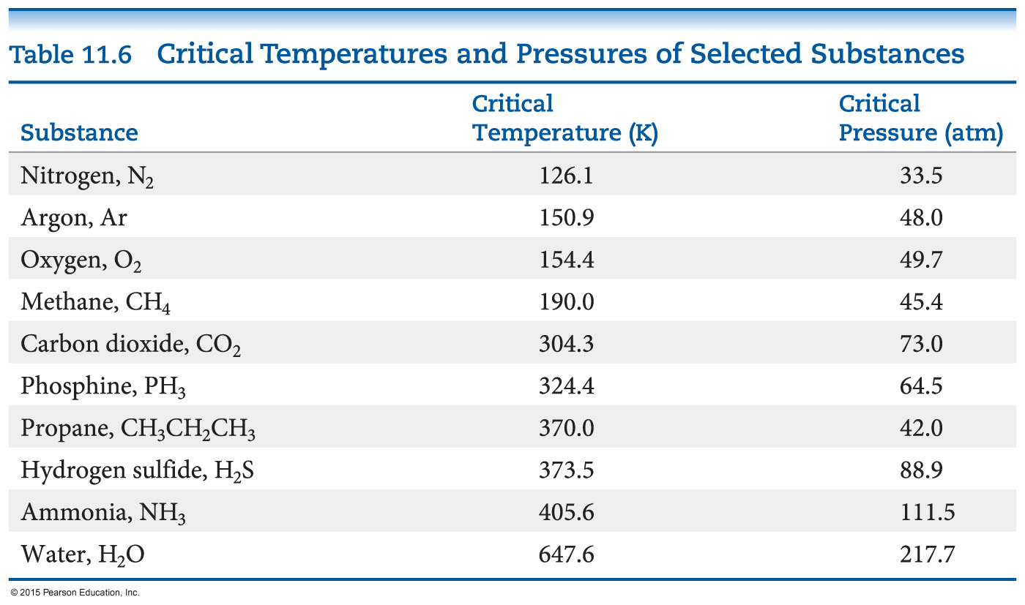
Supercritical Fluids
Gases liquefies when pressure is applied.
The temperature beyond which a gas cannot be compressed is called its critical temperature. The pressure needed to compress the liquid at critical temperature is called critical pressure.
The state beyond this temperature is called a supercritical fluid.

Slide 27
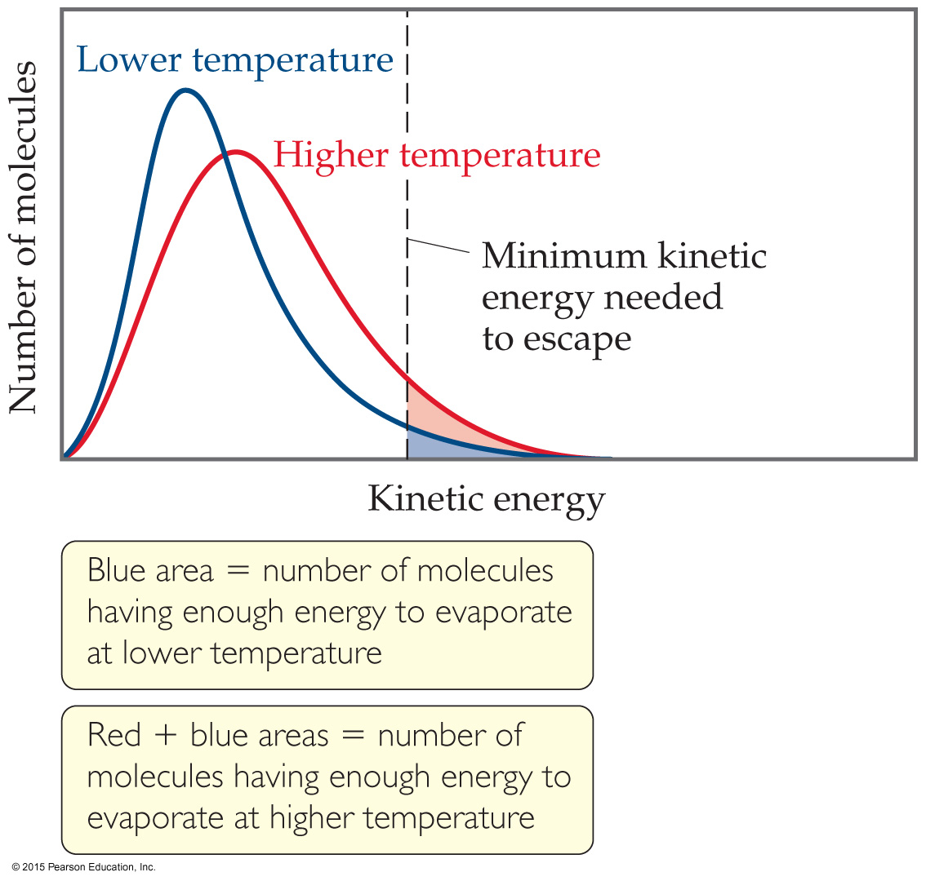
Vapor Pressure
At any temperature, some liquid molecules have enough energy to escape the surface and become a gas.
As the temperature rises, the fraction of molecules that have enough energy to break free increases.

Slide 28
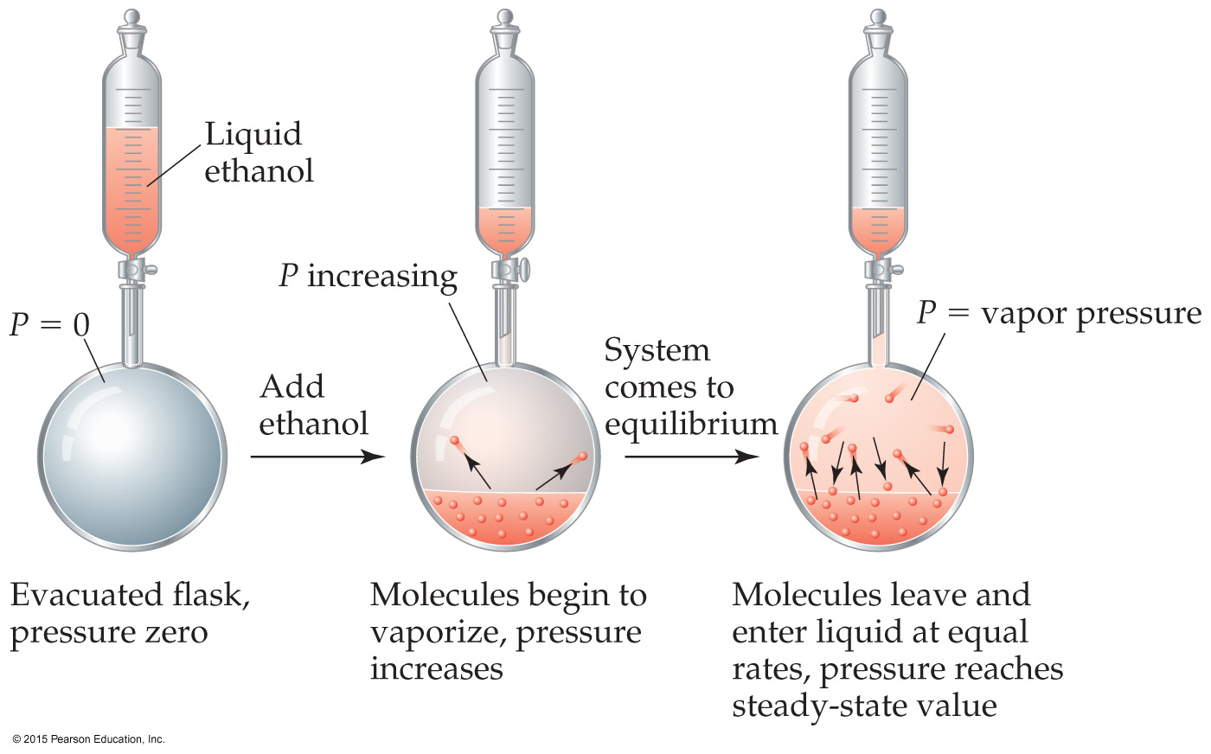
Vapor Pressure
As more molecules escape the liquid, the pressure they exert increases.
The liquid and vapor reach a state of dynamic equilibrium: liquid molecules evaporate and vapor molecules condense at the same rate.

Slide 29
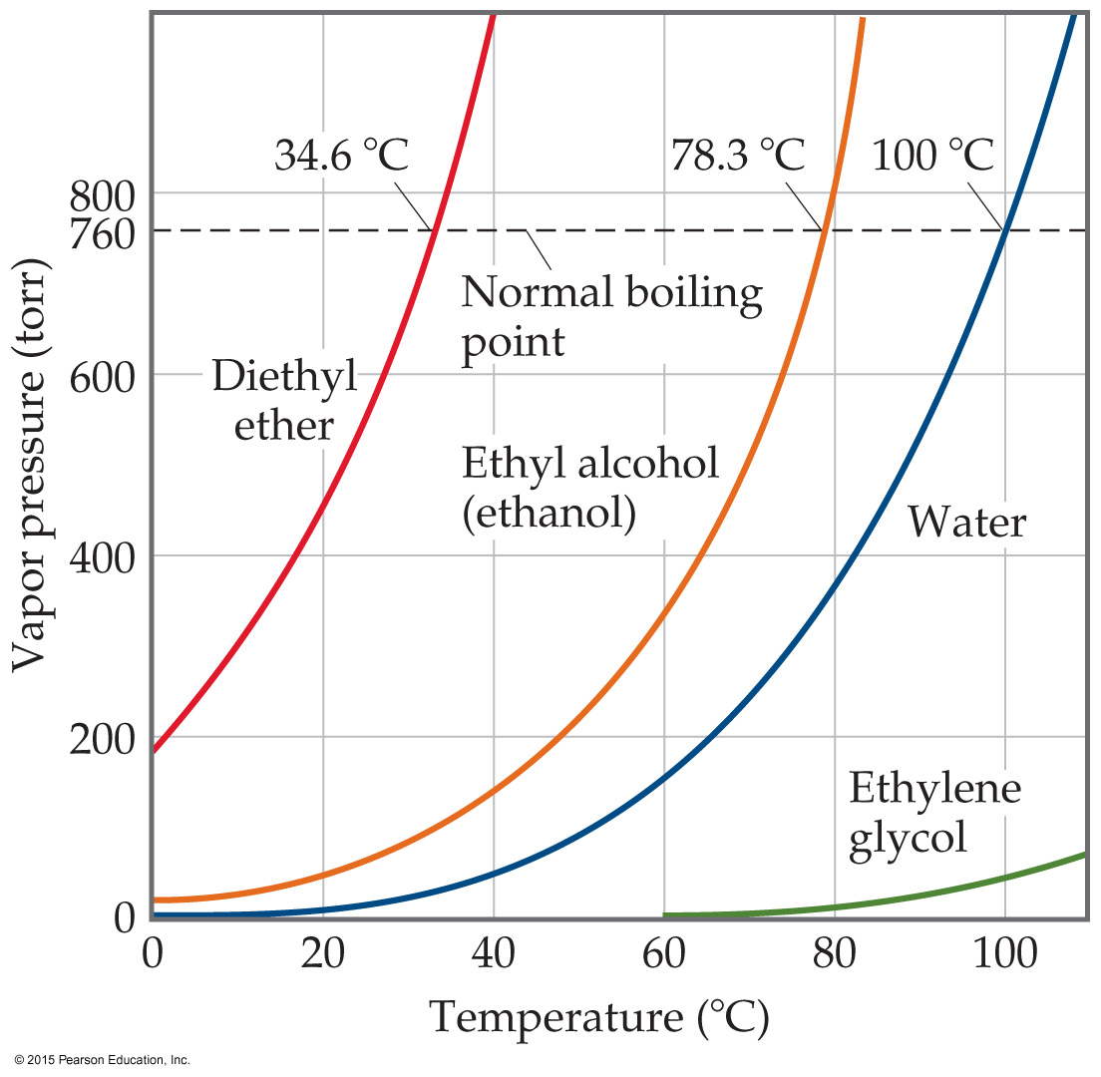
Vapor Pressure
The boiling point of a liquid is the temperature at which its vapor pressure equals atmospheric pressure.
The normal boiling point is the temperature at which its vapor pressure is 760 torr.

Slide 30
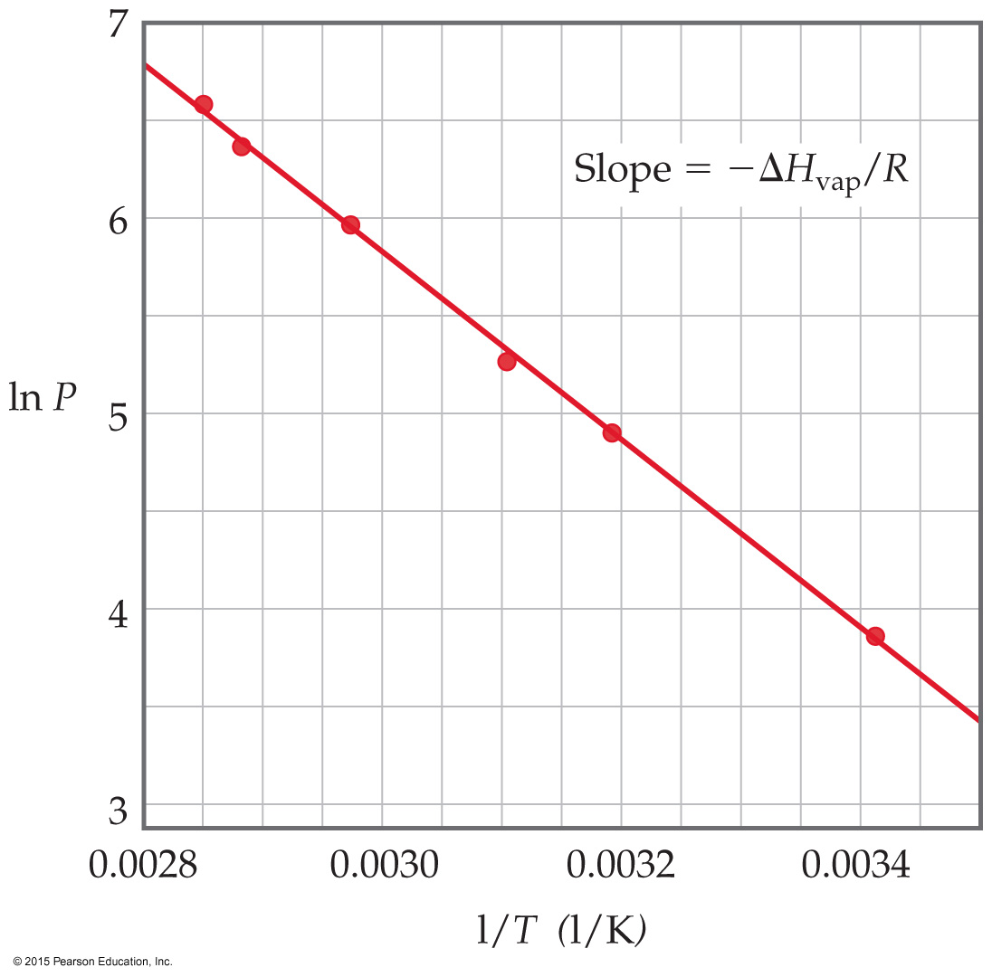
Vapor Pressure
The natural log of the vapor pressure of a liquid is inversely proportional to its temperature.
This relationship is quantified in the Clausius–Clapeyron equation.

Slide 31
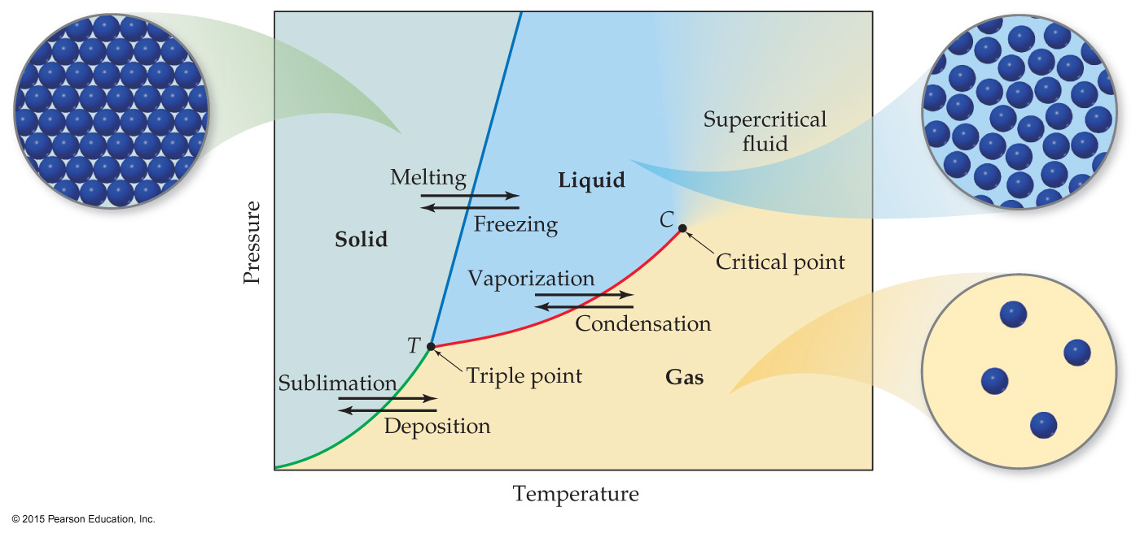
Phase Diagram
A phase diagram is a graph of pressure vs. temperature for a substance. It shows
melting, boiling, and sublimation points at different pressures.
the triple point and critical point.

Slide 32
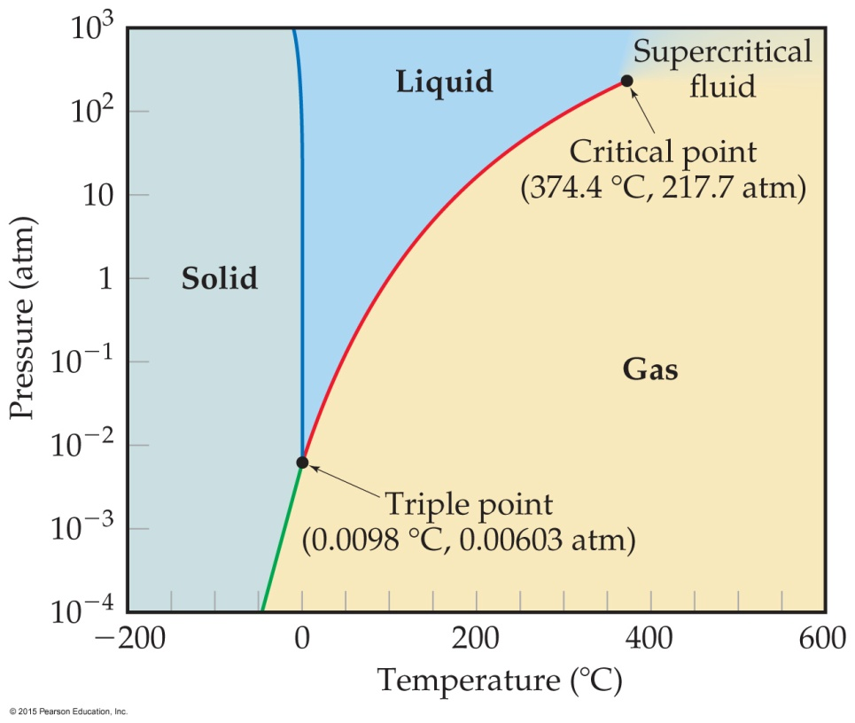
Phase Diagram of Water
Note the high critical temperature and critical pressure.
These are due to the strong van der Waals forces between water molecules.

Slide 33
Phase Diagram of Water
Unusual feature for water:
The slope of the solid– liquid line is negative.
This means that as the pressure is increased, the melting point decreases.

Slide 34
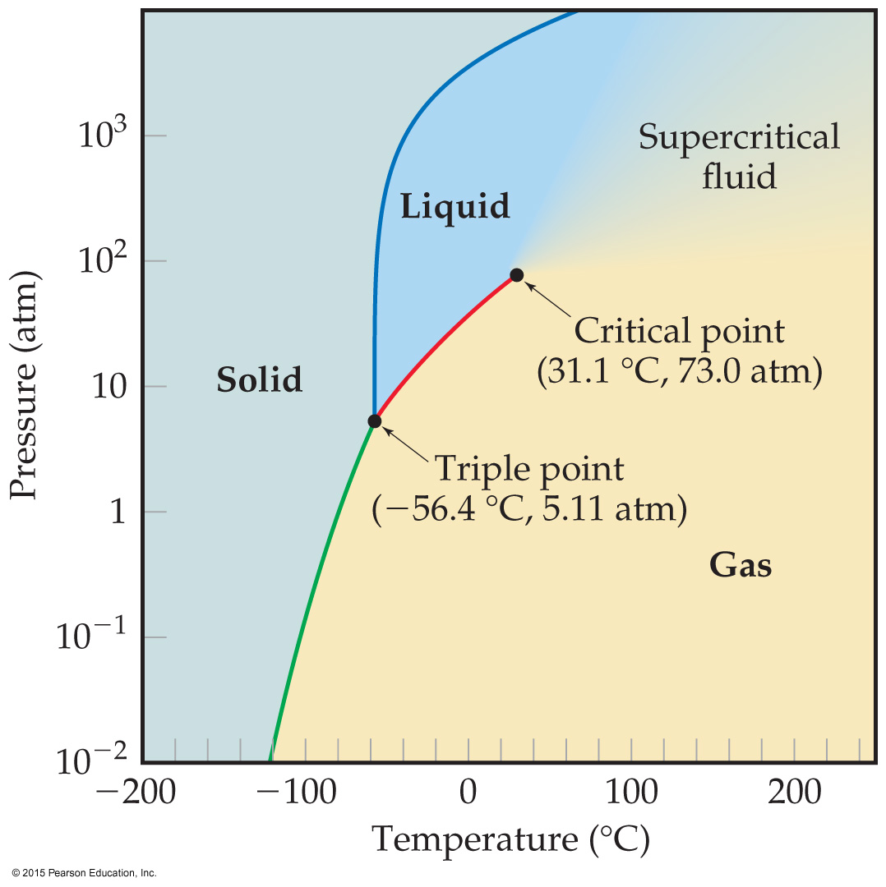
Phase Diagram of Carbon Dioxide
Unusual features for carbon dioxide:
cannot exist in the liquid state at pressures below 5.11 atm (triple point)
CO₂ sublimes at normal pressures.

Slide 35
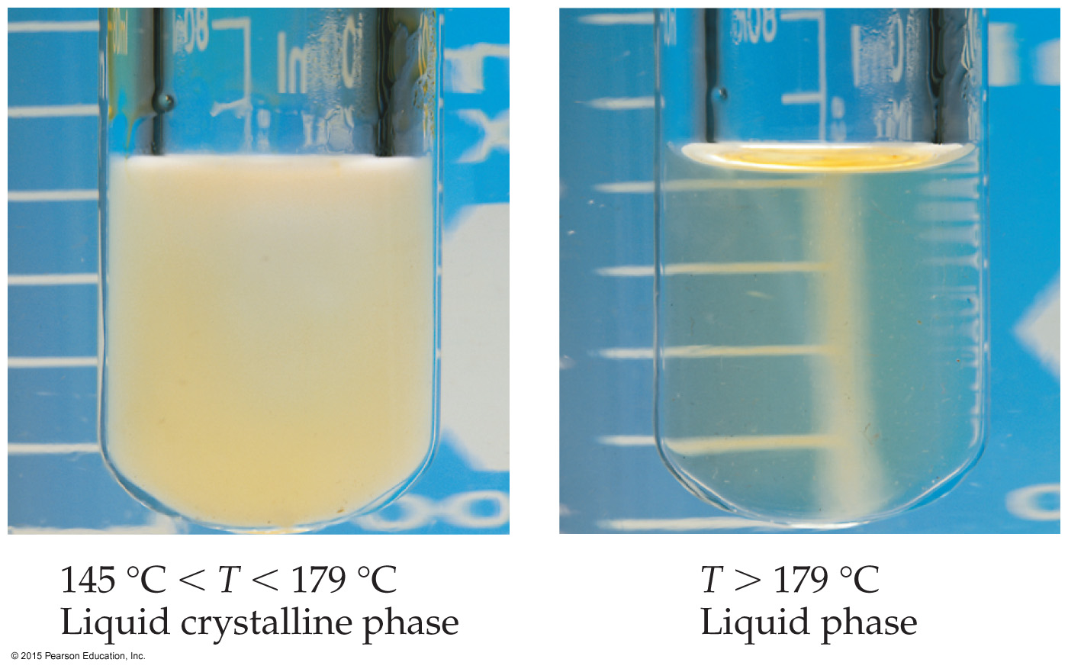
Liquid Crystals
Some substances do not go directly from the solid state to the liquid state.
In this intermediate state, liquid crystals have some traits of solids and some of liquids.
Molecules in liquid crystals have some degree of order.

Slide 36
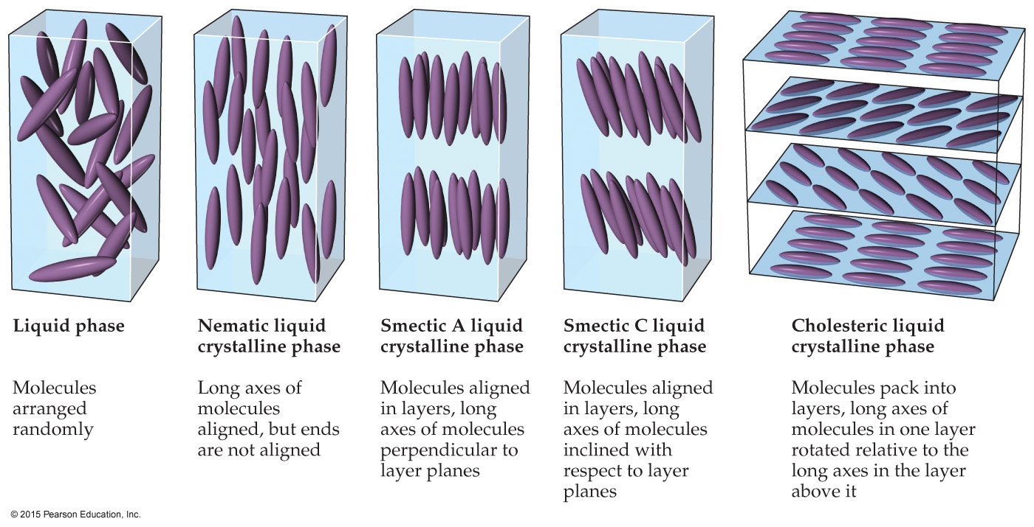
Liquid Crystals
In nematic liquid crystals, molecules are only ordered in one dimension, along the long axis.
In smectic liquid crystals, molecules are ordered in two dimensions, along the long axis and in layers.
In cholesteryic liquid crystals, nematic-like crystals are layered at angles to each other.

