Slide 1
Lecture Presentation
Chapter 6 Electronic Structure of Atoms
James F. Kirby
Quinnipiac University
Hamden, CT

Slide 2
Electronic Structure
This chapter is all about electronic structure—the arrangement and energy of electrons.
It may seem odd to start by talking about waves. However, extremely small particles have properties that can only be explained in this manner!

Slide 3
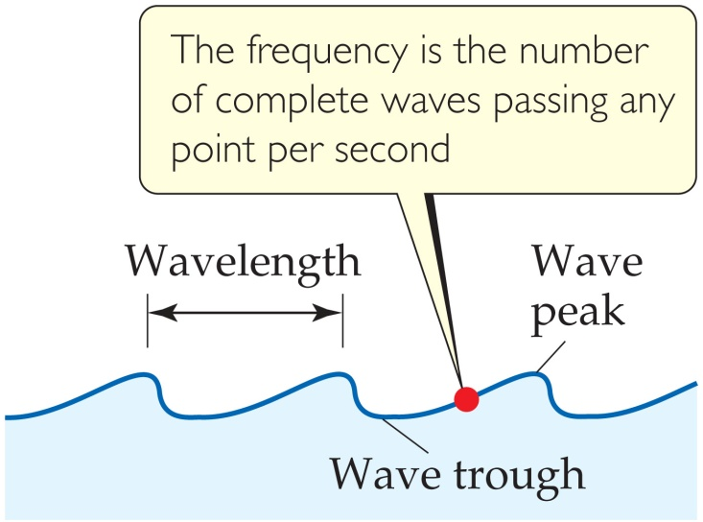
Waves
To understand the electronic structure of atoms, one must understand the nature of electromagnetic radiation.
The distance between corresponding points on adjacent waves is the wavelength (λ).

Slide 4
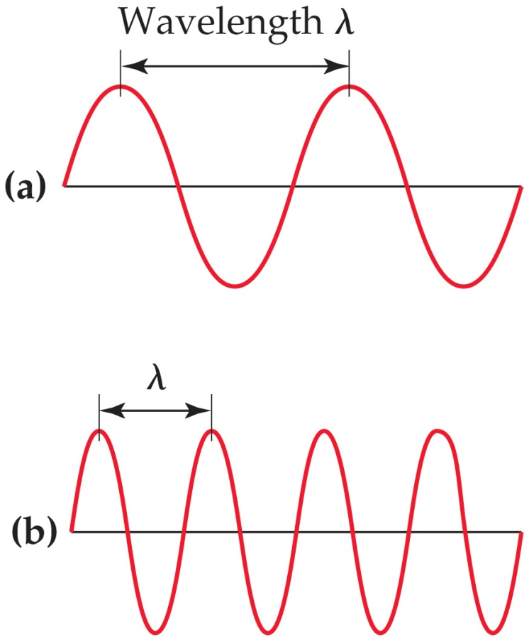
Waves
The number of waves passing a given point per unit of time is the frequency (ν).
For waves traveling at the same velocity, the longer the wavelength, the smaller the frequency.
If the time associated with the lines to the left is one second, then the frequencies would be 2 s^{–1} and 4 s^{–1}, respectively.

Slide 5
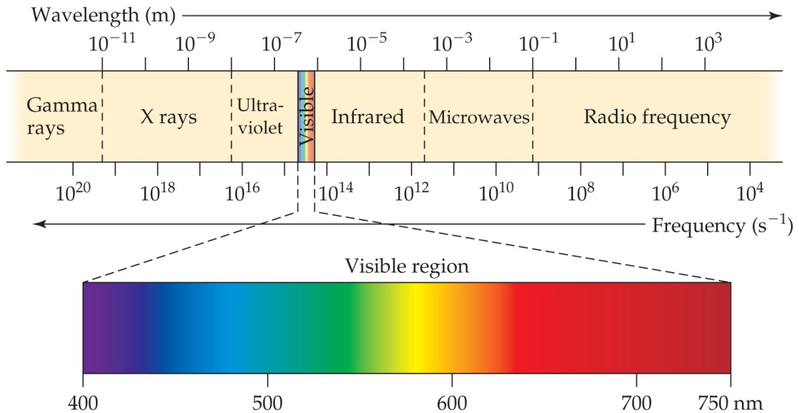
Electromagnetic Radiation
All electromagnetic radiation travels at the same velocity: The speed of light (c) is 3.00 × 10⁸ m/s.
c = λν

Slide 6
The Nature of Energy
The wave nature of light does not explain how an object can glow when its temperature increases.

Slide 7
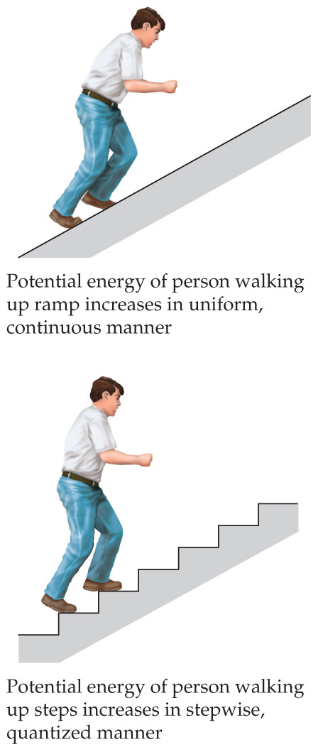
The Nature of Energy—Quanta
Max Planck explained it by assuming that energy comes in packets called quanta (singular: quantum).

Slide 8
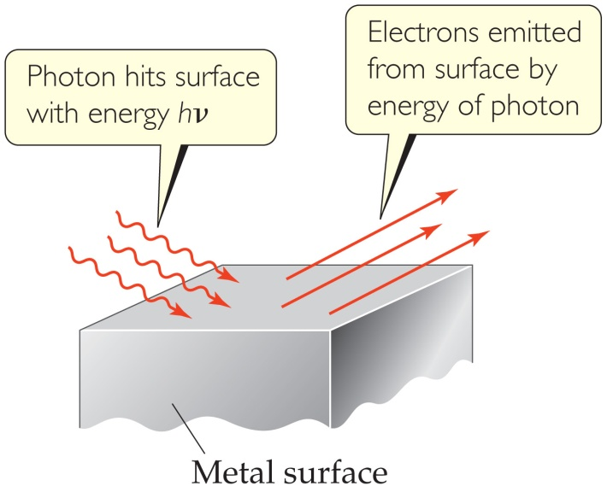
The Photoelectric Effect
Einstein used quanta to explain the photoelectric effect.
Each metal has a different energy at which it ejects electrons. At lower energy, electrons are not emitted.
He concluded that energy is proportional to frequency:
E = hν
where h is Planck’s constant, 6.626 × 10⁻³⁴ J∙s.

Slide 9
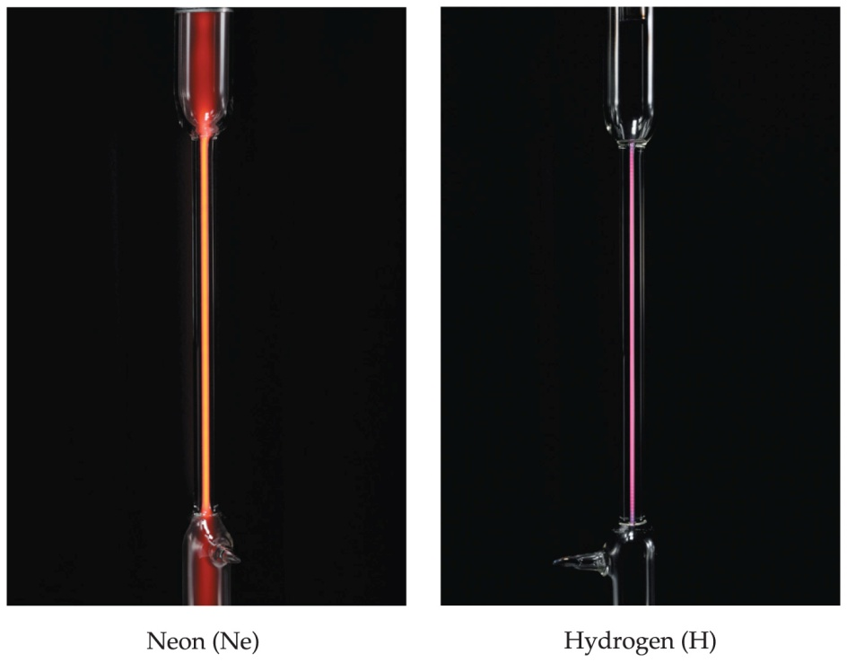
Atomic Emissions
Another mystery in the early twentieth century involved the emission spectra observed from energy emitted by atoms and molecules.

Slide 10
Continuous vs. Line Spectra
For atoms and molecules, one does not observe a continuous spectrum (the “rainbow”), as one gets from a white light source.
Only a line spectrum of discrete wavelengths is observed. Each element has a unique line spectrum.

Slide 11
The Hydrogen Spectrum
Johann Balmer (1885) discovered a simple formula relating the four lines to integers.
Johannes Rydberg advanced this formula.
Neils Bohr explained why this mathematical relationship works.

Slide 12
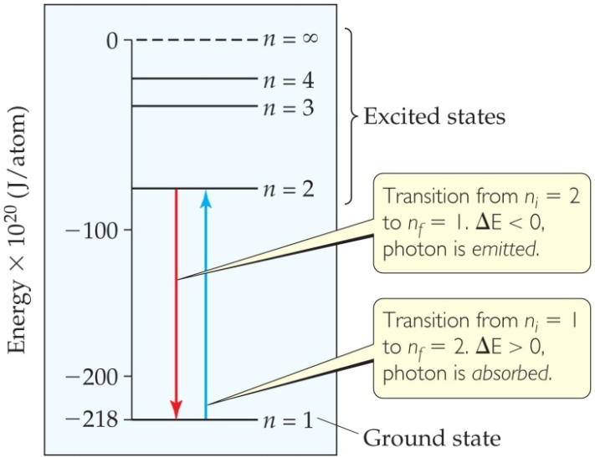
The Bohr Model
Niels Bohr adopted Planck’s assumption and explained these phenomena in this way:
Electrons in an atom can only occupy certain orbits (corresponding to certain energies).

Slide 13
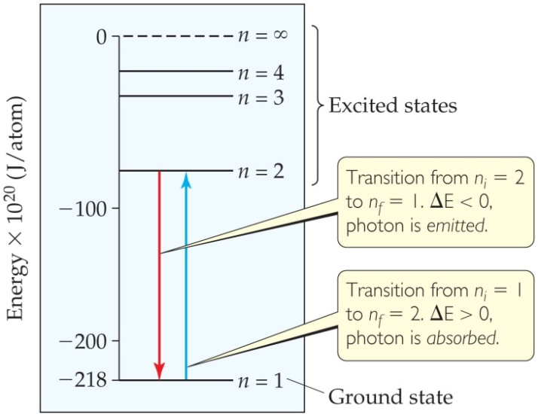
The Bohr Model
Electrons in permitted orbits have specific, “allowed” energies; these energies will not be radiated from the atom.
Energy is only absorbed or emitted in such a way as to move an electron from one “allowed” energy state to another; the energy is defined by
E = hν

Slide 14
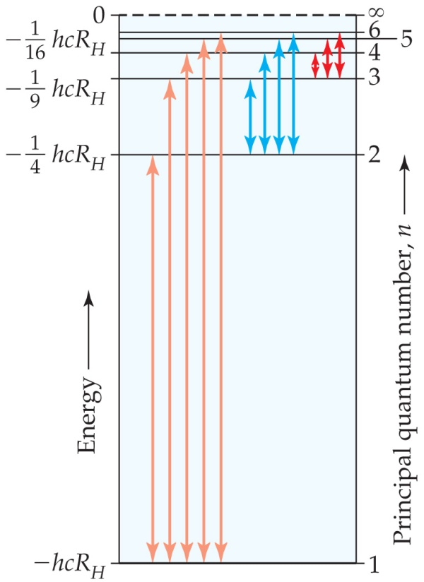
The Bohr Model
The energy absorbed or emitted from the process of electron promotion or demotion can be calculated by the equation
1
n_{f}²
1
n_{i}²
( )
ΔE = −hcR_{H}
–
where R_{H} is the Rydberg constant, 1.097 × 10⁷ m⁻¹, and n_{i} and n_{f} are the initial and final energy levels of the electron.

Slide 15
Limitations of the Bohr Model
It only works for hydrogen!
Classical physics would result in an electron falling into the positively charged nucleus. Bohr simply assumed it would not!
Circular motion is not wave-like in nature.

Slide 16
Important Ideas from the Bohr Model
Points that are incorporated into the current atomic model include the following:
Electrons exist only in certain discrete
energy levels.
2) Energy is involved in the transition of
an electron from one level to another.

Slide 17
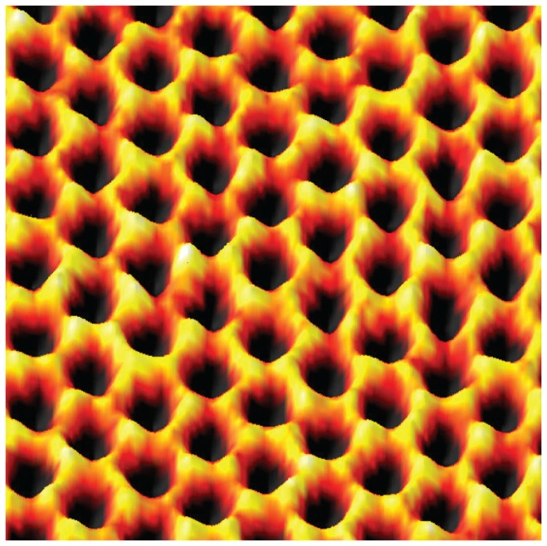
The Wave Nature of Matter
Louis de Broglie theorized that if light can have material properties, matter should exhibit wave properties.
He demonstrated that the relationship between mass and wavelength was
h
mv
λ =
The wave nature of light is used to produce this electron micrograph.

Slide 18
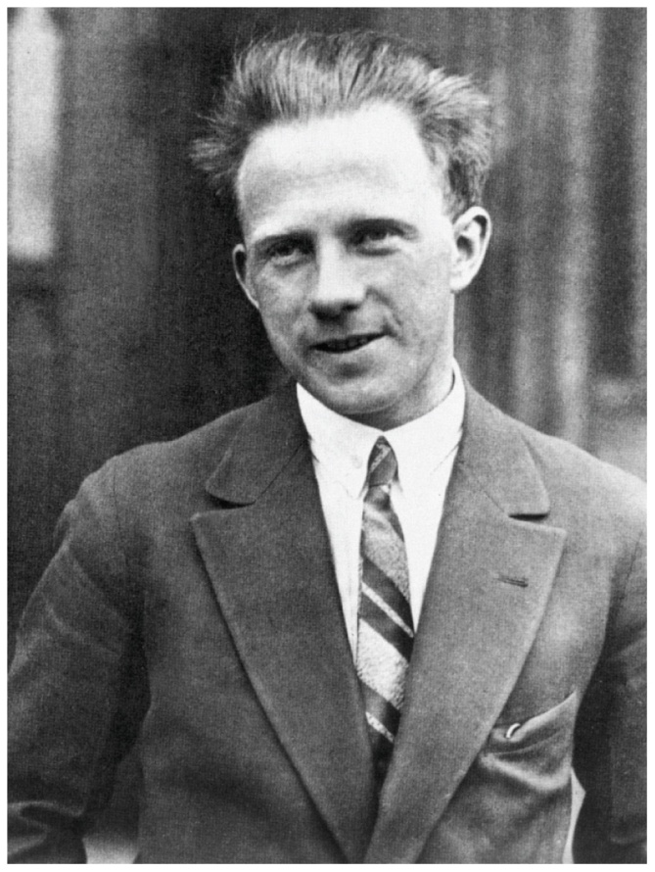
The Uncertainty Principle
Heisenberg showed that the more precisely the momentum of a particle is known, the less precisely is its position is known:
h
4π
(Δx) (Δmv) ≥

Slide 19
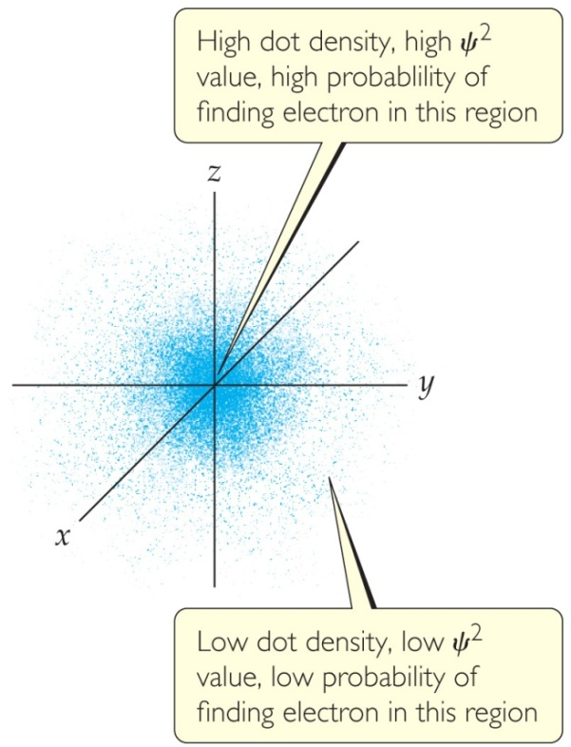
Quantum Mechanics
Erwin Schrödinger developed a mathematical treatment into which both the wave and particle nature of matter could be incorporated.
This is known as quantum mechanics.

Slide 20
Quantum Mechanics
The solution of Schrödinger’s wave equation is designated with a lowercase Greek psi (ψ).
The square of the wave equation, ψ², gives the electron density, or probability of where an electron is likely to be at any given time.

Slide 21
Quantum Numbers
Solving the wave equation gives a set of wave functions, or orbitals, and their corresponding energies.
Each orbital describes a spatial distribution of electron density.
An orbital is described by a set of three quantum numbers.

Slide 22
Principal Quantum Number (n)
The principal quantum number, n, describes the energy level on which the orbital resides.
The values of n are integers ≥ 1.
These correspond to the values in the Bohr model.

Slide 23
Angular Momentum Quantum Number (l)
This quantum number defines the shape of the orbital.
Allowed values of l are integers ranging from 0 to n − 1.
We use letter designations to communicate the different values of l and, therefore, the shapes and types of orbitals.

Slide 24
Angular Momentum Quantum Number (l)

Slide 25
Magnetic Quantum Number (m_{l})
The magnetic quantum number describes the three-dimensional orientation of the orbital.
Allowed values of m_{l} are integers ranging from −l to l:
−l ≤ m_{l} ≤ l
Therefore, on any given energy level, there can be up to 1 s orbital, 3 p orbitals, 5 d orbitals, 7 f orbitals, and so forth.

Slide 26
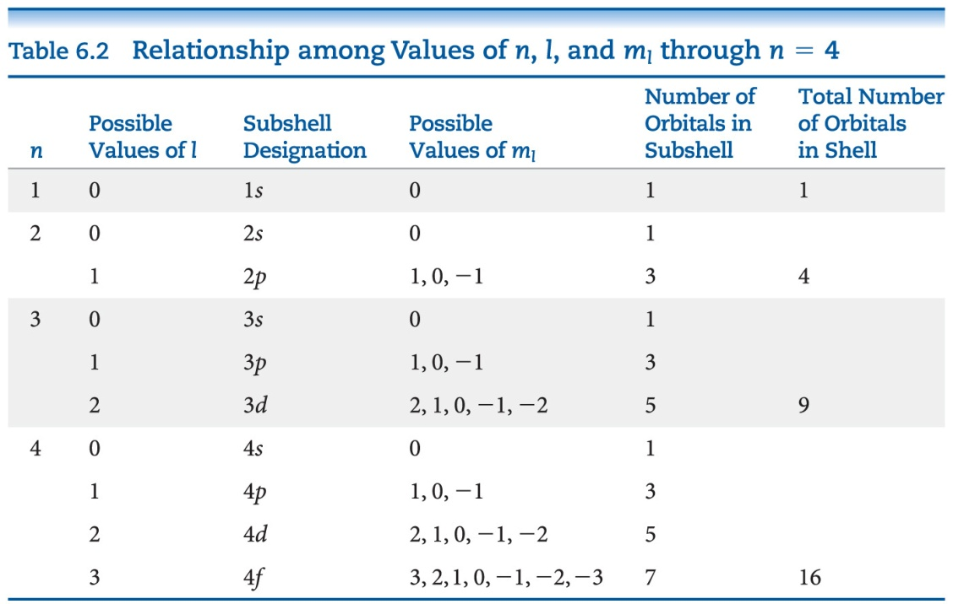
Magnetic Quantum Number (m_{l})
Orbitals with the same value of n form an electron shell.
Different orbital types within a shell are subshells.

Slide 27
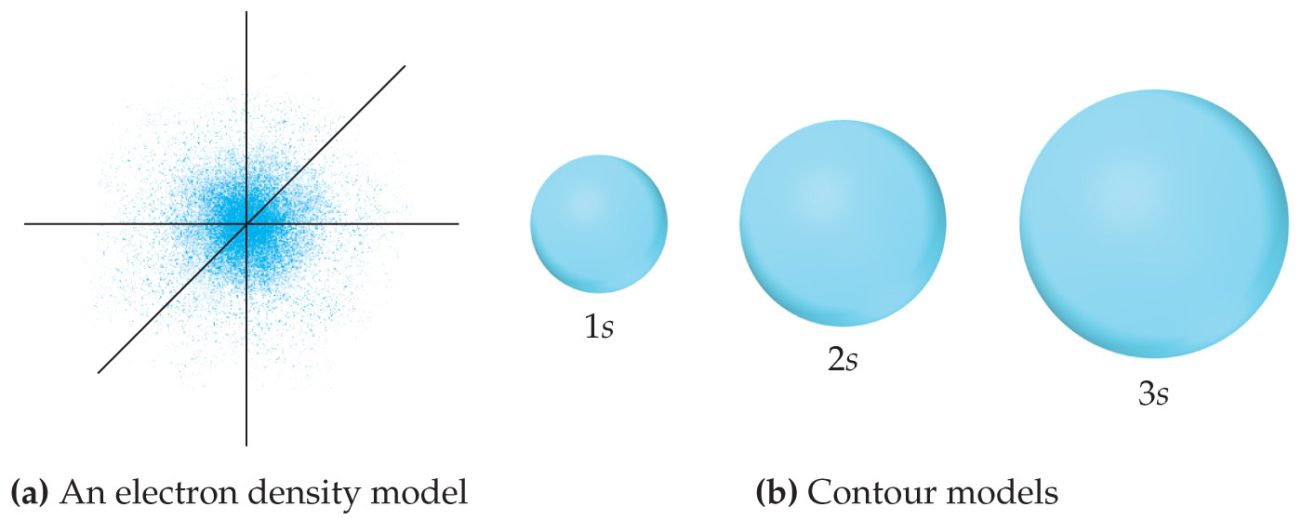
s Orbitals
The value of l for s orbitals is 0.
They are spherical in shape.
The radius of the sphere increases with the value of n.

Slide 28
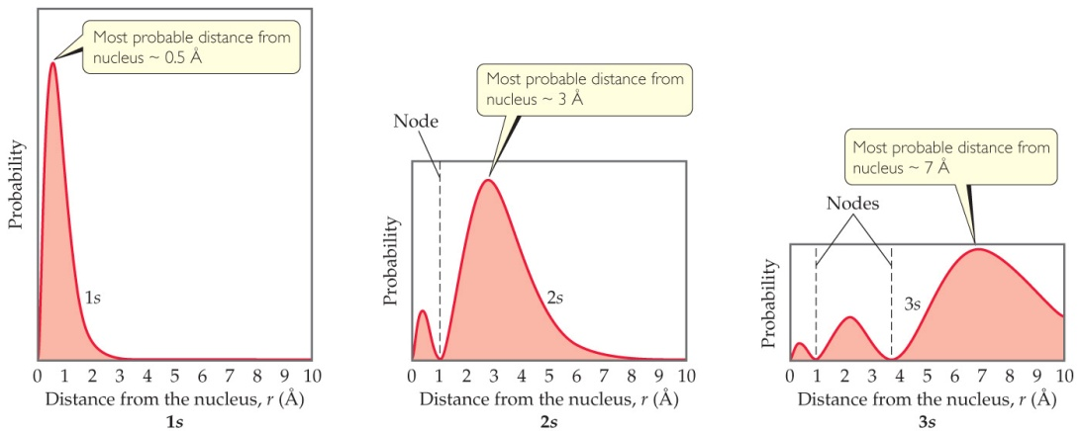
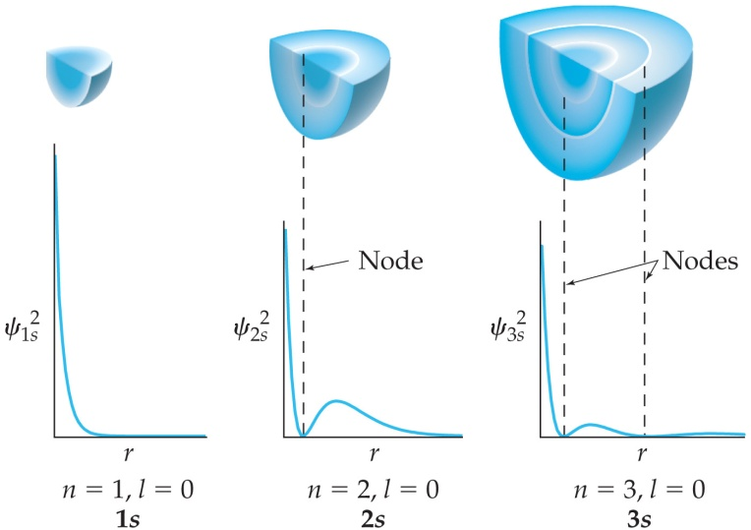
s Orbitals
For an ns orbital, the number of peaks is n.
For an ns orbital, the number of nodes (where there is zero probability of finding an electron) is n – 1.
As n increases, the electron density is more spread out and there is a greater probability of finding an electron further from the nucleus.

Slide 29
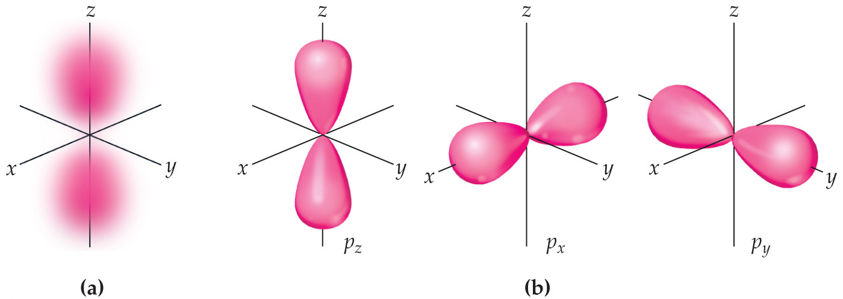
p Orbitals
The value of l for p orbitals is 1.
They have two lobes with a node between them.

Slide 30
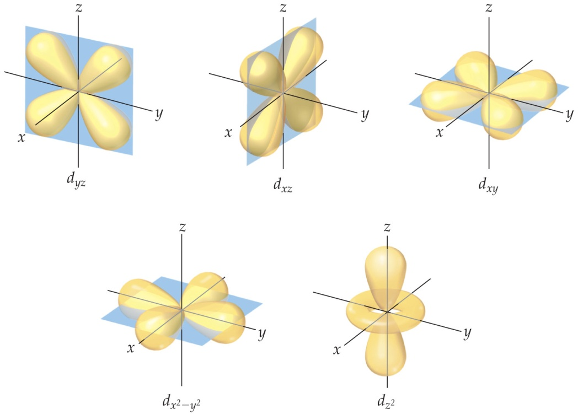
d Orbitals
The value of l for a d orbital is 2.
Four of the five d orbitals have four lobes; the other resembles a p orbital with a doughnut around the center.

Slide 31
f Orbitals
Very complicated shapes (not shown in text)
Seven equivalent orbitals in a sublevel
l = 3

Slide 32
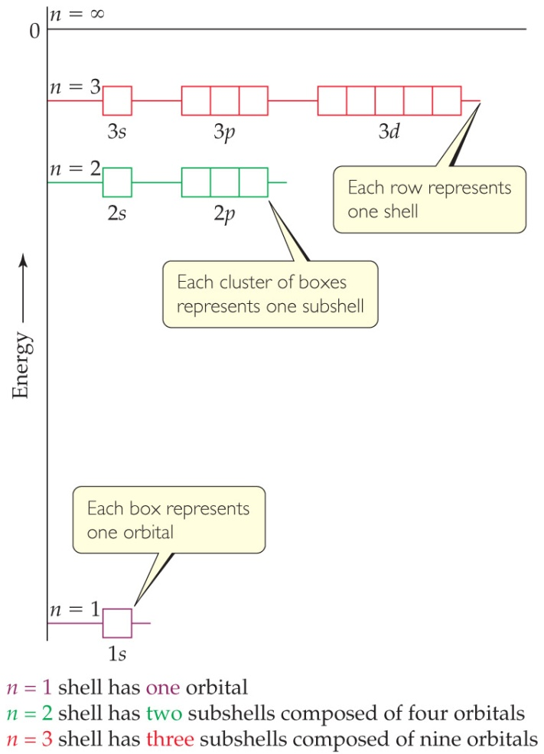
Energies of Orbitals—Hydrogen
For a one-electron hydrogen atom, orbitals on the same energy level have the same energy.
Chemists call them degenerate orbitals.

Slide 33
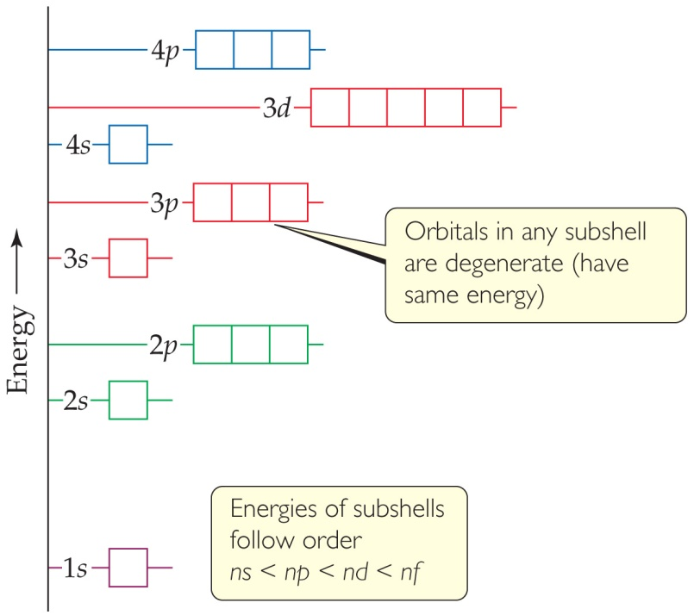
Energies of Orbitals— Many-electron Atoms
As the number of electrons increases, so does the repulsion between them.
Therefore, in atoms with more than one electron, not all orbitals on the same energy level are degenerate.
Orbital sets in the same sublevel are still degenerate.
Energy levels start to overlap in energy (e.g., 4s is lower in energy than 3d.)

Slide 34
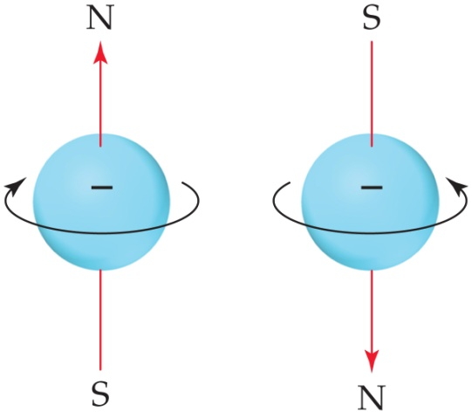
Spin Quantum Number, m_{s}
In the 1920s, it was discovered that two electrons in the same orbital do not have exactly the same energy.
The “spin” of an electron describes its magnetic field, which affects its energy.
This led to the spin quantum number, m_{s}.
The spin quantum number has only two allowed values, +½ and –½.

Slide 35
Pauli Exclusion Principle
No two electrons in the same atom can have exactly the same energy.
Therefore, no two electrons in the same atom can have identical sets of quantum numbers.
This means that every electron in an atom must differ by at least one of the four quantum number values: n, l, m_{l}, and m_{s}.

Slide 36
Electron Configurations
The way electrons are distributed in an atom is called its electron configuration.
The most stable organization is the lowest possible energy, called the ground state.
Each component consists of
a number denoting the energy level;
4p⁵

Slide 37
Electron Configurations
The way electrons are distributed in an atom is called its electron configuration.
The most stable organization is the lowest possible energy, called the ground state.
Each component consists of
a number denoting the energy level;
a letter denoting the type of orbital;
4p⁵

Slide 38
Electron Configurations
The way electrons are distributed in an atom is called its electron configuration.
The most stable organization is the lowest possible energy, called the ground state.
Each component consists of
a number denoting the energy level;
a letter denoting the type of orbital;
a superscript denoting the number of electrons in those orbitals.
4p⁵

Slide 39
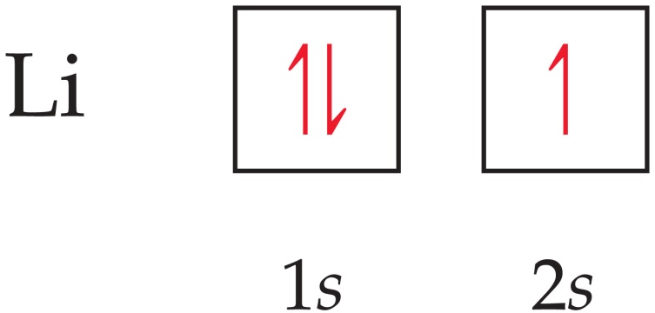
Orbital Diagrams
Each box in the diagram represents one orbital.
Half-arrows represent the electrons.
The direction of the arrow represents the relative spin of the electron.

Slide 40
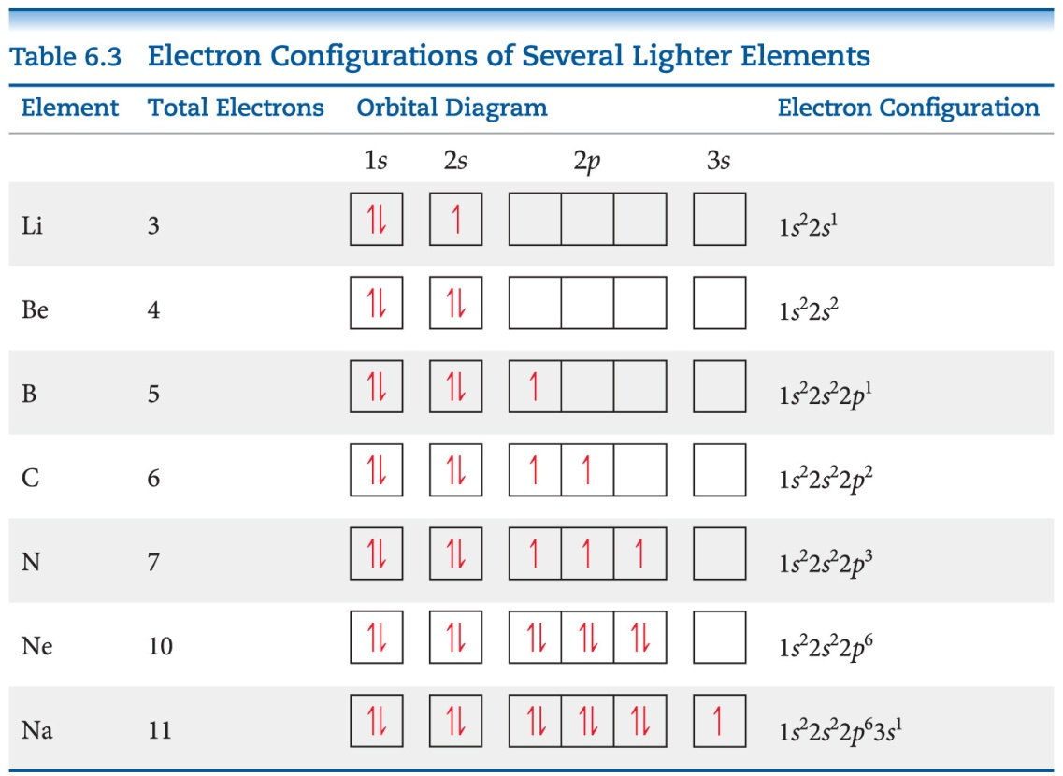
Hund’s Rule
“For degenerate orbitals, the lowest energy is attained when the number of electrons with the same spin is maximized.”
This means that, for a set of orbitals in the same sublevel, there must be one electron in each orbital before pairing and the electrons have the same spin, as much as possible.

Slide 41
Condensed Electron Configurations
Elements in the same group of the periodic table have the same number of electrons in the outer most shell. These are the valence electrons.
The filled inner shell electrons are called core electrons. These include completely filled d or f sublevels.
We write a shortened version of an electron configuration using brackets around a noble gas symbol and listing only valence electrons.

Slide 42
Periodic Table
We fill orbitals in increasing order of energy.
Different blocks on the periodic table correspond to different types of orbitals: s = blue, p = pink (s and p are representative elements); d = orange (transition elements); f = tan (lanthanides and actinides, or inner transition elements)

Slide 43
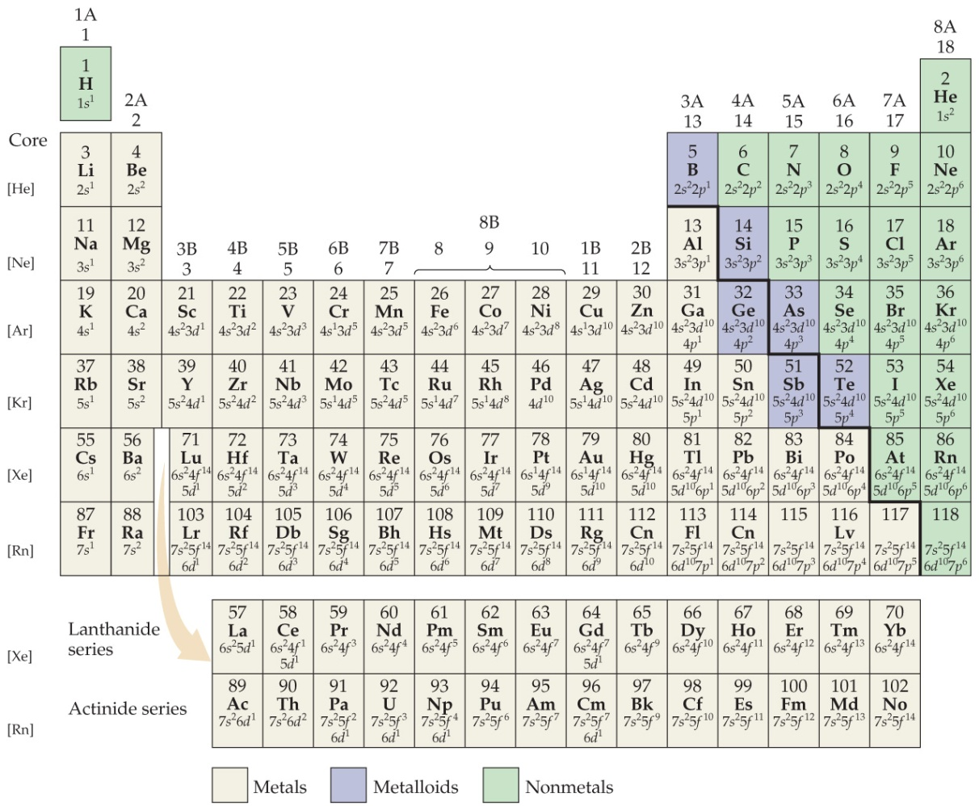
Some Anomalies
Some irregularities occur when there are enough electrons to half-fill s and d orbitals on a given row.

Slide 44
Chromium as an Anomaly
For instance, the electron configuration for chromium is
[Ar] 4s¹ 3d⁵
rather than the expected
[Ar] 4s² 3d⁴.
This occurs because the 4s and 3d orbitals are very close in energy.
These anomalies occur in f-block atoms with f and d orbitals, as well.

