Slide 1
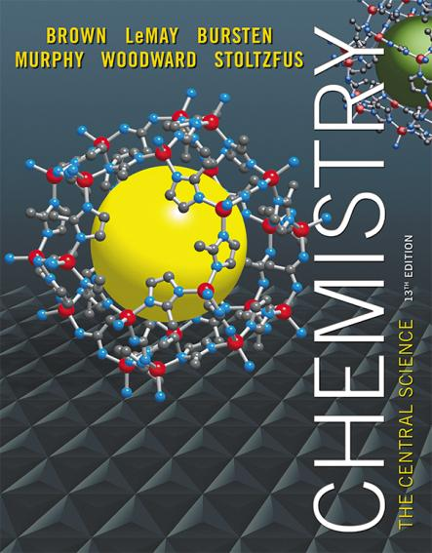
Lecture Presentation
Chapter 5 Thermochemistry
James F. Kirby
Quinnipiac University
Hamden, CT

Slide 2
Energy
Energy is the ability to do work or transfer heat.
Energy used to cause an object that has mass to move is called work.
Energy used to cause the temperature of an object to rise is called heat.
This chapter is about thermodynamics, which is the study of energy transformations, and thermochemistry, which applies the field to chemical reactions, specifically.

Slide 3
Kinetic Energy
Kinetic energy is energy an object possesses by virtue of its motion:

Slide 4
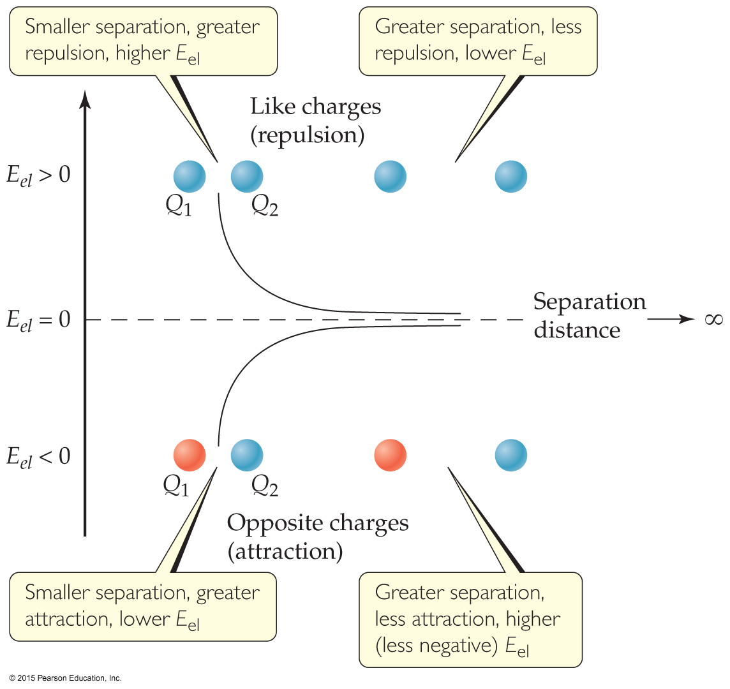
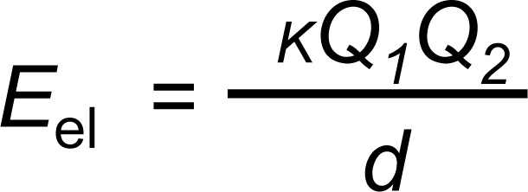
Potential Energy
Potential energy is energy an object possesses by virtue of its position or chemical composition.
The most important form of potential energy in molecules is electrostatic potential energy, E_{el}:

Slide 5
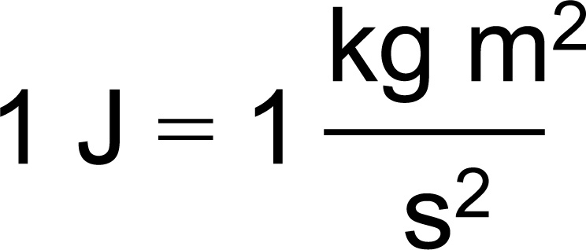
Units of Energy
The SI unit of energy is the joule (J):
An older, non-SI unit is still in widespread use, the calorie (cal):
1 cal = 4.184 J
(Note: this is not the same as the calorie of foods; the food calorie is 1 kcal!)

Slide 6
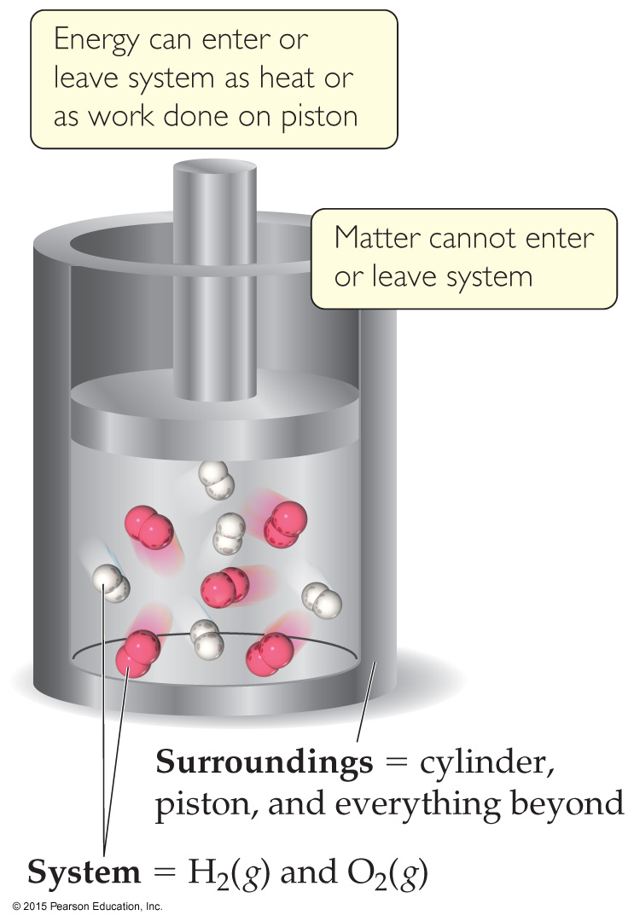
Definitions: System and Surroundings
The system includes the molecules we want to study (here, the hydrogen and oxygen molecules).
The surroundings are everything else (here, the cylinder and piston).

Slide 7
Definitions: Work
Energy used to move an object over some distance is work:
w = F × d
where w is work, F is the force, and d is the distance over which the force is exerted.

Slide 8
Heat
Energy can also be transferred as heat.
Heat flows from warmer objects to cooler objects.

Slide 9
Conversion of Energy
Energy can be converted from one type to another.
The cyclist has potential energy as she sits on top of the hill.
As she coasts down the hill, her potential energy is converted to kinetic energy until the bottom, where the energy is converted to kinetic energy.

Slide 10
First Law of Thermodynamics
Energy is neither created nor destroyed.
In other words, the total energy of the universe is a constant; if the system loses energy, it must be gained by the surroundings, and vice versa.

Slide 11
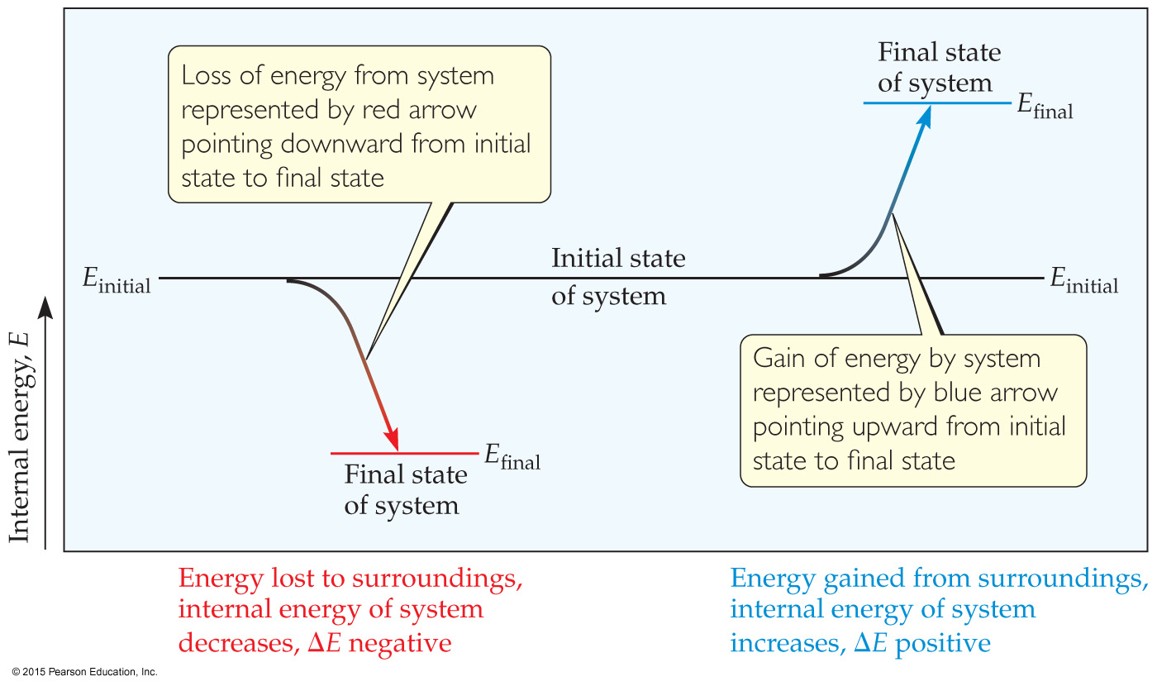
Internal Energy
The internal energy of a system is the sum of all kinetic and potential energies of all components of the system; we call it E.

Slide 12
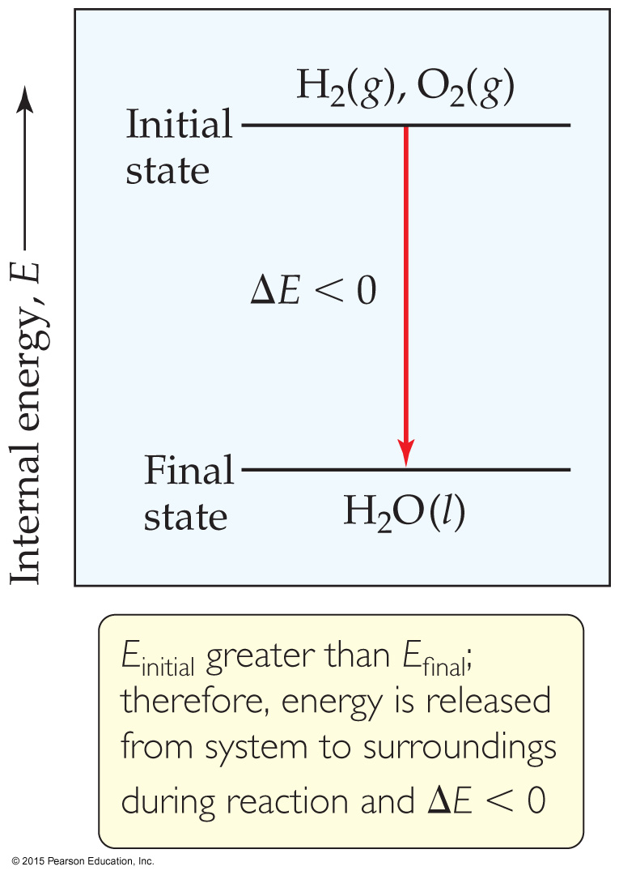
Internal Energy
By definition, the change in internal energy, ΔE, is the final energy of the system minus the initial energy of the system:
ΔE = E_{final} − E_{initial}

Slide 13
Changes in Internal Energy
If ΔE > 0, E_{final} > E_{initial}
Therefore, the system absorbed energy from the surroundings.
This energy change is called endergonic.

Slide 14
Changes in Internal Energy
If ΔE < 0, E_{final} < E_{initial}
Therefore, the system released energy to the surroundings.
This energy change is called exergonic.

Slide 15
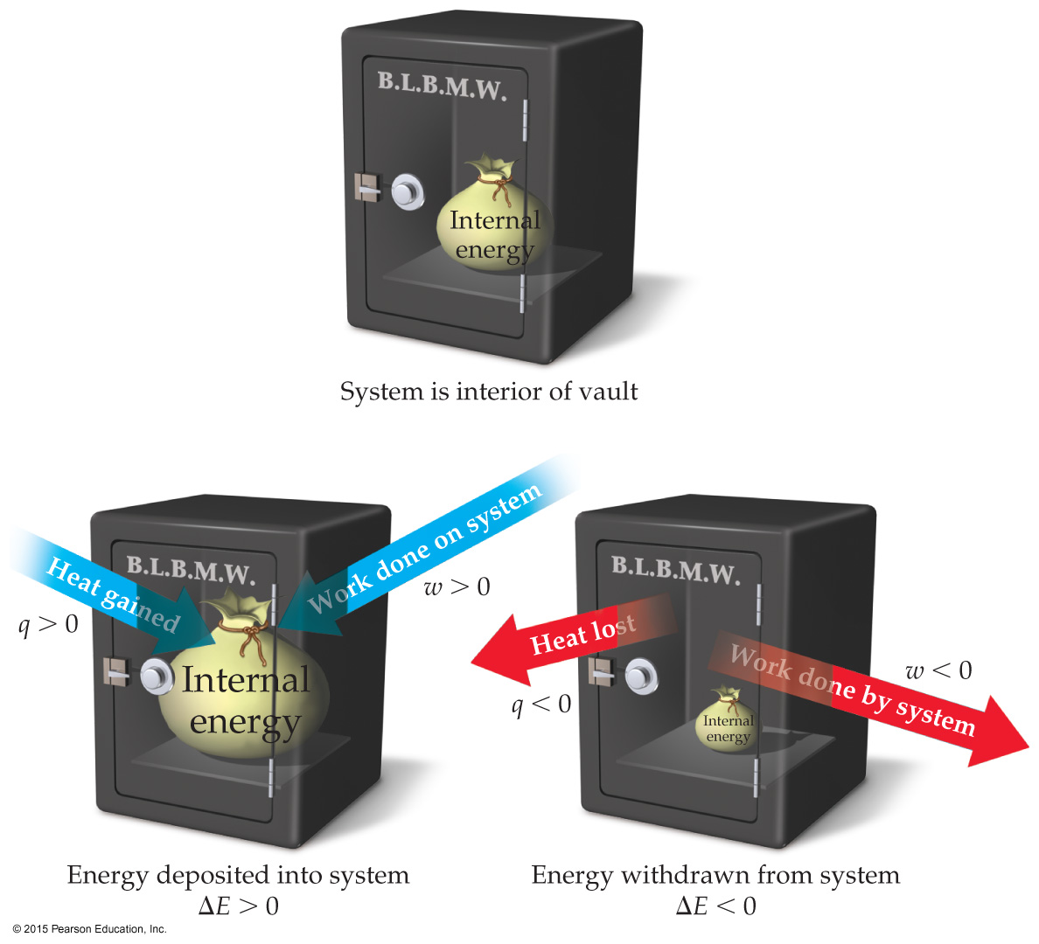
Changes in Internal Energy
When energy is exchanged between the system and the surroundings, it is exchanged as either heat (q) or work (w).
That is, ΔE = q + w.

Slide 16
ΔE, q, w, and Their Signs

Slide 17
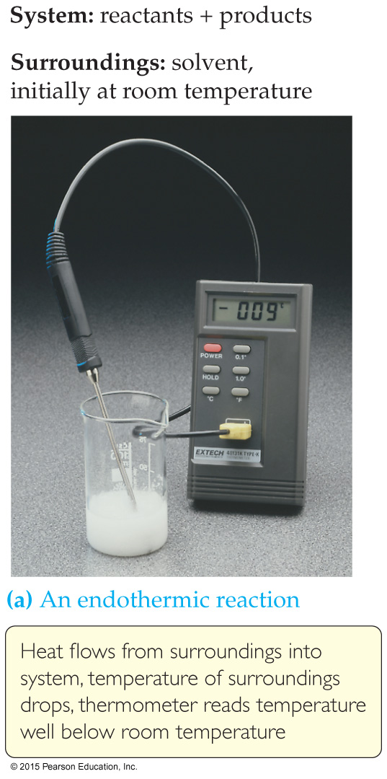
Exchange of Heat between System and Surroundings
When heat is absorbed by the system from the surroundings, the process is endothermic.

Slide 18
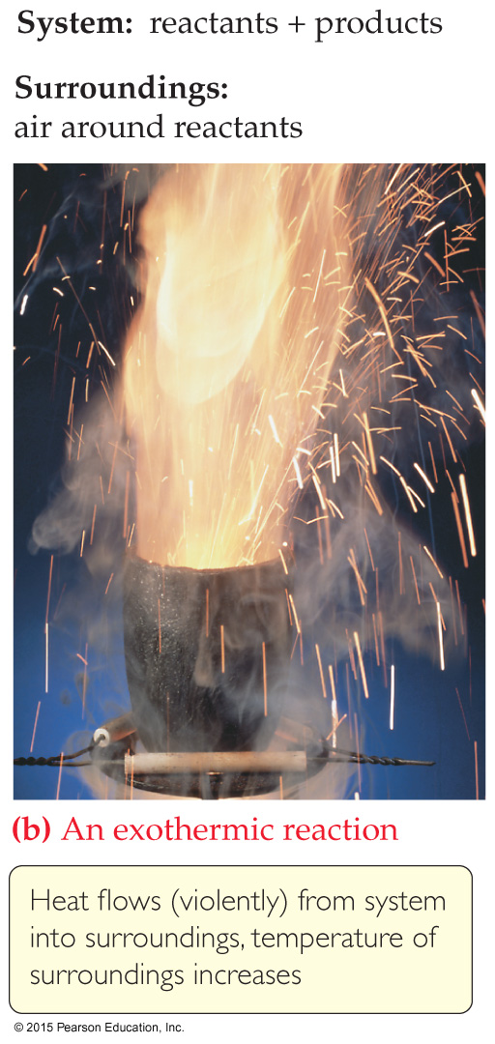
Exchange of Heat between System and Surroundings
When heat is released by the system into the surroundings, the process is exothermic.

Slide 19
State Functions
Usually we have no way of knowing the internal energy of a system; finding that value is simply too complex a problem.
However, we do know that the internal energy of a system is independent of the path by which the system achieved that state.
In the system below, the water could have reached room temperature from either direction.

Slide 20
State Functions
Therefore, internal energy is a state function.
It depends only on the present state of the system, not on the path by which the system arrived at that state.
And so, ΔE depends only on E_{initial} and E_{final}.

Slide 21
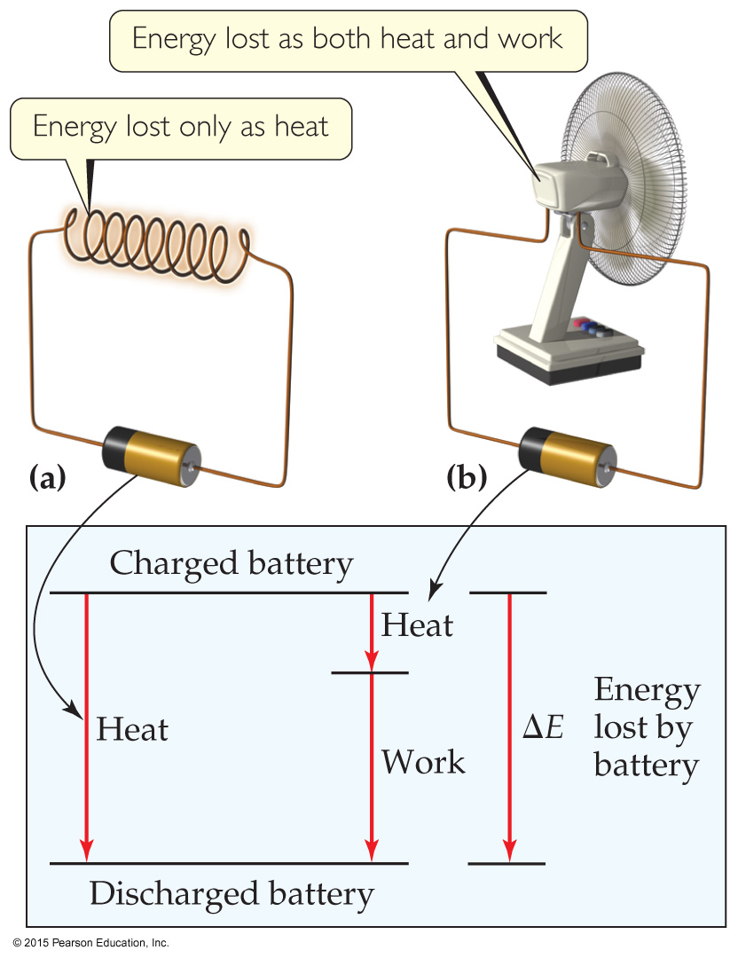
State Functions
However, q and w are not state functions.
Whether the battery is shorted out or is discharged by running the fan, its ΔE is the same.
But q and w are different in the two cases.

Slide 22
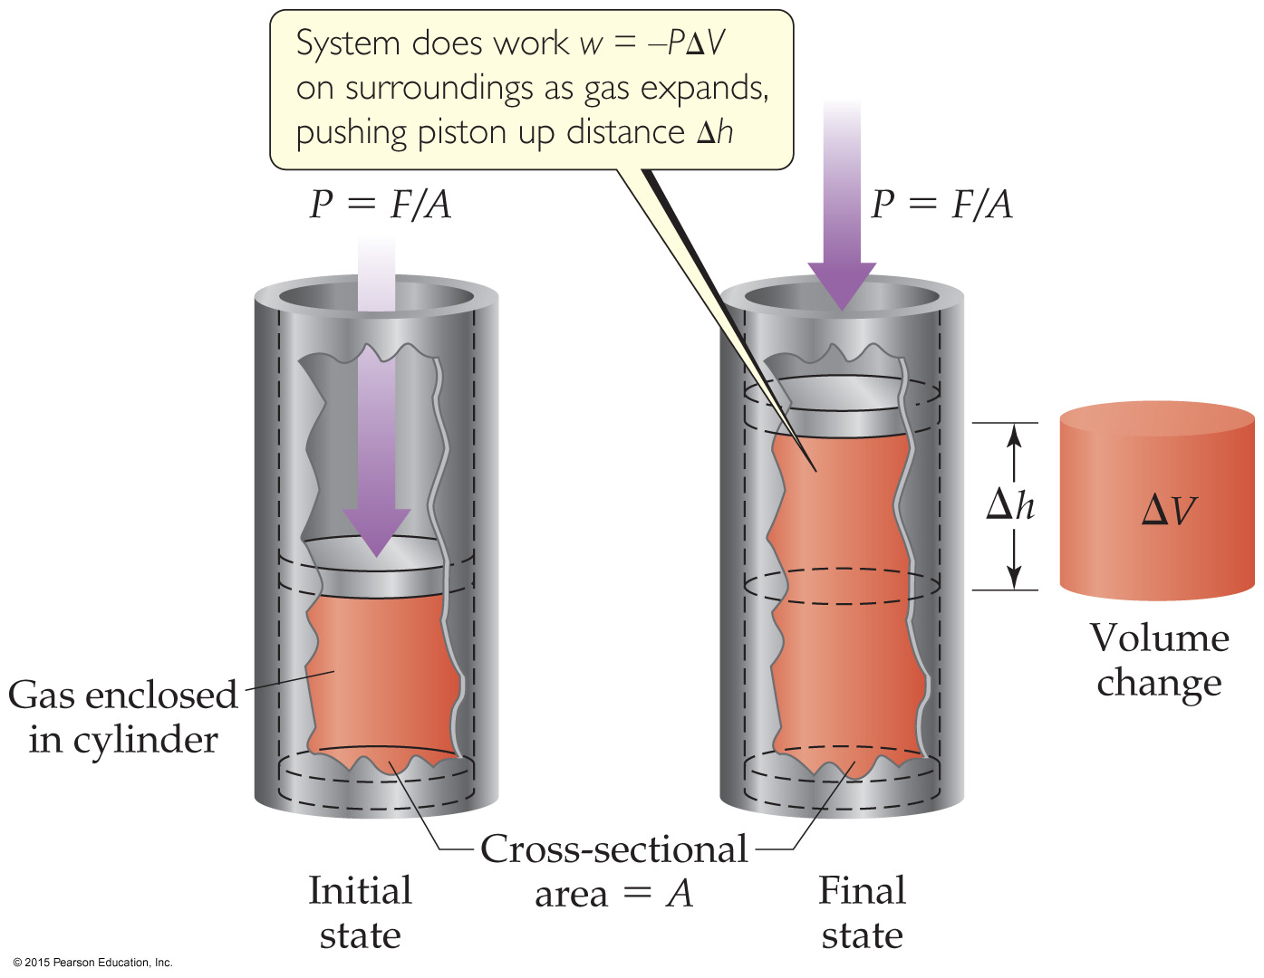
Work
Usually in an open container the only work done is by a gas pushing on the surroundings (or by the surroundings pushing on the gas).

Slide 23
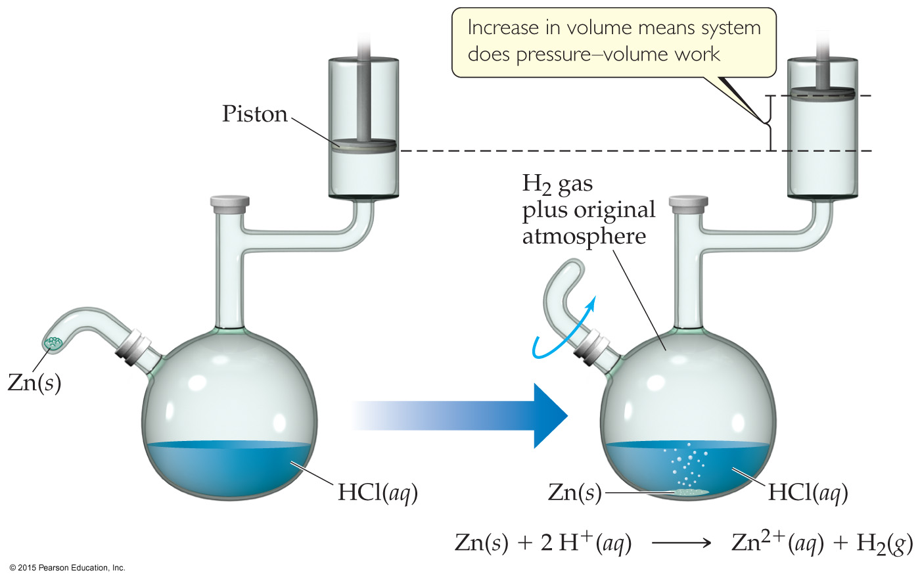
Work
We can measure the work done by the gas if the reaction is done in a vessel that has been fitted with a piston:
w = −PΔV

Slide 24
Enthalpy
If a process takes place at constant pressure (as the majority of processes we study do) and the only work done is this pressure–volume work, we can account for heat flow during the process by measuring the enthalpy of the system.
Enthalpy is the internal energy plus the product of pressure and volume:
H = E + PV

Slide 25
Enthalpy
When the system changes at constant pressure, the change in enthalpy, ΔH, is
ΔH = Δ(E + PV)
This can be written
ΔH = ΔE + PΔV

Slide 26
Enthalpy
Since ΔE = q + w and w = −PΔV, we can substitute these into the enthalpy expression:
ΔH = ΔE + PΔV
ΔH = (q + w) − w
ΔH = q
So, at constant pressure, the change in enthalpy is the heat gained or lost.

Slide 27
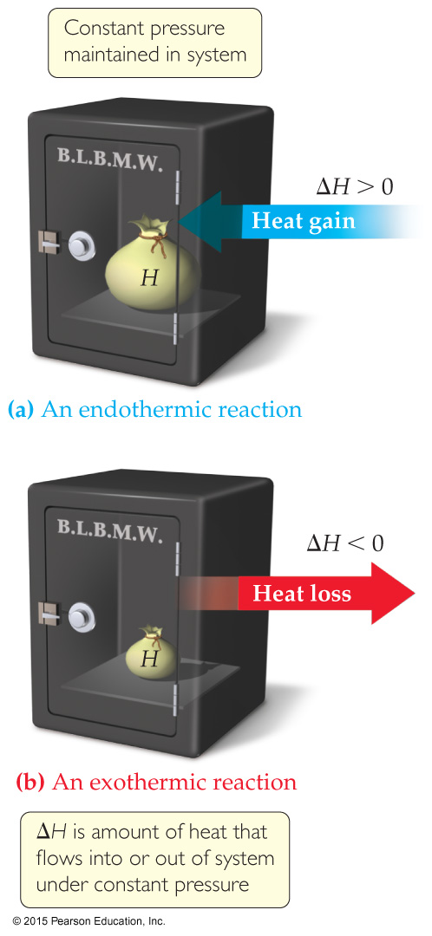
Endothermic and Exothermic
A process is endothermic when ΔH is positive.
A process is exothermic when ΔH is negative.

Slide 28
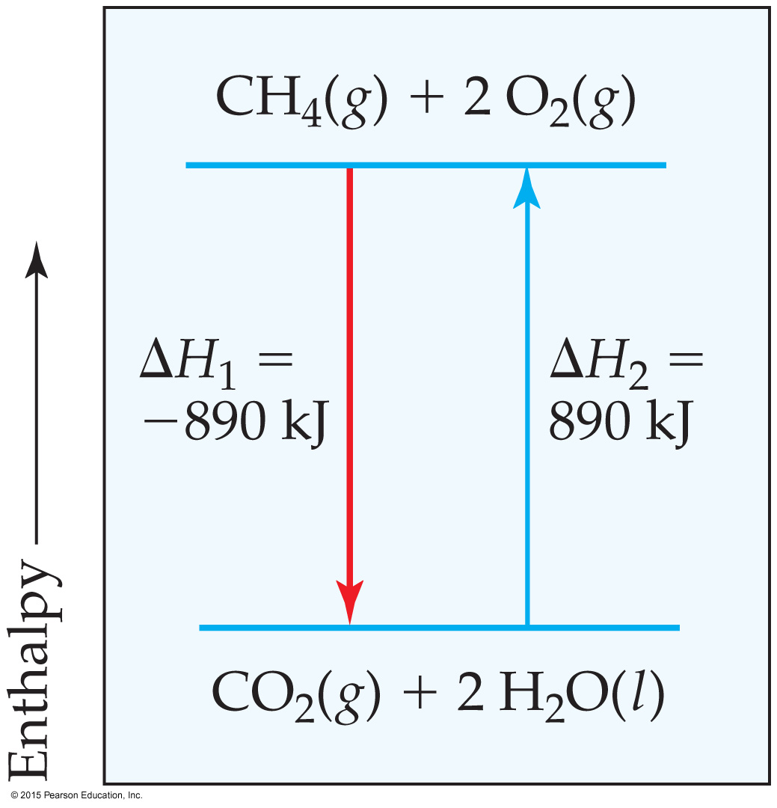
Enthalpy of Reaction
The change in enthalpy, ΔH, is the enthalpy of the products minus the enthalpy of the reactants:
ΔH = H_{products} − H_{reactants}

Slide 29
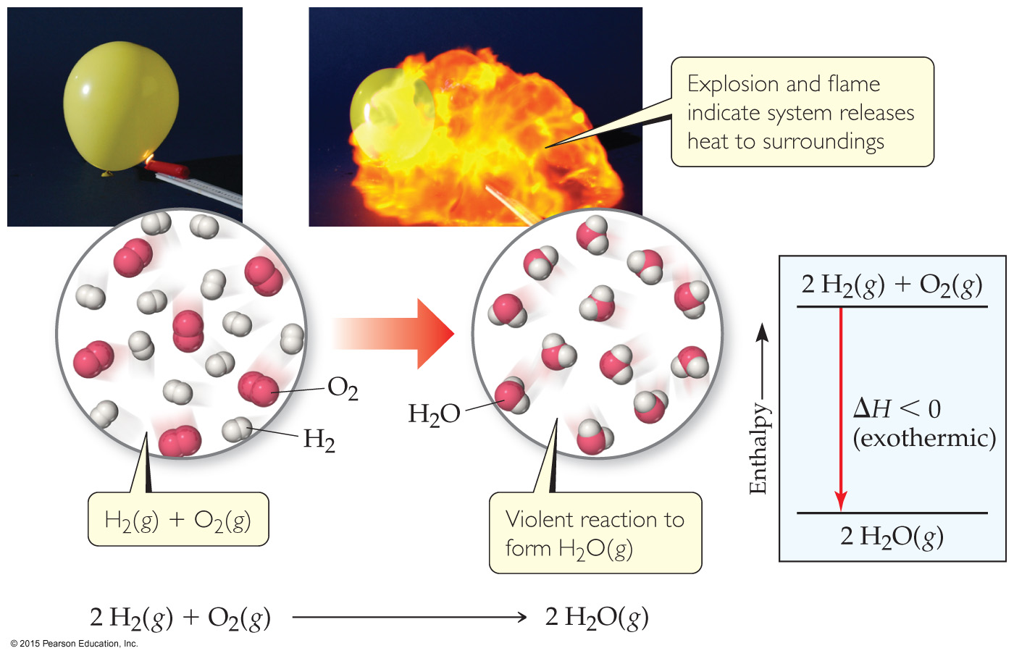
Enthalpy of Reaction
This quantity, ΔH, is called the enthalpy of reaction, or the heat of reaction.

Slide 30
The Truth about Enthalpy
Enthalpy is an extensive property.
ΔH for a reaction in the forward direction is equal in size, but opposite in sign, to ΔH for the reverse reaction.
ΔH for a reaction depends on the state of the products and the state of the reactants.

Slide 31
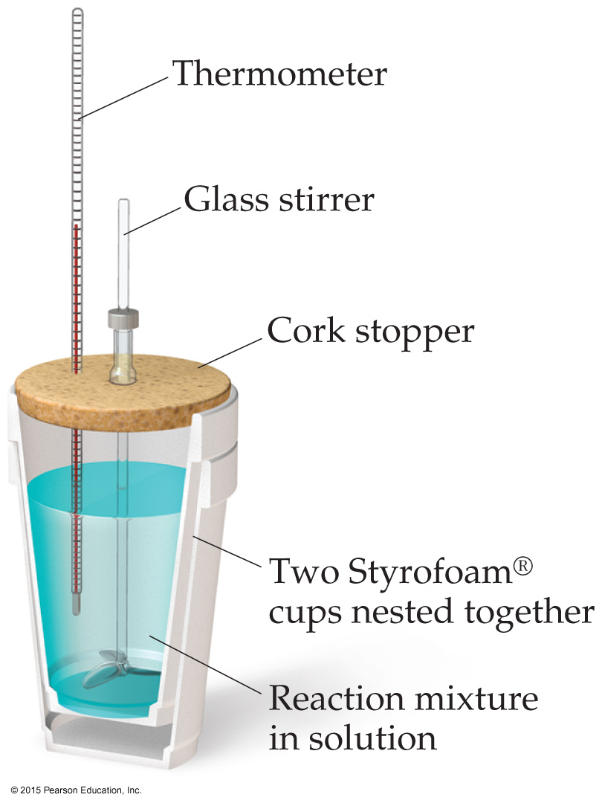
Calorimetry
Since we cannot know the exact enthalpy of the reactants and products, we measure ΔH through calorimetry, the measurement of heat flow.
The instrument used to measure heat flow is called a calorimeter.

Slide 32
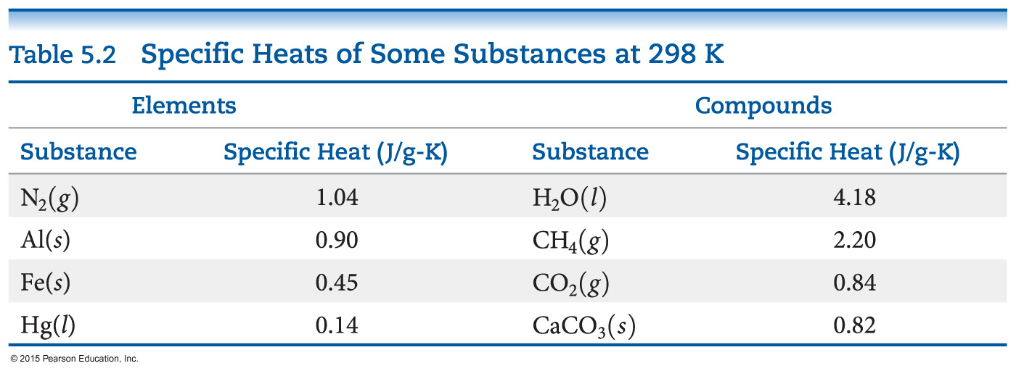
Heat Capacity and Specific Heat
The amount of energy required to raise the temperature of a substance by 1 K (1 °C) is its heat capacity, usually given for one mole of the substance.

Slide 33
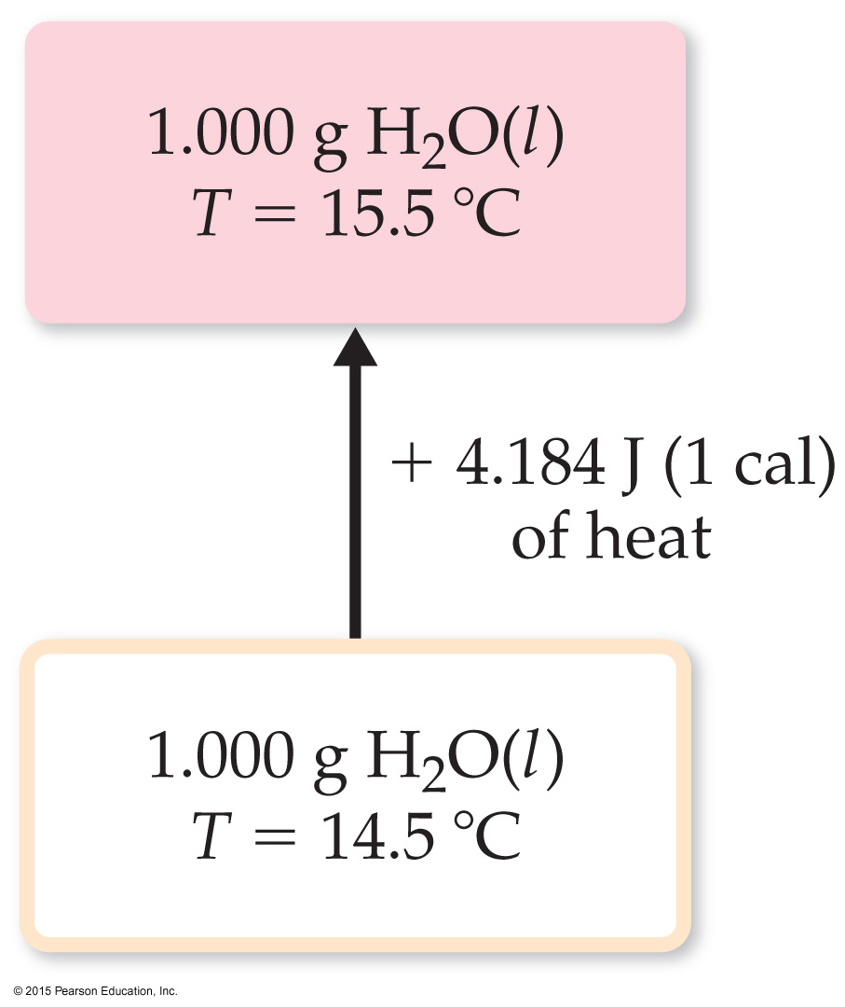
Heat Capacity and Specific Heat
We define specific heat capacity (or simply specific heat) as the amount of energy required to raise the temperature of 1 g of a substance by 1 K (or 1 °C).

Slide 34
Heat Capacity and Specific Heat
Specific heat, then, is

Slide 35
Constant Pressure Calorimetry
By carrying out a reaction in aqueous solution in a simple calorimeter, the heat change for the system can be found by measuring the heat change for the water in the calorimeter.
The specific heat for water is well known (4.184 J/g∙K).
We can calculate ΔH for the reaction with this equation:
q = m × C_{s} × ΔT

Slide 36
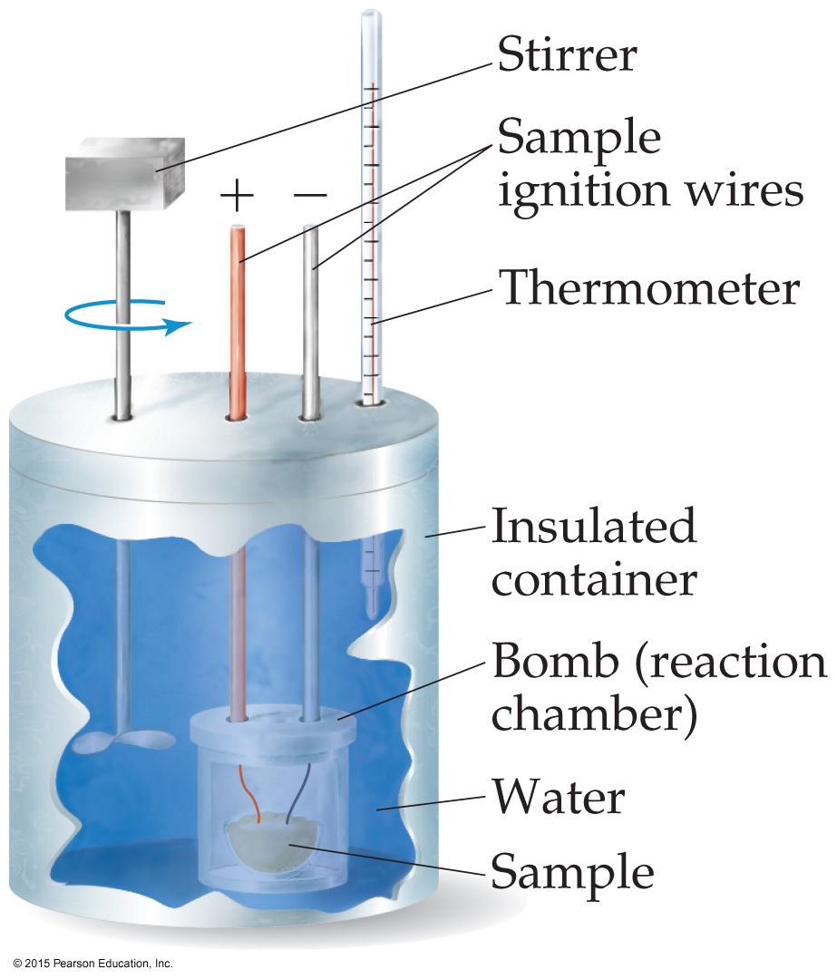
Bomb Calorimetry
Reactions can be carried out in a sealed “bomb” such as this one.
The heat absorbed (or released) by the water is a very good approximation of the enthalpy change for the reaction.
q_{rxn} = – C_{cal} × ∆T

Slide 37
Bomb Calorimetry
Because the volume in the bomb calorimeter is constant, what is measured is really the change in internal energy, ΔE, not ΔH.
For most reactions, the difference is very small.

Slide 38
Hess’s Law
ΔH is well known for many reactions, and it is inconvenient to measure ΔH for every reaction in which we are interested.
However, we can estimate ΔH using published ΔH values and the properties of enthalpy.

Slide 39
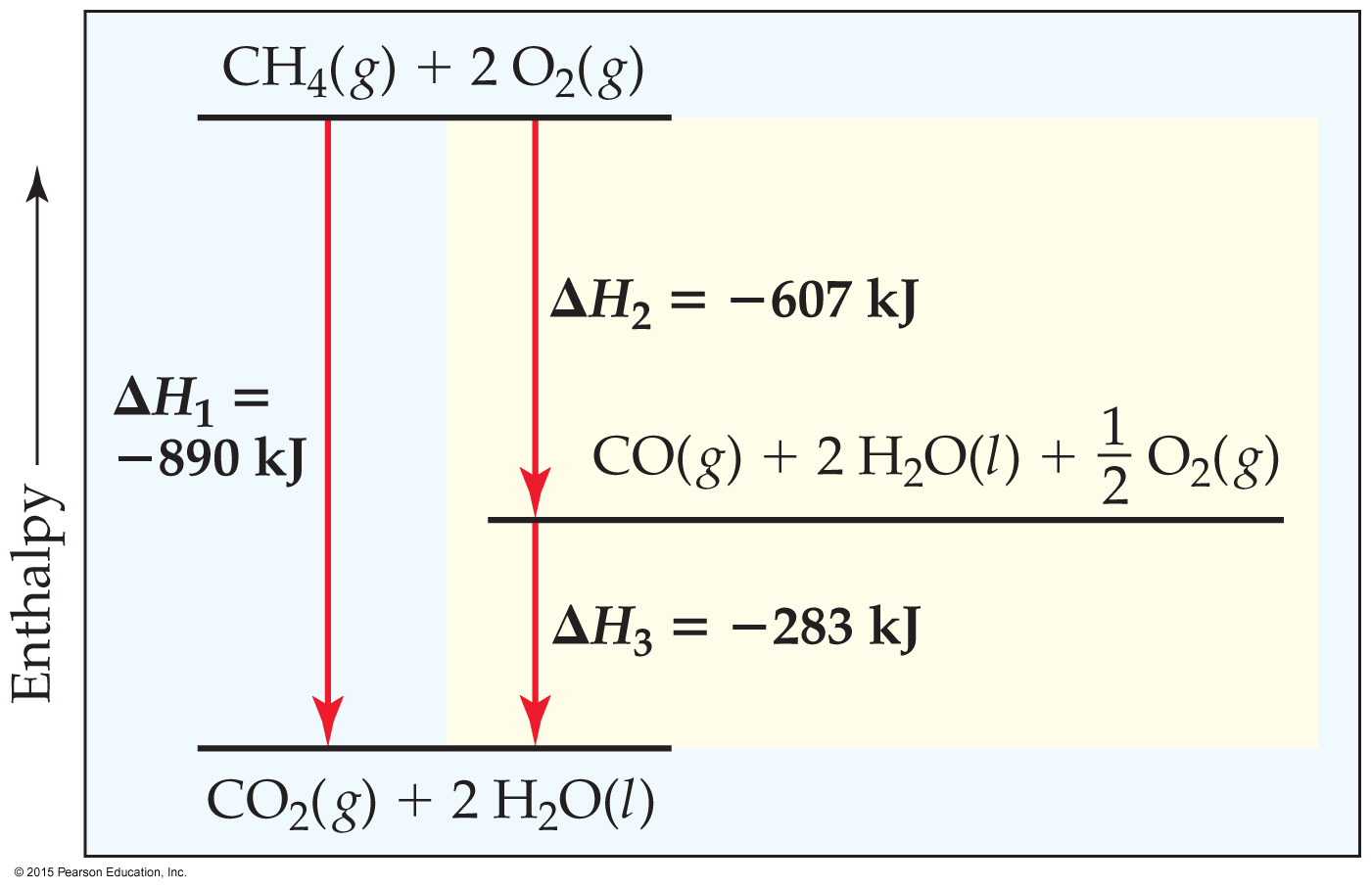
Hess’s Law
Hess’s law: If a reaction is carried out in a series of steps, ΔH for the overall reaction will be equal to the sum of the enthalpy changes for the individual steps.
Because ΔH is a state function, the total enthalpy change depends only on the initial state (reactants) and the final state (products) of the reaction.

Slide 40
Enthalpies of Formation
An enthalpy of formation, ΔH_{f}, is defined as the enthalpy change for the reaction in which a compound is made from its constituent elements in their elemental forms.

Slide 41
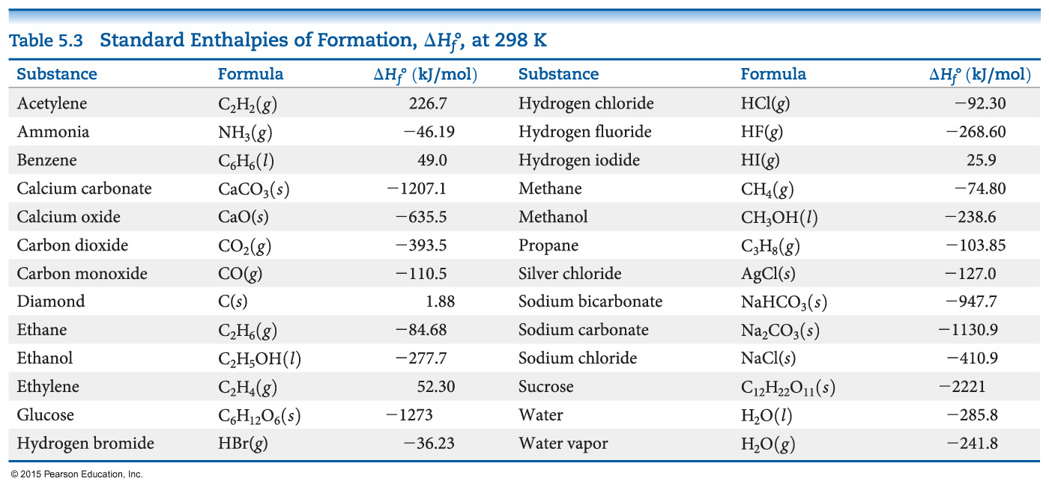
Standard Enthalpies of Formation
Standard enthalpies of formation, ∆H_{f}°, are measured under standard conditions (25 ºC and 1.00 atm pressure).

Slide 42
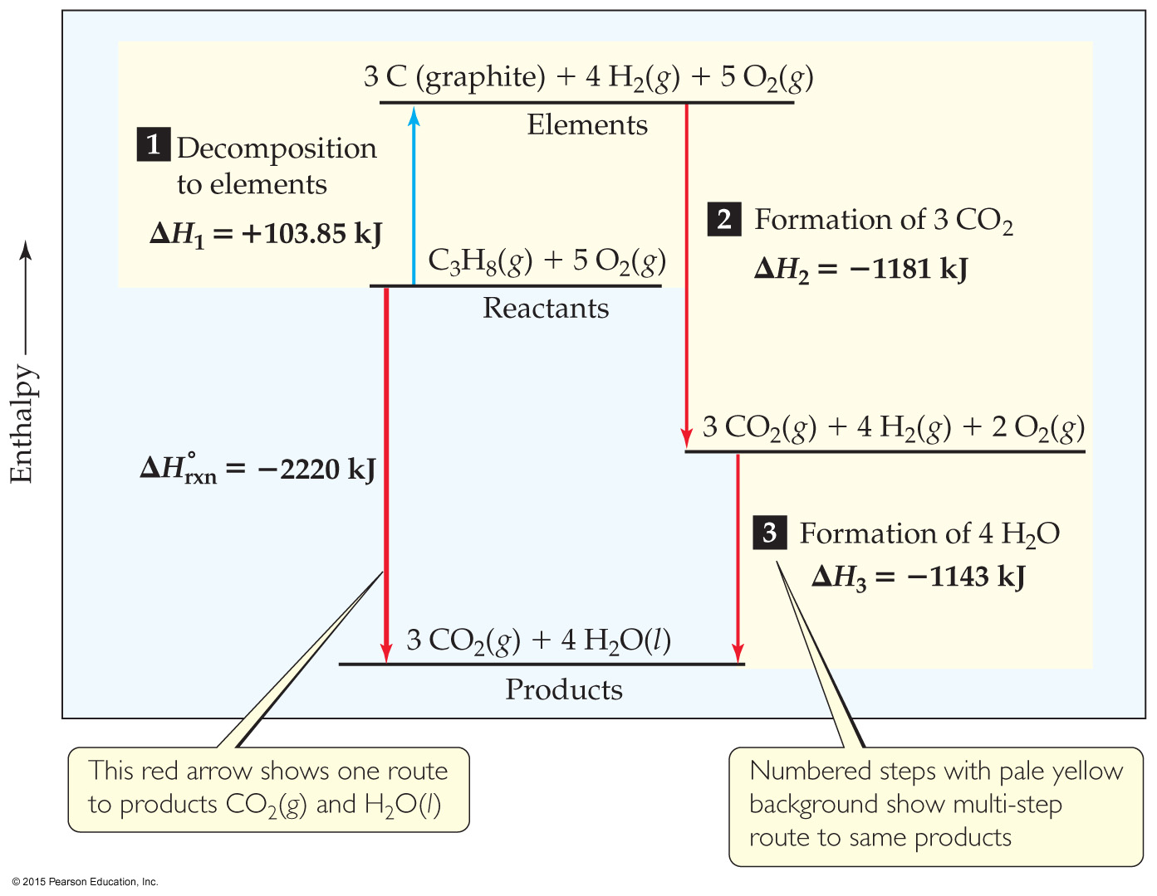
Calculation of ΔH
C₃H₈(g) + 5 O₂(g) ⎯→ 3 CO₂(g) + 4 H₂O(l)
Imagine this as occurring
in three steps:
1) Decomposition of propane to the elements:
C₃H₈(g) ⎯→ 3 C_{(graphite)} + 4 H₂(g)

Slide 43
Calculation of ΔH
C₃H₈(g) + 5 O₂(g) ⎯→ 3 CO₂(g) + 4 H₂O(l)
Imagine this as occurring
in three steps:
2) Formation of CO₂:
3 C_{(graphite)} + 3 O₂(g) ⎯→3 CO₂(g)

Slide 44
Calculation of ΔH
C₃H₈(g) + 5 O₂(g) ⎯→ 3 CO₂(g) + 4 H₂O(l)
Imagine this as occurring
in three steps:
3) Formation of H₂O:
4 H₂(g) + 2 O₂(g) ⎯→ 4 H₂O(l)

Slide 45
Calculation of ΔH
C₃H₈(g) + 5 O₂(g) ⎯→ 3 CO₂(g) + 4 H₂O(l)
So, all steps look like this:
C₃H₈(g) ⎯→ 3 C_{(graphite)} + 4 H₂(g)
3 C_{(graphite)} + 3 O₂(g) ⎯→3 CO₂(g)
4 H₂(g) + 2 O₂(g) ⎯→ 4 H₂O(l)

Slide 46
Calculation of ΔH
C₃H₈(g) + 5 O₂(g) ⎯→ 3 CO₂(g) + 4 H₂O(l)
The sum of these equations is the overall equation!
C₃H₈(g) ⎯→ 3 C_{(graphite)} + 4 H₂(g)
3 C_{(graphite)} + 3 O₂(g) ⎯→3 CO₂(g)
4 H₂(g) + 2 O₂(g) ⎯→ 4 H₂O(l)
C₃H₈(g) + 5 O₂(g) ⎯→ 3 CO₂(g) + 4 H₂O(l)

Slide 47
Calculation of ΔH
We can use Hess’s law in this way:
ΔH = ΣnΔH_{f,products} – ΣmΔH_{f}°_{,reactants}
where n and m are the stoichiometric coefficients.

Slide 48
Calculation of ΔH using Values from the Standard Enthalpy Table
C₃H₈(g) + 5 O₂(g) ⎯→ 3 CO₂(g) + 4 H₂O(l)
ΔH = [3(−393.5 kJ) + 4(−285.8 kJ)] – [1(−103.85 kJ) + 5(0 kJ)]
= [(−1180.5 kJ) + (−1143.2 kJ)] – [(−103.85 kJ) + (0 kJ)]
= (−2323.7 kJ) – (−103.85 kJ) = −2219.9 kJ

Slide 49
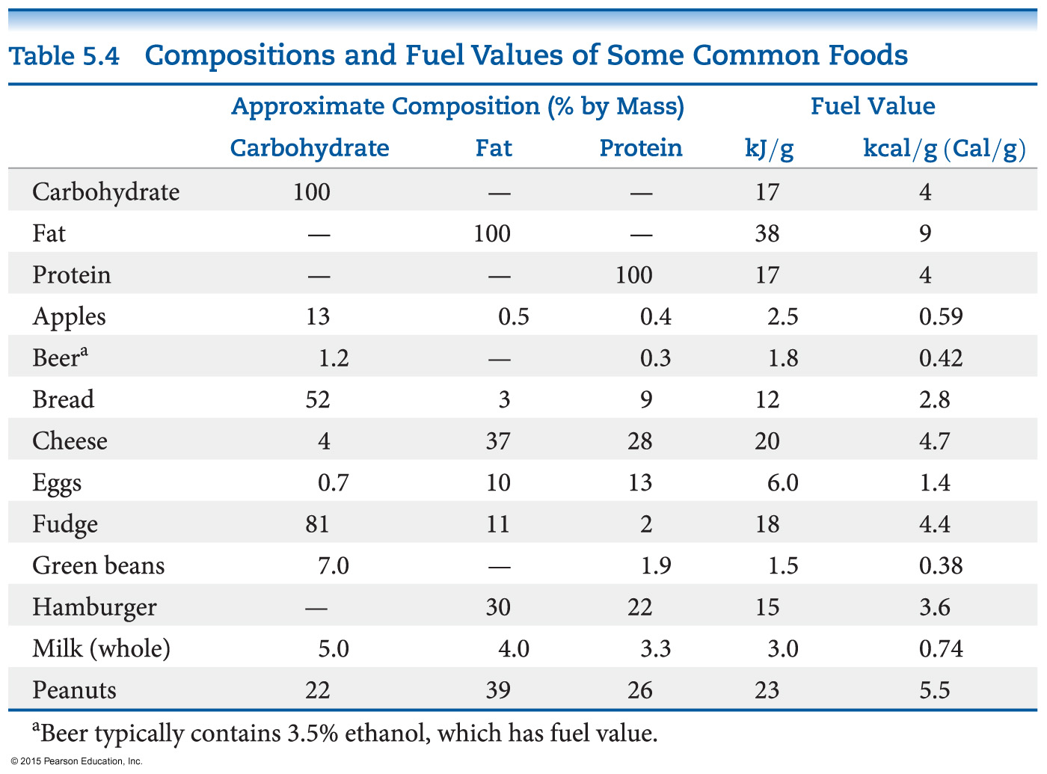
Energy in Foods
Most of the fuel in the food we eat comes from carbohydrates and fats.

Slide 50
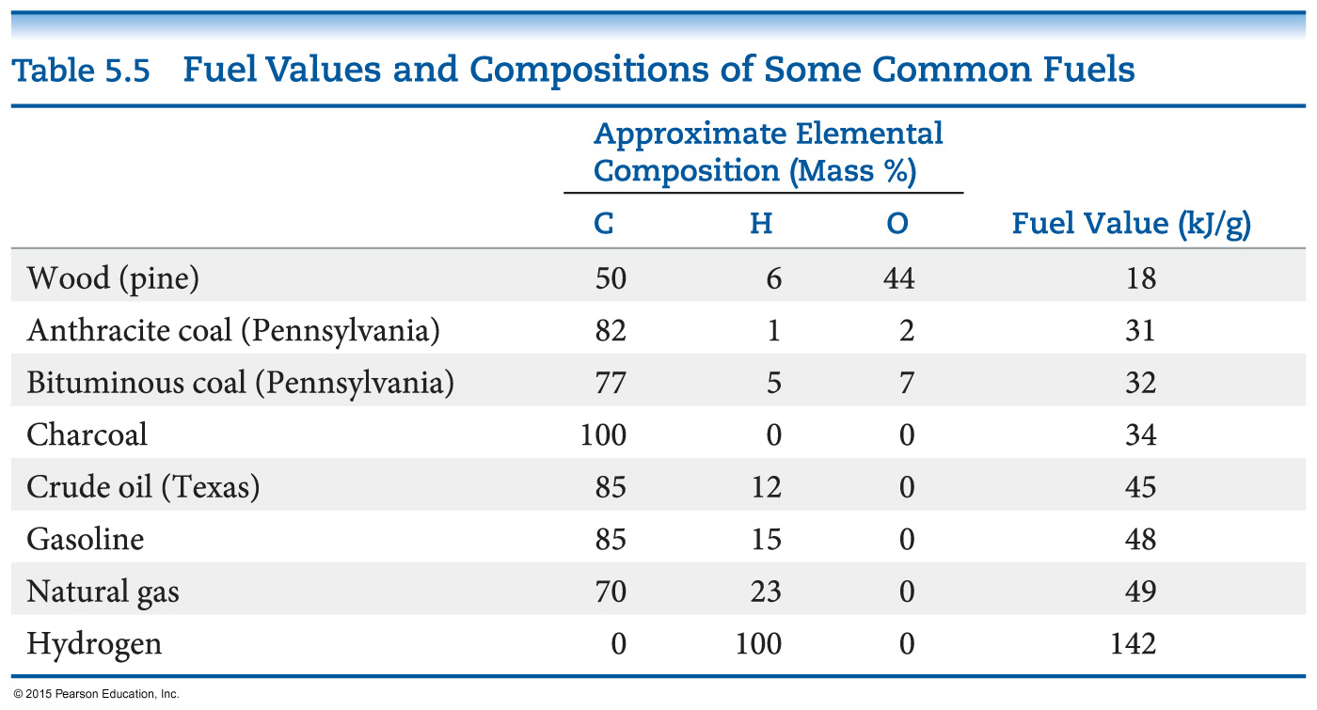
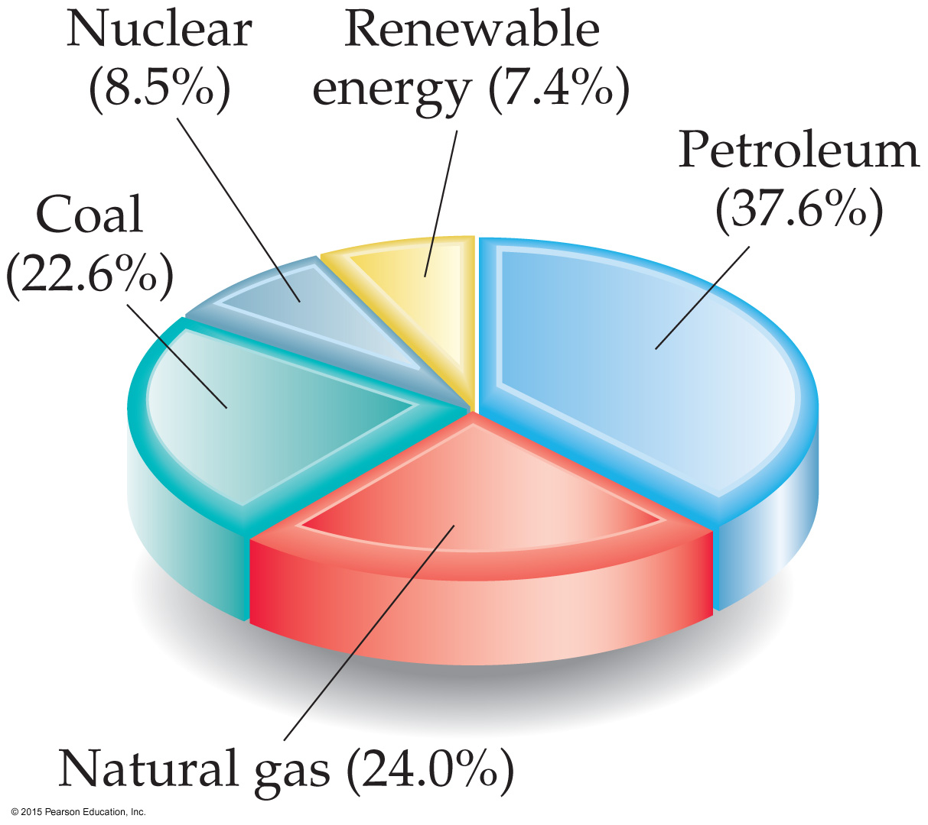
Energy in Fuels
The vast majority of the energy consumed in this country comes from fossil fuels.

Slide 51
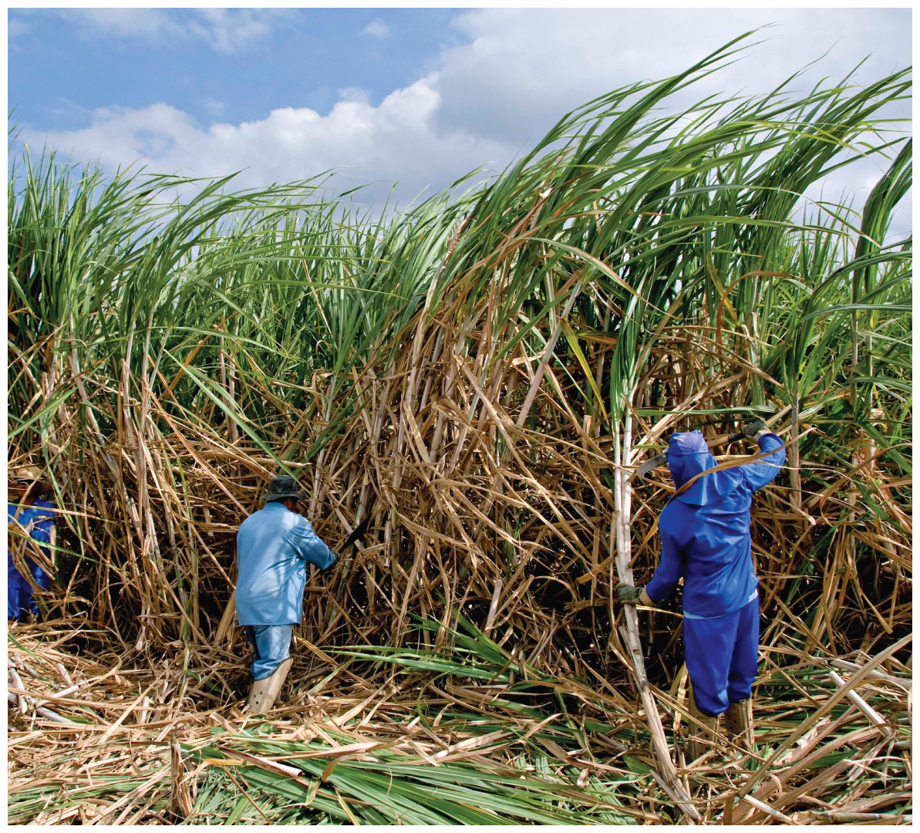
Other Energy Sources
Nuclear fission produces 8.5% of the U.S. energy needs.
Renewable energy sources, like solar, wind, geothermal, hydroelectric, and biomass sources produce 7.4% of the U.S. energy needs.

