Slide 1
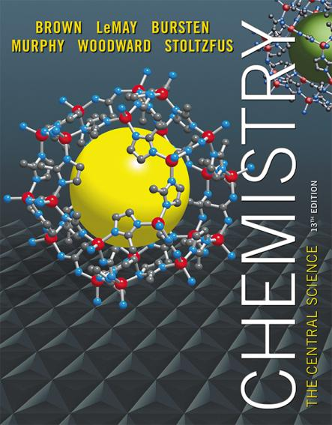
Lecture Presentation
Chapter 2 Atoms, Molecules, and Ions
James F. Kirby
Quinnipiac University
Hamden, CT
© 2015 Pearson Education, Inc.

Slide 2
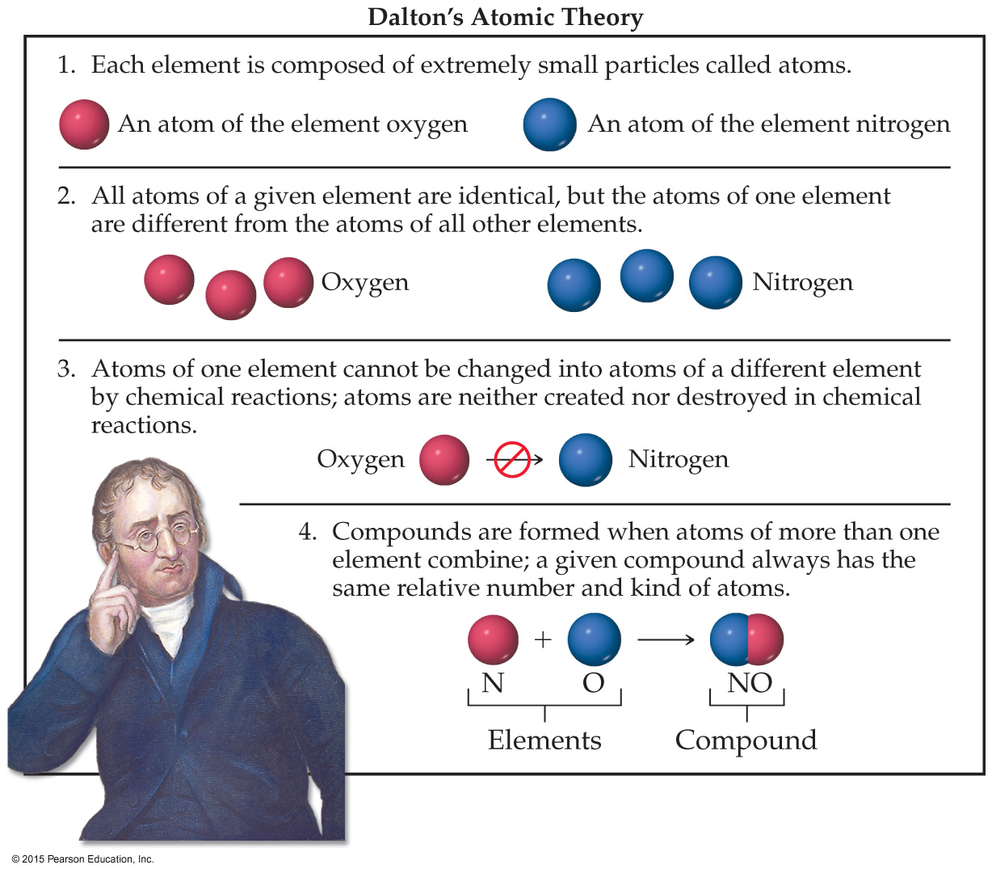
Atomic Theory of Matter
The theory that atoms are the fundamental building blocks of matter reemerged in the early nineteenth century, championed by John Dalton.

Slide 3
Dalton’s Postulates
Each element is composed of extremely small particles called atoms.

Slide 4
Dalton’s Postulates
All atoms of a given element are identical to one another in mass and other properties, but the atoms of one element are different from the atoms of all other elements.

Slide 5
Dalton’s Postulates
Atoms of an element are not changed into atoms of a different element by chemical reactions; atoms are neither created nor destroyed in chemical reactions.

Slide 6
Dalton’s Postulates
Atoms of more than one element combine to form compounds; a given compound always has the same relative number and kind of atoms.

Slide 7
Law of Conservation of Mass
The total mass of substances present at the end of a chemical process is the same as the mass of substances present before the process took place.
This law was one of the laws on which Dalton’s atomic theory was based.

Slide 8
Law of Multiple Proportions
If two elements, A and B, form more than one compound, the masses of B that combine with a given mass of A are in the ratio of small whole numbers.
Dalton predicted this law and observed it while developing his atomic theory.
When two or more compounds exist from the same elements, they can not have the same relative number of atoms.

Slide 9
Discovery of Subatomic Particles
In Dalton’s view, the atom was the smallest particle possible. Many discoveries led to the fact that the atom itself was made up of smaller particles.
Electrons and cathode rays
Radioactivity
Nucleus, protons, and neutrons

Slide 10
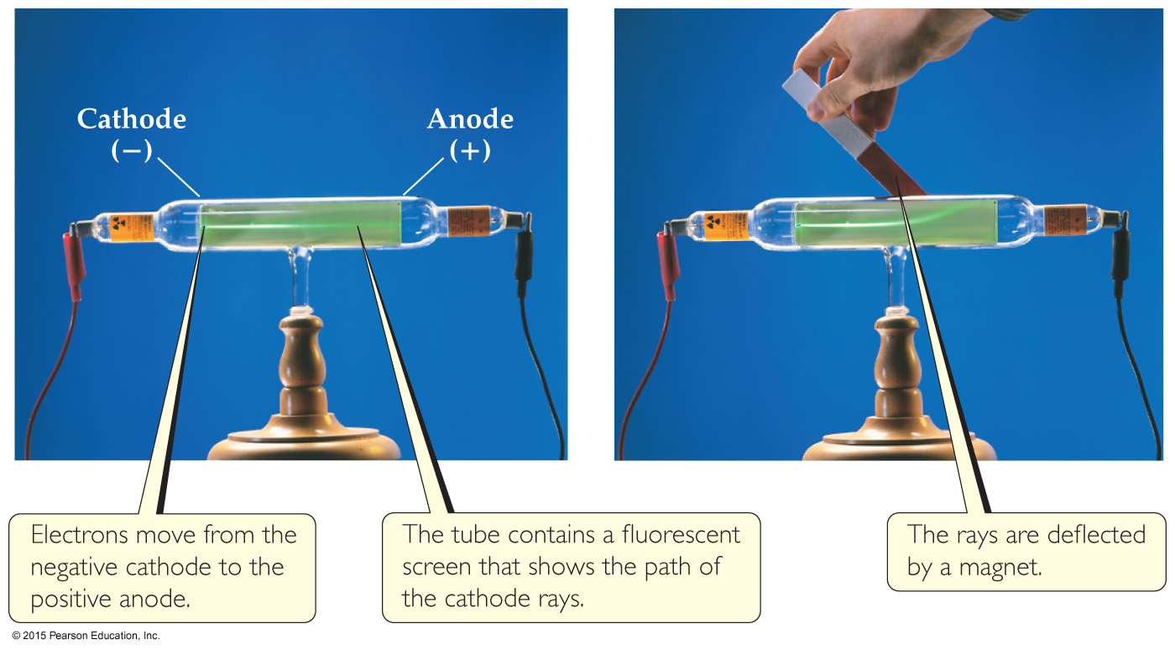
The Electron (Cathode Rays)
Streams of negatively charged particles were found to emanate from cathode tubes, causing fluorescence.
J. J. Thomson is credited with their discovery (1897).

Slide 11
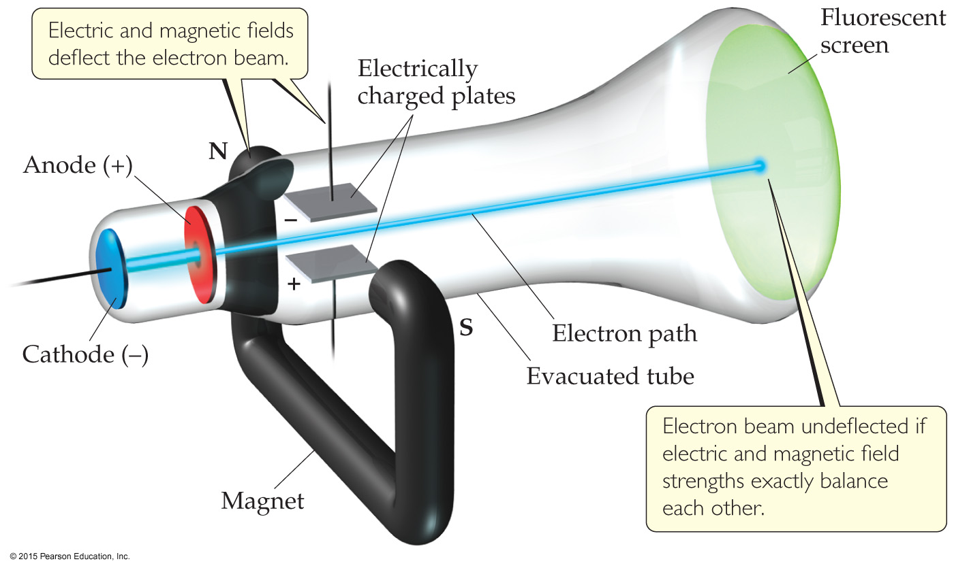
The Electron
Thomson measured the charge/mass ratio of the electron to be 1.76 × 10⁸ coulombs/gram (C/g).

Slide 12
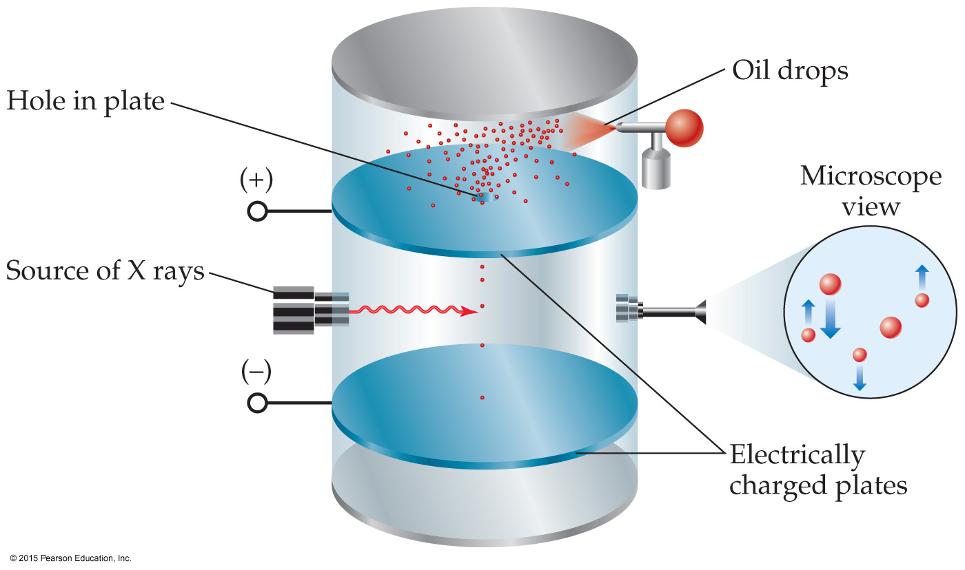
Millikan Oil-Drop Experiment (Electrons)
Once the charge/mass ratio of the electron was known, determination of either the charge or the mass of an electron would yield the other.
Robert Millikan determined the charge on the electron in 1909.

Slide 13
Radioactivity
Radioactivity is the spontaneous emission of high-energy radiation by an atom.
It was first observed by Henri Becquerel.
Marie and Pierre Curie also studied it.
Its discovery showed that the atom had more subatomic particles and energy associated with it.

Slide 14
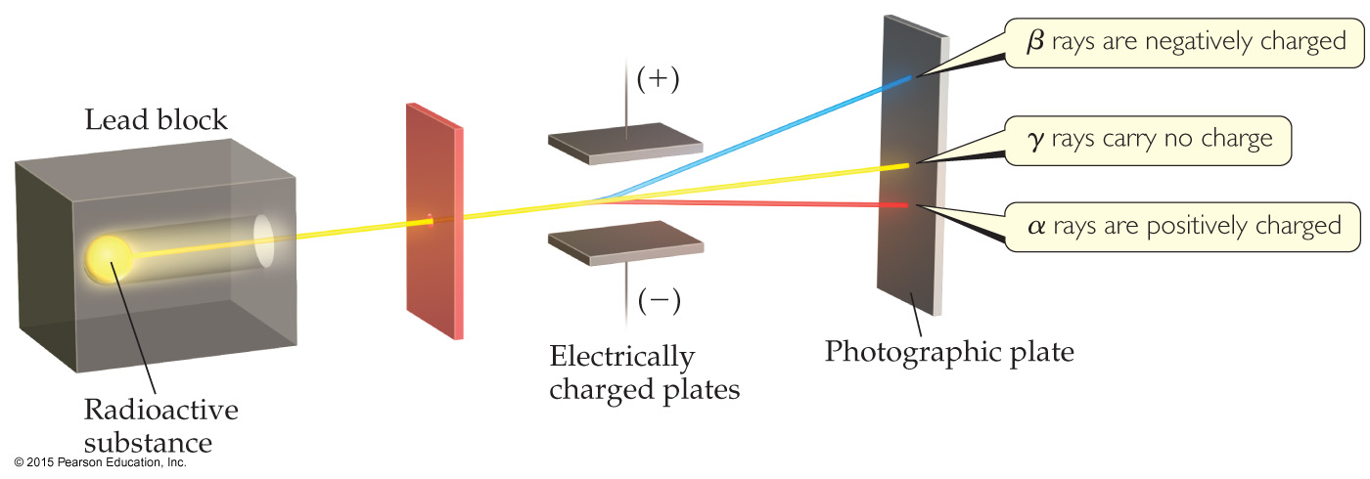
Radioactivity
Three types of radiation were discovered by Ernest Rutherford:
α particles (positively charged)
β particles (negatively charged, like electrons)
γ rays (uncharged)

Slide 15
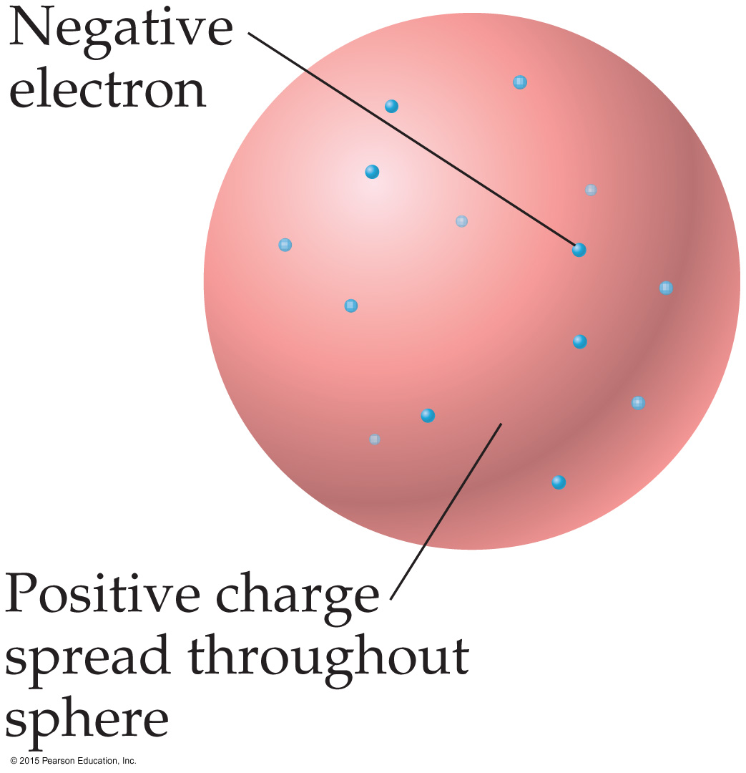
The Atom, circa 1900
The prevailing theory was that of the “plum pudding” model, put forward by Thomson.
It featured a positive sphere of matter with negative electrons embedded in it.

Slide 16
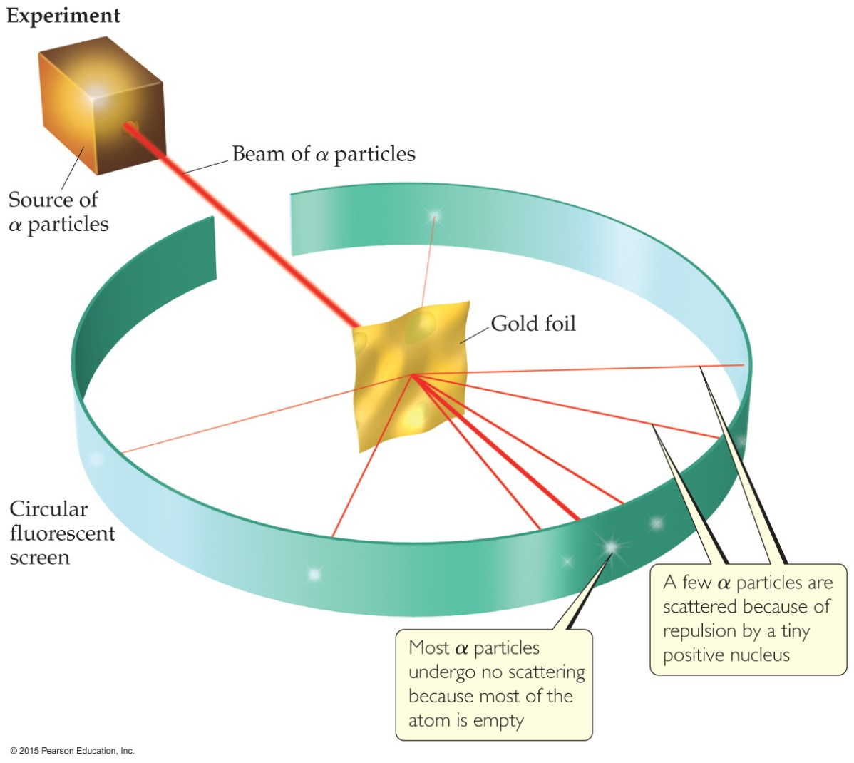
Discovery of the Nucleus
Ernest Rutherford shot α particles at a thin sheet of gold foil and observed the pattern of scatter of the particles.

Slide 17
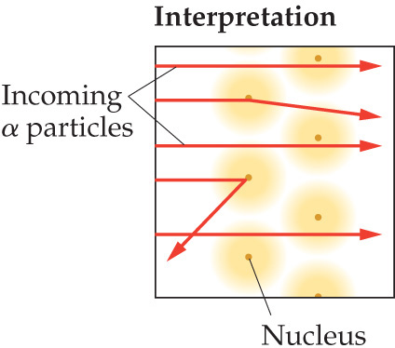
The Nuclear Atom
Since some particles were deflected at large angles, Thomson’s model could not be correct.

Slide 18
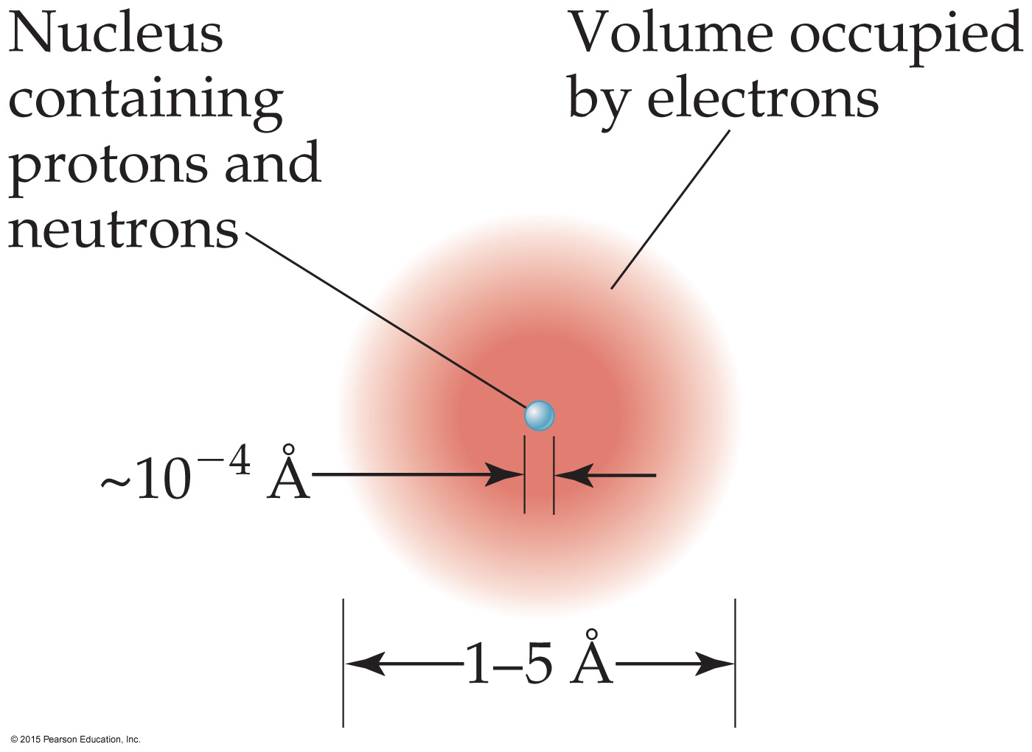
The Nuclear Atom
Rutherford postulated a very small, dense nucleus with the electrons around the outside of the atom.
Most of the volume is empty space.
Atoms are very small; 1 – 5 Å or 100 – 500 pm.
Other subatomic particles (protons and neutrons) were discovered.

Slide 19
Subatomic Particles
Protons (+1) and electrons (–1) have a charge; neutrons are neutral.
Protons and neutrons have essentially the same mass (relative mass 1). The mass of an electron is so small we ignore it (relative mass 0).
Protons and neutrons are found in the nucleus; electrons travel around the nucleus.

Slide 20
Atomic Mass
Atoms have extremely small masses.
The heaviest known atoms have a mass of approximately 4 × 10^{–22} g.
A mass scale on the atomic level is used, where an atomic mass unit (amu) is the base unit.
1 amu = 1.66054 × 10^{–24} g

Slide 21
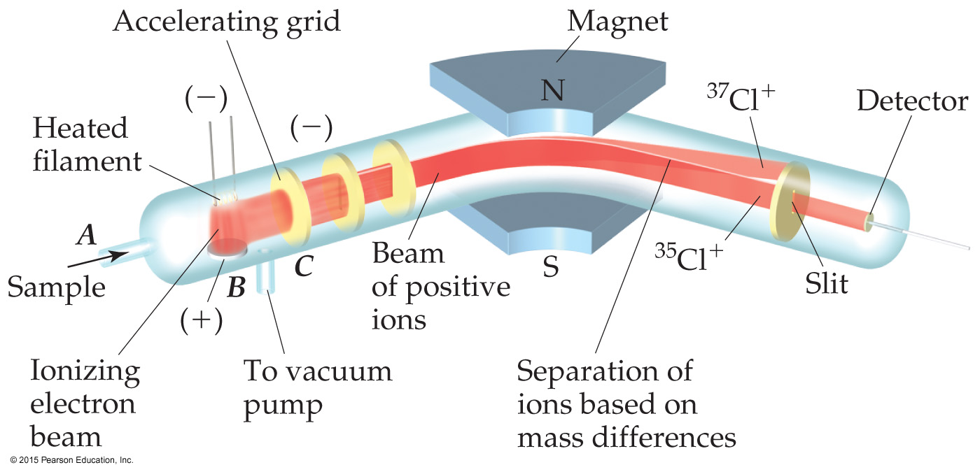
Atomic Weight Measurement
Atomic and molecular weight can be measured with great accuracy using a mass spectrometer.
Masses of atoms are compared to the carbon atom with 6 protons and 6 neutrons (C-12).

Slide 22
Symbols of Elements
Elements are represented by a one or two letter symbol. This is the symbol for carbon.
All atoms of the same element have the same number of protons, which is called the atomic number, Z. It is written as a subscript BEFORE the symbol.
The mass number is the total number of protons and neutrons in the nucleus of an atom. It is written as a superscript BEFORE the symbol.

Slide 23
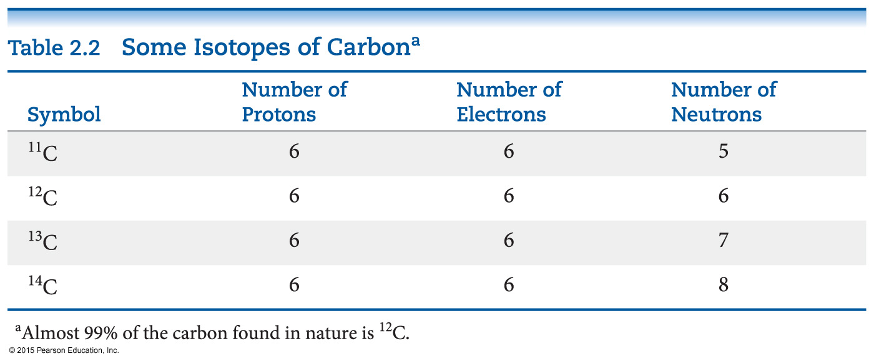
Isotopes
Isotopes are atoms of the same element with different masses.
Isotopes have different numbers of neutrons, but the same number of protons.

Slide 24
Atomic Weight
Because in the real world we use large amounts of atoms and molecules, we use average masses in calculations.
An average mass is found using all isotopes of an element weighted by their relative abundances. This is the element’s atomic weight.
That is, Atomic Weight = Ʃ [(isotope mass) × (fractional natural abundance)]. Note: the sum is for ALL isotopes of an element.

Slide 25
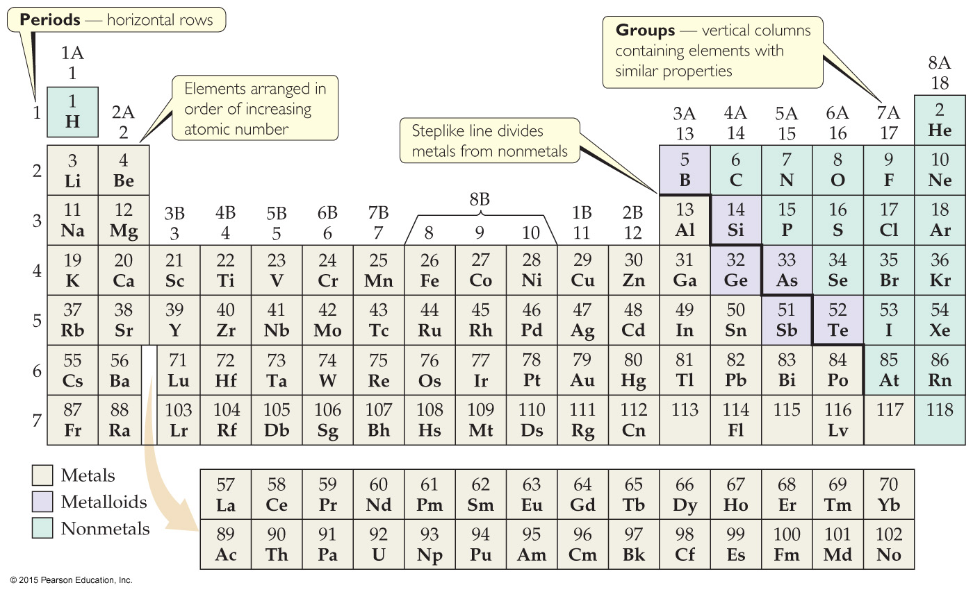
Periodic Table
The periodic table is a systematic organization of the elements.
Elements are arranged in order of atomic number.
Unlike the way we write isotopes, the atomic number is at the TOP of a box in the periodic table.
The atomic weight of an element appears at the BOTTOM of the box. (They are not shown on this version of the Periodic Table.)

Slide 26
Periodic Table
The rows on the periodic table are called periods.
Columns are called groups.
Elements in the same group have similar chemical properties.

Slide 27
Periodicity
When one looks at the chemical properties of elements, one notices a repeating pattern of reactivities.

Slide 28
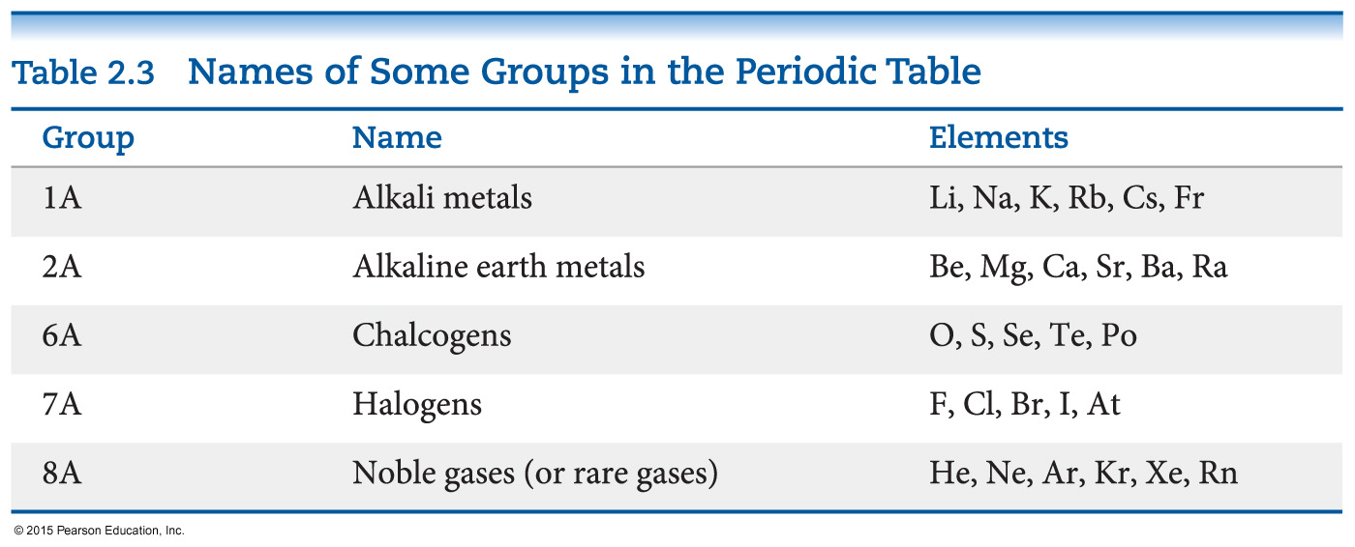
Groups
These five groups are known by their names.

Slide 29
Periodic Table
Metals are on the left side of the periodic table.
Some properties of metals include
shiny luster.
conducting heat and electricity.
solidity (except mercury).

Slide 30
Periodic Table
Nonmetals are on the right side of the periodic table (with the exception of H).
They can be solid (like carbon), liquid (like bromine), or gas (like neon) at room temperature.

Slide 31
Periodic Table
Elements on the steplike line are metalloids (except Al, Po, and At).
Their properties are sometimes like metals and sometimes like nonmetals.

Slide 32
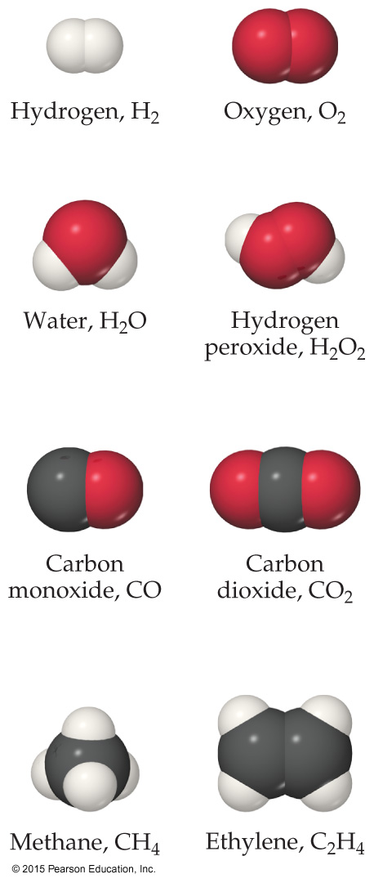
Chemical Formulas
The subscript to the right of the symbol of an element tells the number of atoms of that element in one molecule of the compound.
Molecular compounds are composed of molecules and almost always contain only nonmetals.

Slide 33
Diatomic Molecules
These seven elements occur naturally as molecules containing two atoms:
Hydrogen
Nitrogen
Oxygen
Fluorine
Chlorine
Bromine
Iodine

Slide 34
Types of Formulas
Empirical formulas give the lowest whole-number ratio of atoms of each element in a compound.
Molecular formulas give the exact number of atoms of each element in a compound.
If we know the molecular formula of a compound, we can determine its empirical formula. The converse is not true!

Slide 35
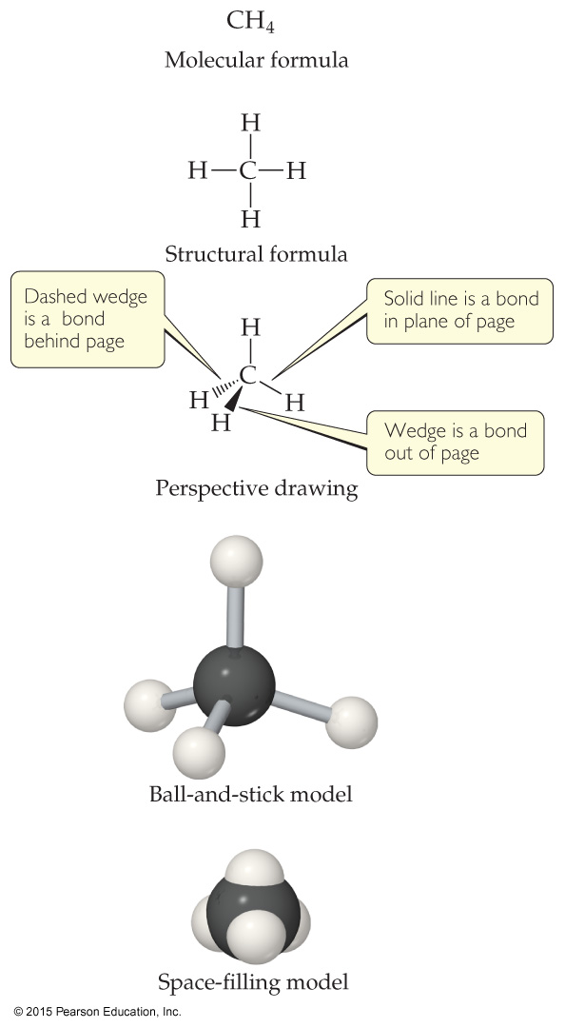
Types of Formulas
Structural formulas show the order in which atoms are attached. They do NOT depict the three-dimensional shape of molecules.
Perspective drawings also show the three-dimensional order of the atoms in a compound. These are also demonstrated using models.

Slide 36
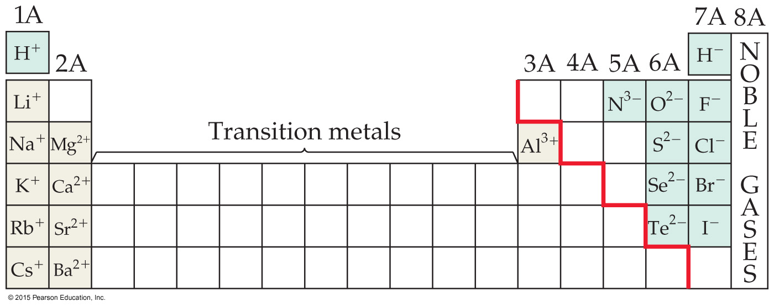
Ions
When an atom of a group of atoms loses or gains electrons, it becomes an ion.
Cations are formed when at least one electron is lost. Monatomic cations are formed by metals.
Anions are formed when at least one electron is gained. Monatomic anions are formed by nonmetals.

Slide 37
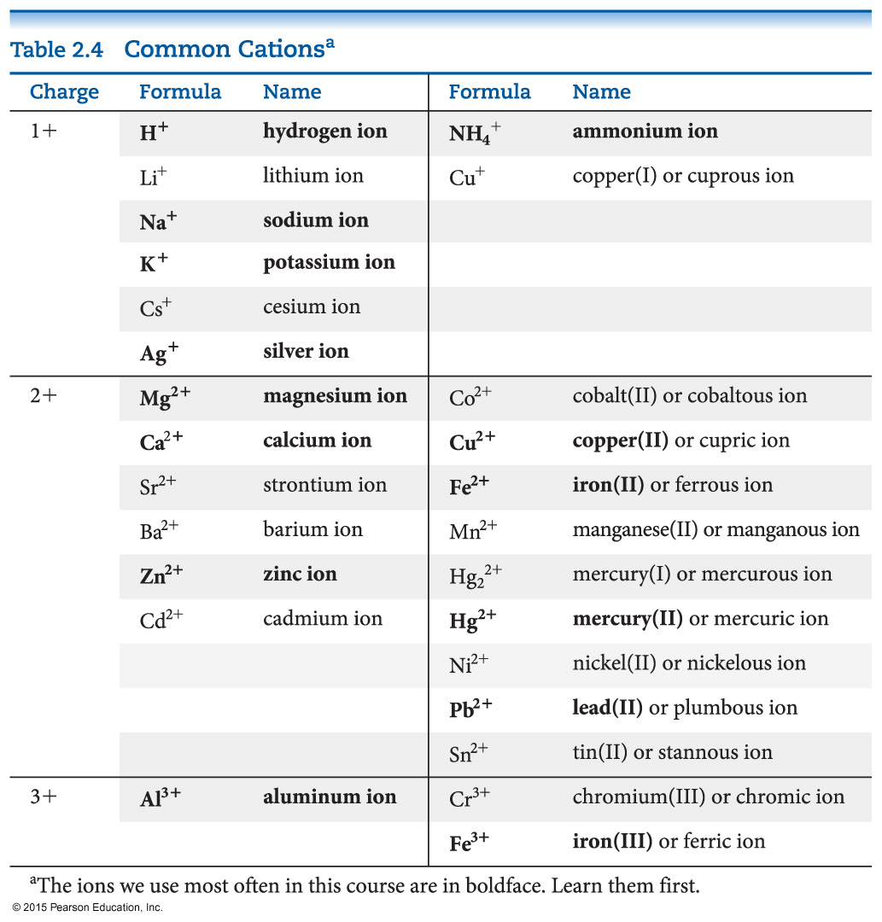
Common Cations

Slide 38
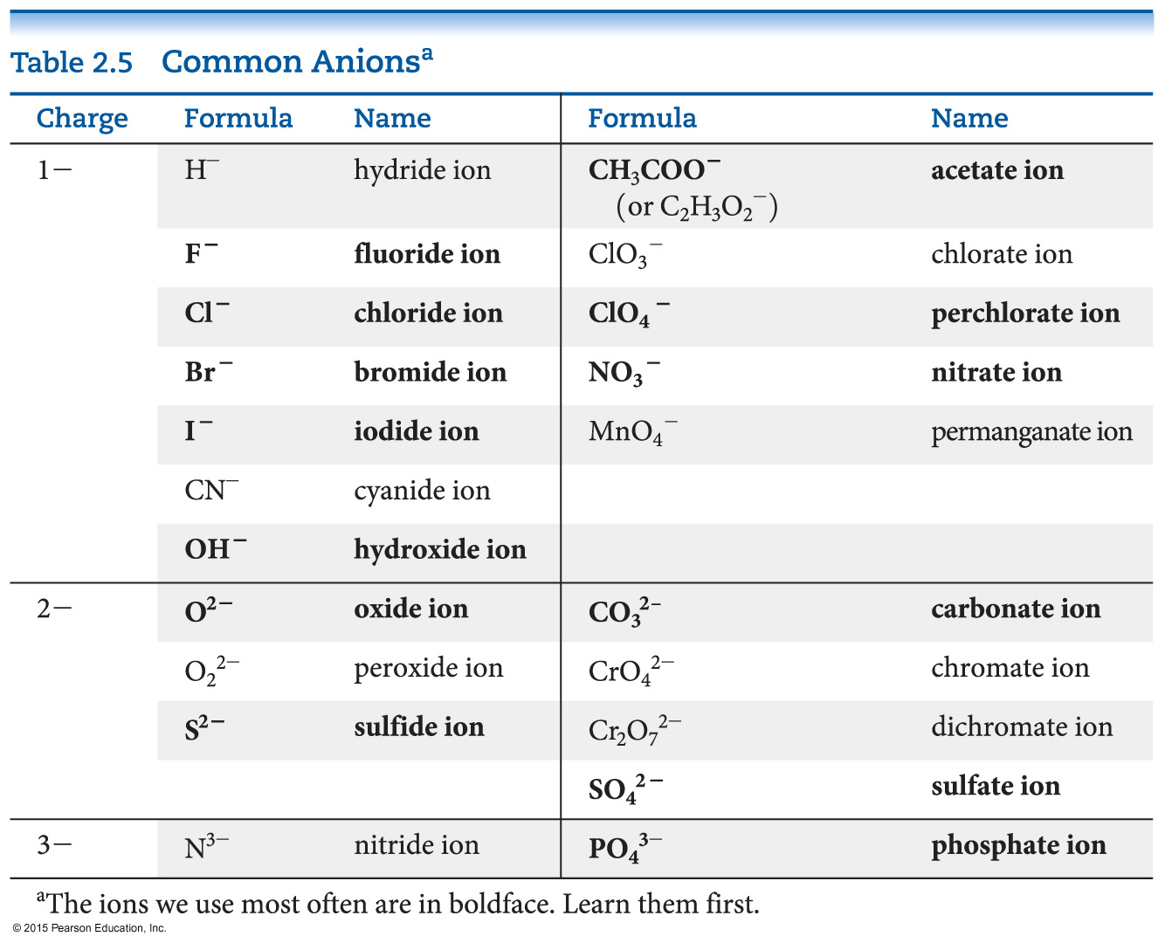
Common Anions

Slide 39
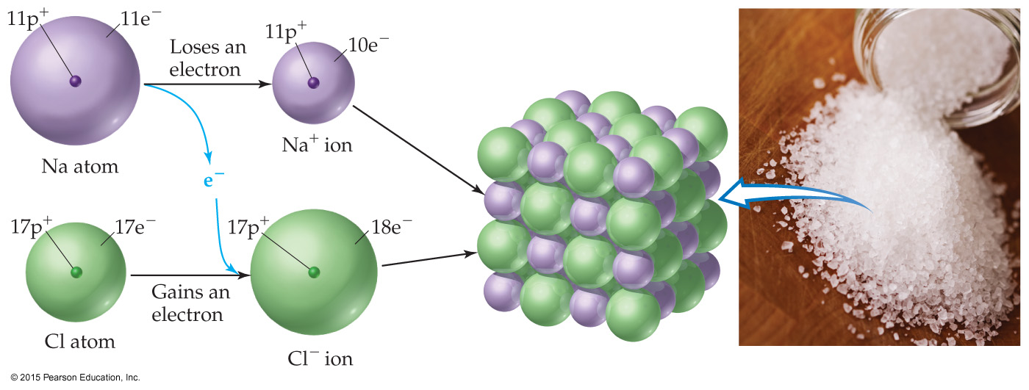
Ionic Compounds
Ionic compounds (such as NaCl) are generally formed between metals and nonmetals.
Electrons are transferred from the metal to the nonmetal. The oppositely charged ions attract each other. Only empirical formulas are written.

Slide 40
Writing Formulas
Because compounds are electrically neutral, one can determine the formula of a compound this way:
The charge on the cation becomes the subscript on the anion.
The charge on the anion becomes the subscript on the cation.
If these subscripts are not in the lowest whole-number ratio, divide them by the greatest common factor.

Slide 41
Inorganic Nomenclature
Write the name of the cation. If the cation can have more than one possible charge, write the charge as a Roman numeral in parentheses.
If the anion is an element, change its ending to -ide; if the anion is a polyatomic ion, simply write the name of the polyatomic ion.

Slide 42
Patterns in Oxyanion Nomenclature
When there are two oxyanions involving the same element
the one with fewer oxygens ends in -ite.
the one with more oxygens ends in -ate.
NO₂⁻ : nitrite; NO₃⁻ : nitrate
SO₃²⁻ : sulfite; SO₄²⁻ : sulfate

Slide 43
Patterns in Oxyanion Nomenclature
Central atoms on the second row have a bond to, at most, three oxygens; those on the third row take up to four.
Charges increase as you go from right to left.

Slide 44
Patterns in Oxyanion Nomenclature
The one with the second fewest oxygens ends in -ite: ClO₂⁻ is chlorite.
The one with the second most oxygens ends in -ate: ClO₃⁻ is chlorate.
The one with the fewest oxygens has the prefix hypo- and ends in -ite: ClO⁻ is hypochlorite.
The one with the most oxygens has the prefix per- and ends in -ate: ClO₄⁻ is perchlorate.

Slide 45
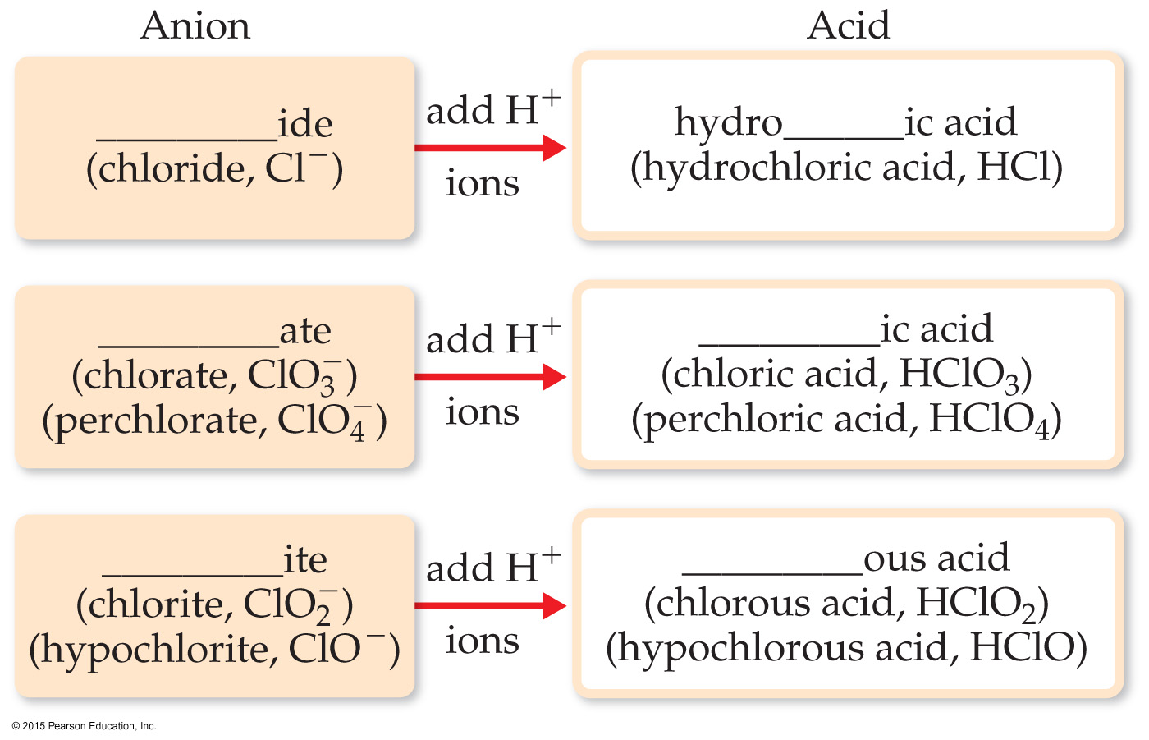
Acid Nomenclature
If the anion in the acid ends in -ide, change the ending to -ic acid and add the prefix hydro-.
HCl: hydrochloric acid
HBr: hydrobromic acid
HI: hydroiodic acid
If the anion ends in -ite, change the ending to -ous acid.
HClO: hypochlorous acid
HClO₂: chlorous acid
If the anion ends in -ate, change the ending to -ic acid.
HClO₃: chloric acid
HClO₄: perchloric acid

Slide 46
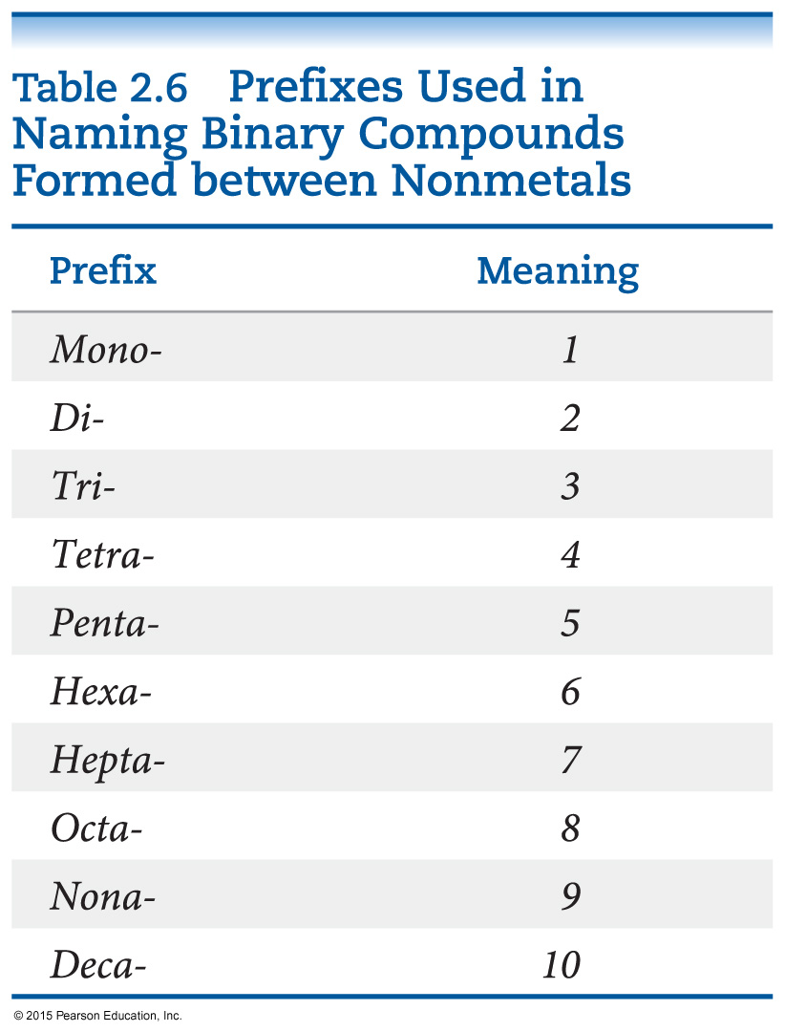
Nomenclature of Binary Molecular Compounds
The name of the element farther to the left in the periodic table (closer to the metals) or lower in the same group is usually written first.
A prefix is used to denote the number of atoms of each element in the compound (mono- is not used on the first element listed, however).

Slide 47
Nomenclature of Binary Compounds
The ending on the second element is changed to -ide.
CO₂: carbon dioxide
CCl₄: carbon tetrachloride
If the prefix ends with a or o and the name of the element begins with a vowel, the two successive vowels are often elided into one.
N₂O₅: dinitrogen pentoxide

Slide 48
Nomenclature of Organic Compounds
Organic chemistry is the study of carbon.
Organic chemistry has its own system of nomenclature.
The simplest hydrocarbons (compounds containing only carbon and hydrogen) are alkanes.
The first part of the names just listed correspond to the number of carbons (meth- = 1, eth- = 2, prop- = 3, etc.).

Slide 49
Nomenclature of Organic Compounds
When a hydrogen in an alkane is replaced with something else (a functional group, like -OH in the compounds above), the name is derived from the name of the alkane.
The ending denotes the type of compound.
An alcohol ends in -ol.

