Slide 1
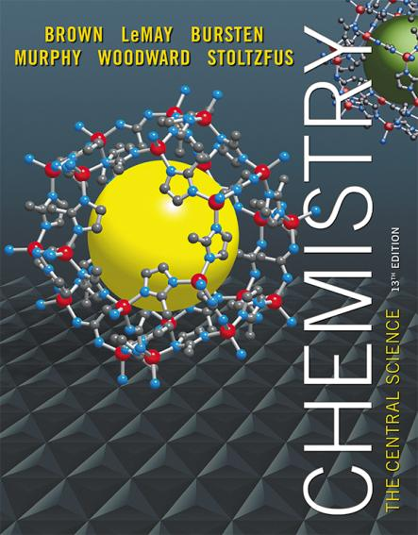
Lecture Presentation
Chapter 1 Introduction: Matter and Measurement
James F. Kirby
Quinnipiac University
Hamden, CT

Slide 2
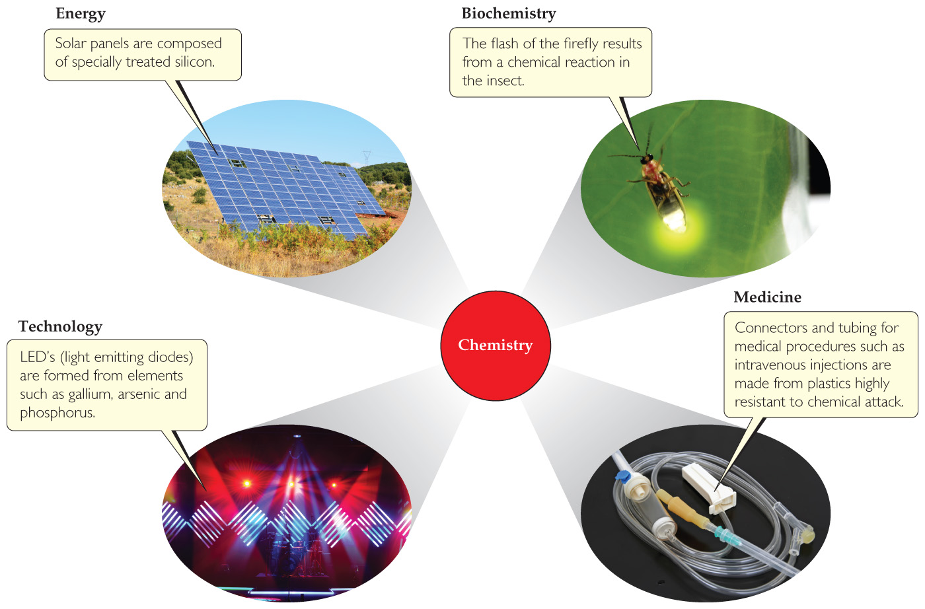
Chemistry
Chemistry is the study of the properties and behavior of matter.
It is central to our fundamental understanding of many science-related fields.

Slide 3
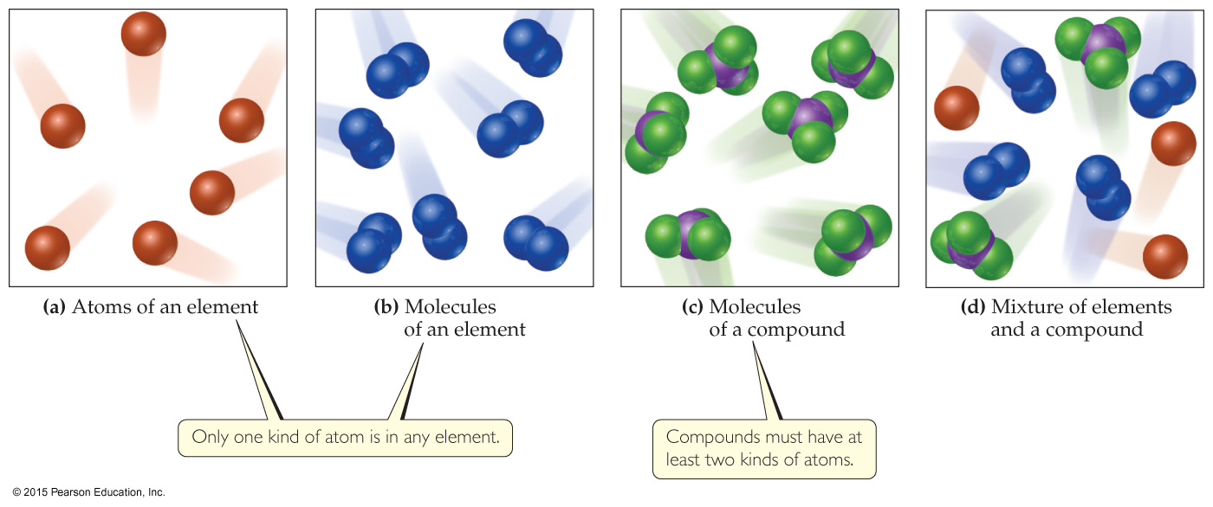
Matter
Matter is anything that has mass and takes up space.

Slide 4
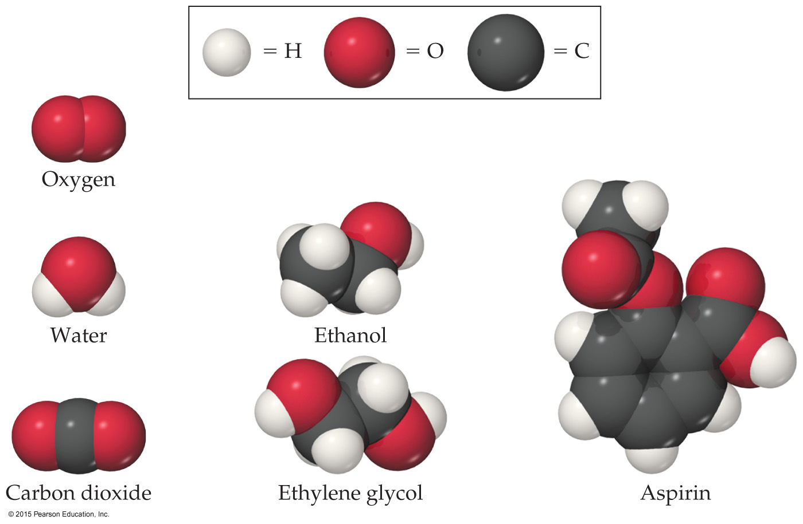
Matter
Atoms are the building blocks of matter.
Each element is made of a unique kind of atom.
A compound is made of two or more different kinds of elements.
Note: Balls of different colors are used to represent atoms of different elements. Attached balls represent connections between atoms that are seen in nature. These groups of atoms are called molecules.

Slide 5
Methods of Classification
State of Matter
Composition of Matter

Slide 6
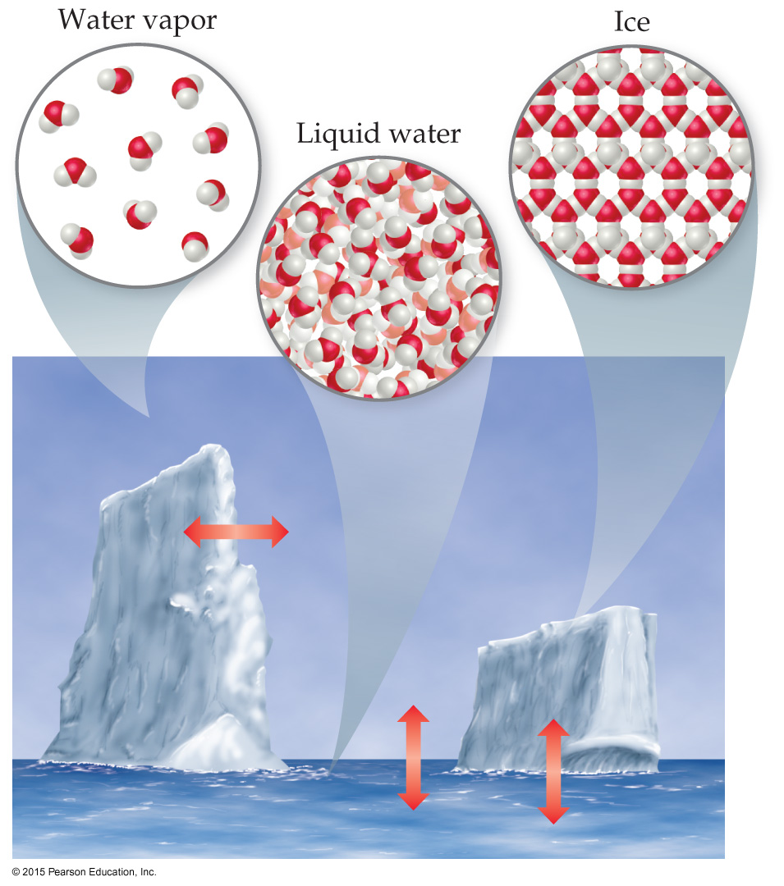
States of Matter
The three states of matter are
solid.
liquid.
gas.
In this figure, those states are ice, liquid water, and water vapor.

Slide 7
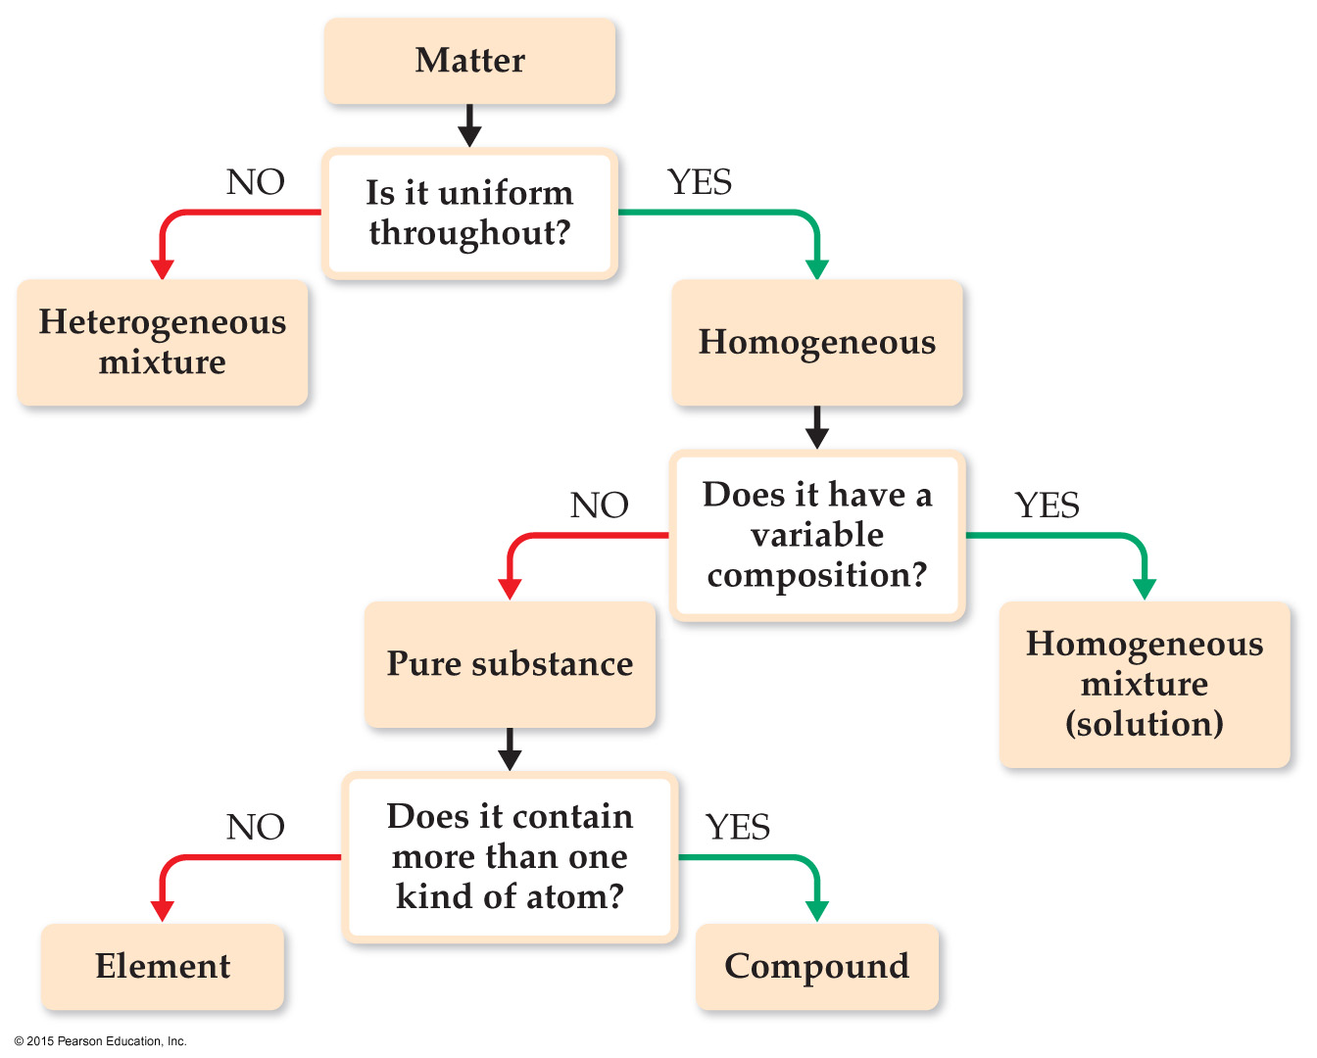
Classification of Matter Based on Composition
If you follow this scheme, you can determine how to classify any type of matter.
Homogeneous mixture
Heterogeneous mixture
Element
Compound
Matter
And
Measurement

Slide 8
Classification of Matter—Substances
A substance has distinct properties and a composition that does not vary from sample to sample.
The two types of substances are elements and compounds.
An element is a substance which can not be decomposed to simpler substances.
A compound is a substance which can be decomposed to simpler substances.

Slide 9
Compounds and Composition
Compounds have a definite composition. That means that the relative number of atoms of each element that makes up the compound is the same in any sample.
This is The Law of Constant Composition (or The Law of Definite Proportions).

Slide 10
Classification of Matter—Mixtures
Mixtures exhibit the properties of the substances that make them up.
Mixtures can vary in composition throughout a sample (heterogeneous) or can have the same composition throughout the sample (homogeneous).
Another name for a homogeneous mixture is solution.

Slide 11
Types of Properties
Physical Properties can be observed without changing a substance into another substance.
Some examples include boiling point, density, mass, or volume.
Chemical Properties can only be observed when a substance is changed into another substance.
Some examples include flammability, corrosiveness, or reactivity with acid.

Slide 12
Types of Properties
Intensive Properties are independent of the amount of the substance that is present.
Examples include density, boiling point, or color.
Extensive Properties depend upon the amount of the substance present.
Examples include mass, volume, or energy.

Slide 13
Types of Changes
Physical Changes are changes in matter that do not change the composition of a substance.
Examples include changes of state, temperature, and volume.
Chemical Changes result in new substances.
Examples include combustion, oxidation, and decomposition.

Slide 14
Changes in State of Matter
Converting between the three states of matter is a physical change.
When ice melts or water evaporates, there are still 2 H atoms and 1 O atom in each molecule.

Slide 15
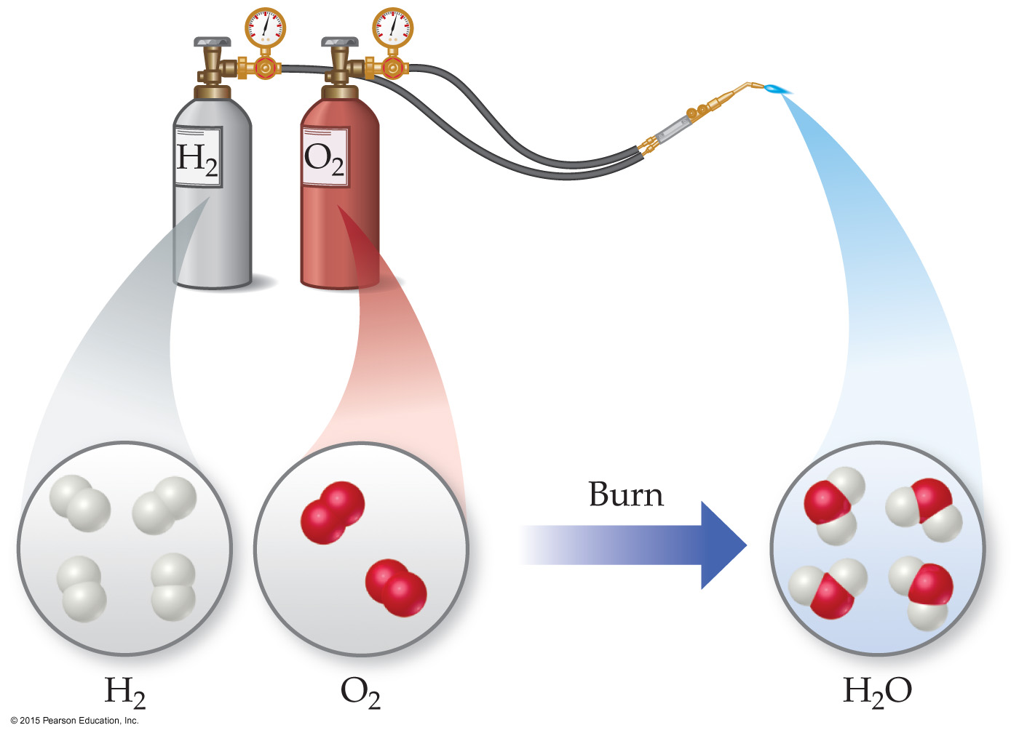
Chemical Reactions (Chemical Change)
In the course of a chemical reaction, the reacting substances are converted to new substances. Here, the elements hydrogen and oxygen become water.

Slide 16
Separating Mixtures
Mixtures can be separated based on physical properties of the components of the mixture. Some methods used are
filtration.
distillation.
chromatography.

Slide 17
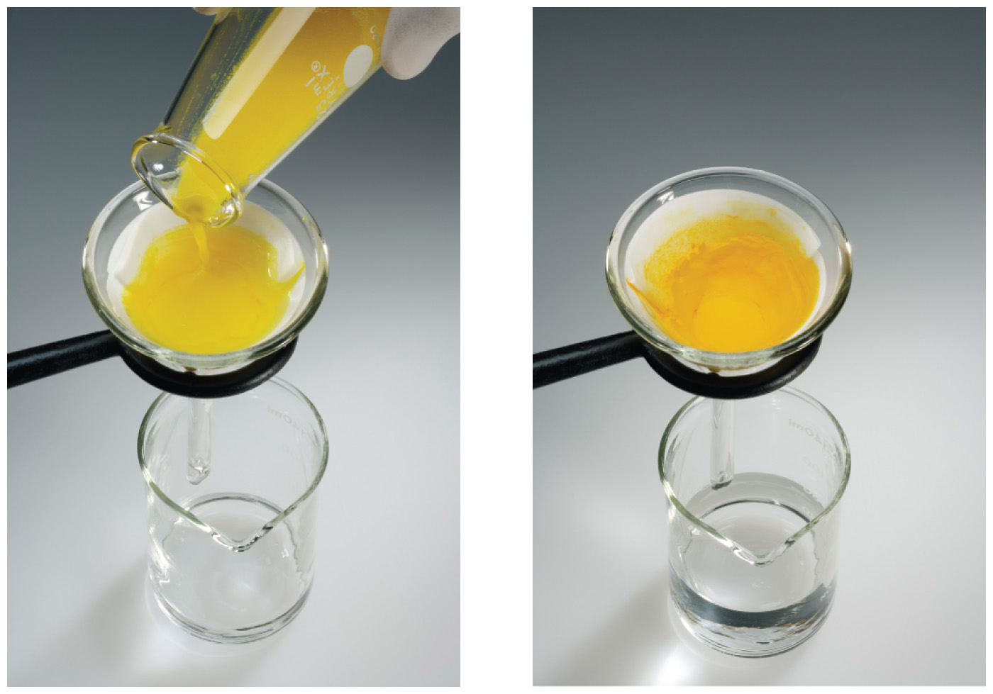
Filtration
In filtration, solid substances are separated from liquids and solutions.

Slide 18
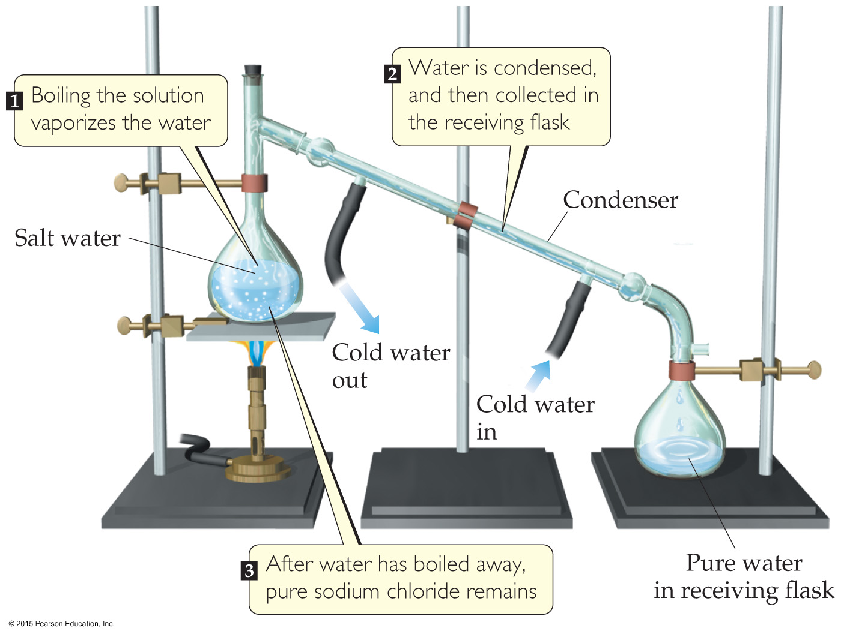
Distillation
Distillation uses differences in the boiling points of substances to separate a homogeneous mixture into its components.

Slide 19
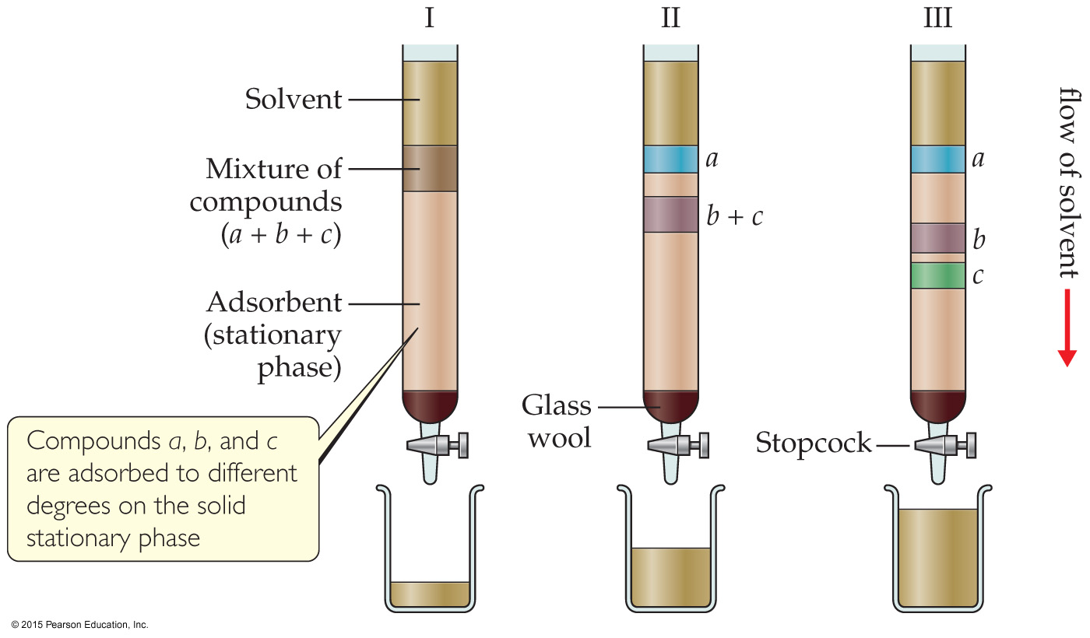
Chromatography
This technique separates substances on the basis of differences in the ability of substances to adhere to the solid surface, in this case, dyes to paper.

Slide 20
Numbers and Chemistry
Numbers play a major role in chemistry. Many topics are quantitative (have a numerical value).
Concepts of numbers in science
Units of measurement
Quantities that are measured and calculated
Uncertainty in measurement
Significant figures
Dimensional analysis

Slide 21
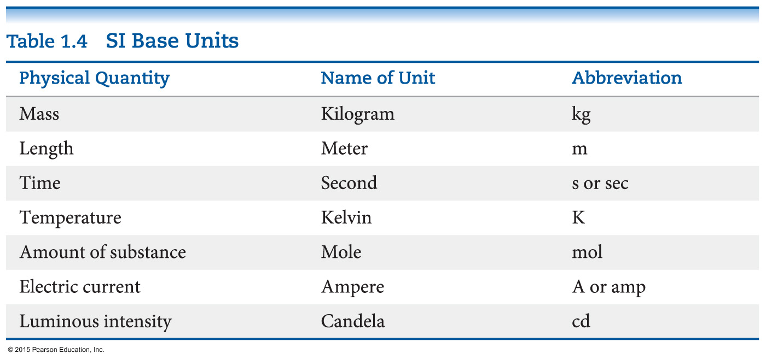
Units of Measurements—SI Units
Système International d’Unités (“The International System of Units”)
A different base unit is used for each quantity.

Slide 22
Units of Measurement—Metric System
The base units used in the metric system
Mass: gram (g)
Length: meter (m)
Time: second (s or sec)
Temperature: degrees Celsius (ºC) or Kelvins (K)
Amount of a substance: mole (mol)
Volume: cubic centimeter (cc or cm³) or liter (l)

Slide 23
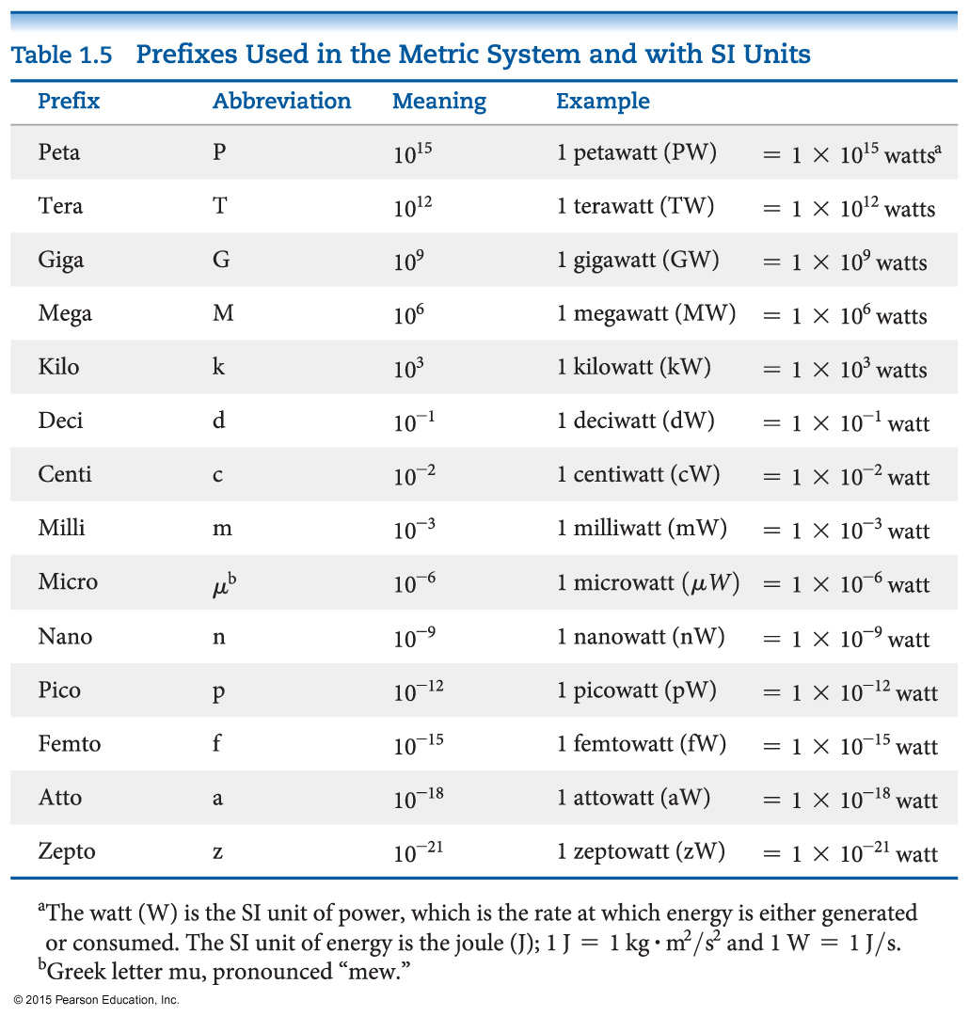
Units of Measurement— Metric System Prefixes
Prefixes convert the base units into units that are appropriate for common usage or appropriate measure.

Slide 24
Mass and Length
These are basic units we measure in science.
Mass is a measure of the amount of material in an object. SI uses the kilogram as the base unit. The metric system uses the gram as the base unit.
Length is a measure of distance. The meter is the base unit.

Slide 25
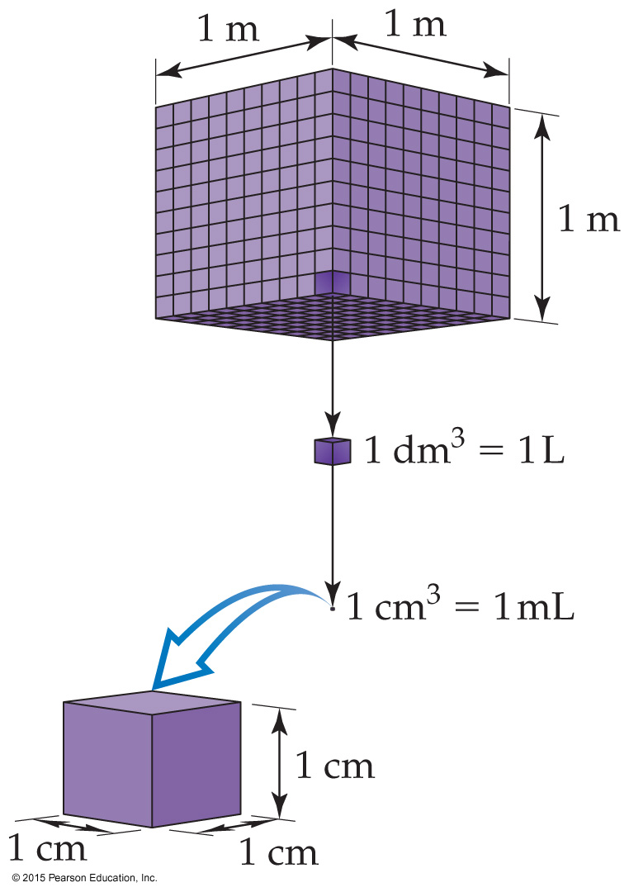
Volume
Note that volume is not a base unit for SI; it is derived from length (m × m × m = m³).
The most commonly used metric units for volume are the liter (L) and the milliliter (mL).
A liter is a cube 1 decimeter (dm) long on each side.
A milliliter is a cube 1 centimeter (cm) long on each side, also called 1 cubic centimeter (cm × cm × cm = cm³).

Slide 26
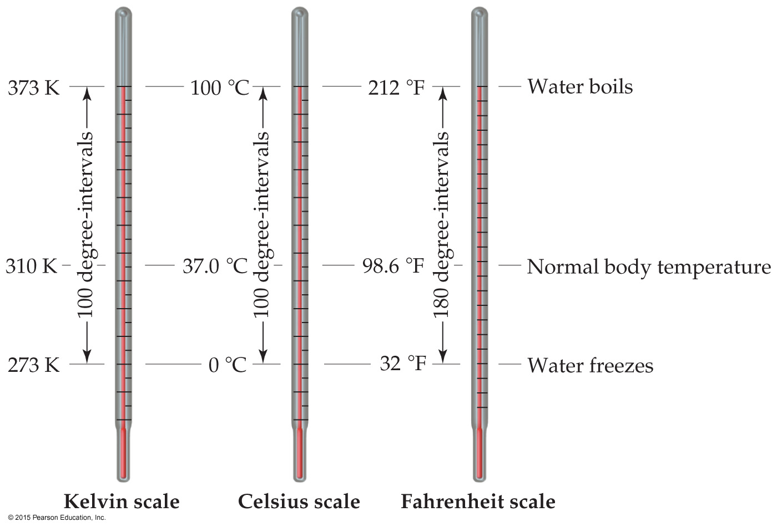
Temperature
In general usage, temperature is considered the “hotness and coldness” of an object that determines the direction of heat flow.
Heat flows spontaneously from an object with a higher temperature to an object with a lower temperature.

Slide 27
Temperature
In scientific measurements, the Celsius and Kelvin scales are most often used.
The Celsius scale is based on the properties of water.
0 °C is the freezing point of water.
100 °C is the boiling point of water.
The kelvin is the SI unit of temperature.
It is based on the properties of gases.
There are no negative Kelvin temperatures.
The lowest possible temperature is called absolute zero (0 K).
K = °C + 273.15

Slide 28
Temperature
The Fahrenheit scale is not used in scientific measurements, but you hear about it in weather reports!
The equations below allow for conversion between the Fahrenheit and Celsius scales:
°F = 9/5(°C) + 32
°C = 5/9(°F − 32)

Slide 29
Density
Density is a physical property of a substance.
It has units that are derived from the units for mass and volume.
The most common units are g/mL or g/cm³.
D = m/V

Slide 30
Numbers Encountered in Science
Exact numbers are counted or given by definition. For example, there are 12 eggs in 1 dozen.
Inexact (or measured) numbers depend on how they were determined. Scientific instruments have limitations. Some balances measure to ±0.01 g; others measure to ±0.0001g.

Slide 31
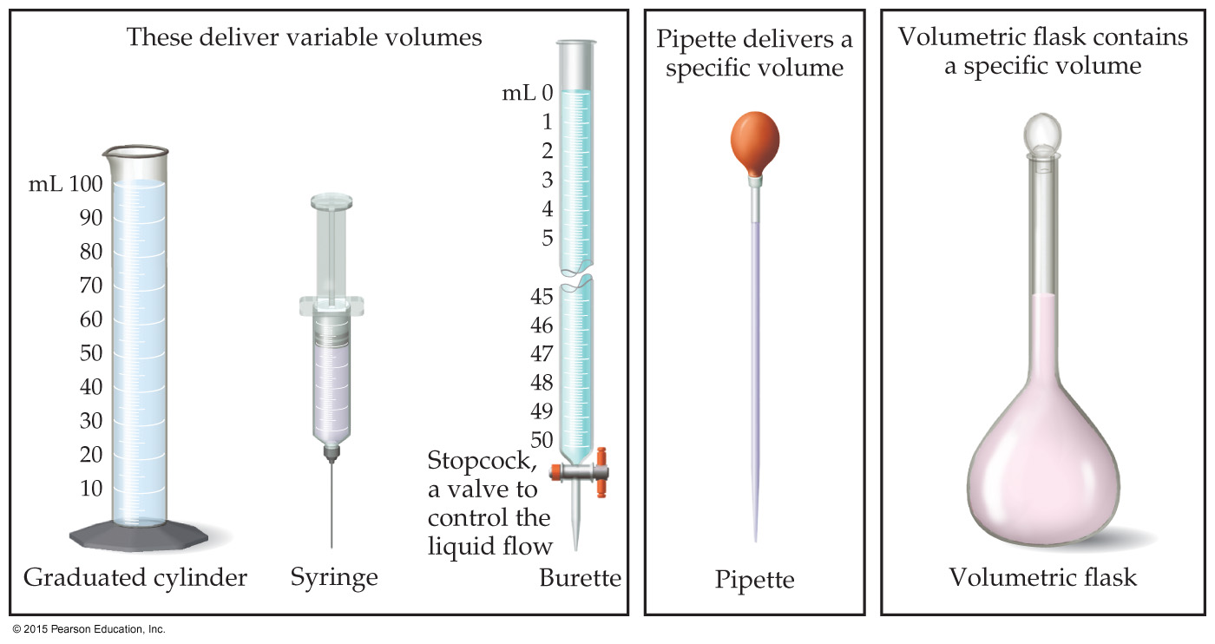
Uncertainty in Measurements
Different measuring devices have different uses and different degrees of accuracy.
All measured numbers have some degree of inaccuracy.

Slide 32
Accuracy versus Precision
Accuracy refers to the proximity of a measurement to the true value of a quantity.
Precision refers to the proximity of several measurements to each other.

Slide 33
Significant Figures
The term significant figures refers to digits that were measured.
When rounding calculated numbers, we pay attention to significant figures so we do not overstate the accuracy of our answers.

Slide 34
Significant Figures
All nonzero digits are significant.
Zeroes between two significant figures are themselves significant.
Zeroes at the beginning of a number are never significant.
Zeroes at the end of a number are significant if a decimal point is written in the number.

Slide 35
Significant Figures
When addition or subtraction is performed, answers are rounded to the least significant decimal place.
When multiplication or division is performed, answers are rounded to the number of digits that corresponds to the least number of significant figures in any of the numbers used in the calculation.

Slide 36
Dimensional Analysis
We use dimensional analysis to convert one quantity to another.
Most commonly, dimensional analysis utilizes conversion factors (e.g., 1 in. = 2.54 cm).
We can set up a ratio of comparison for the equality either 1 in/2.54 cm or 2.54 cm/1 in.
We use the ratio which allows us to change units (puts the units we have in the denominator to cancel).

